Slide 1

136th ANNUAL SAR NATIONAL CONGRESS
10–16 JULY 2026
MECKLENBURG CHAPTER

Slide 2
Buffalo Presbyterian Church Grave Marking & Bench Dedication
Friday, 10 July 2026

Slide 3
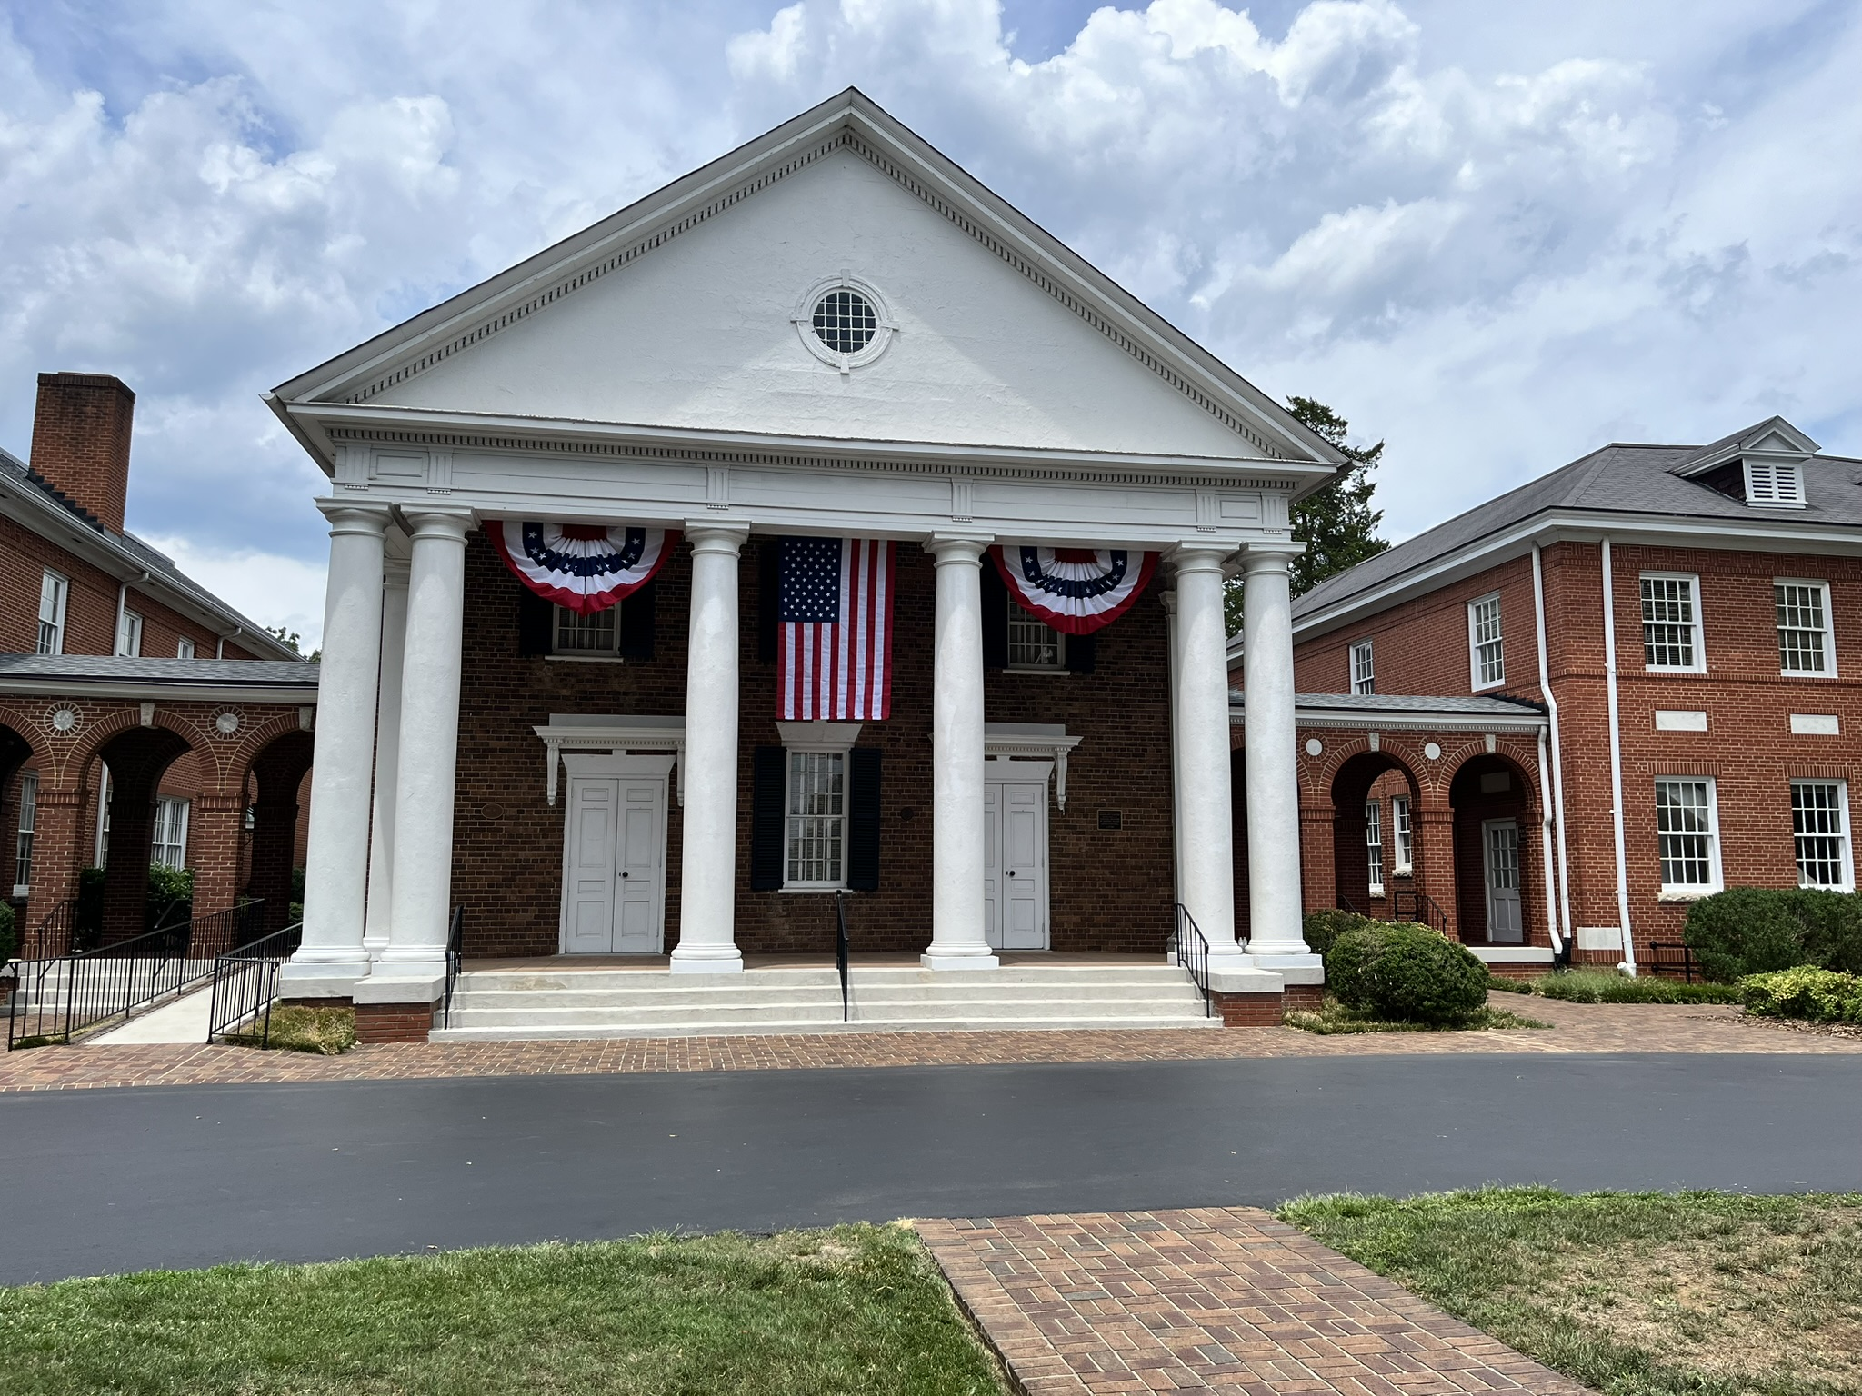
Buffalo Presbyterian Church

Slide 4
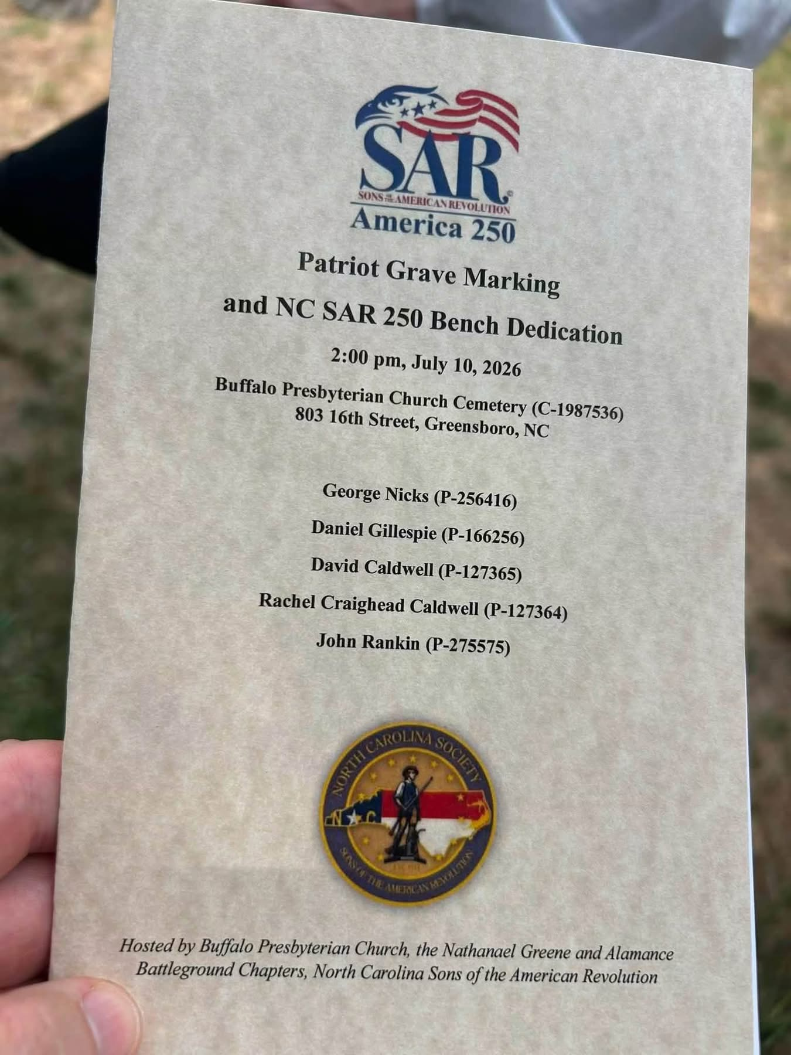
Buffalo Presbyterian Church Grave Marking & Bench Dedication
Program

Slide 5
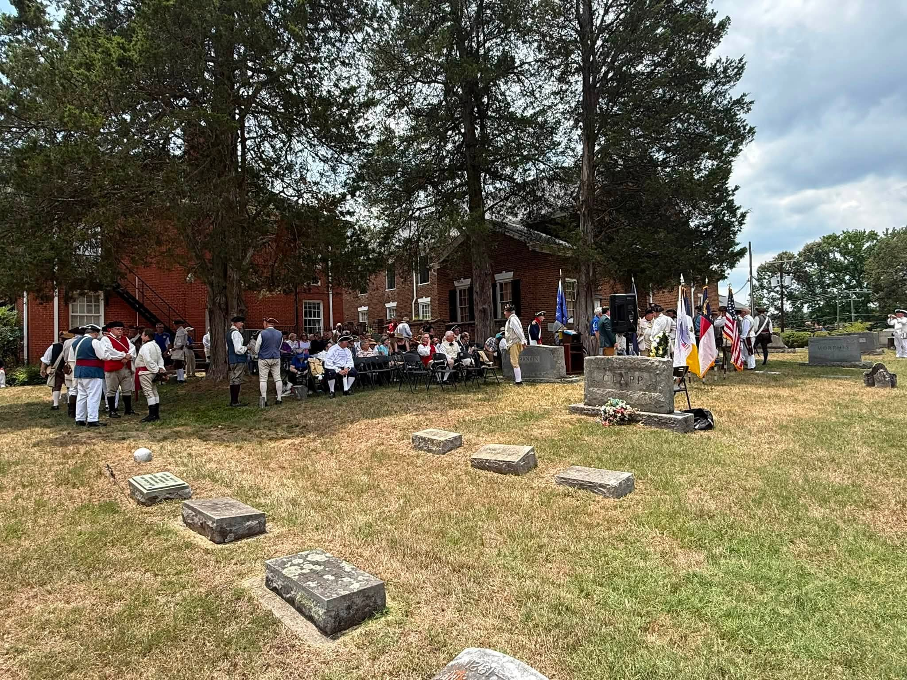
Buffalo Presbyterian Church Cemetery

Slide 6
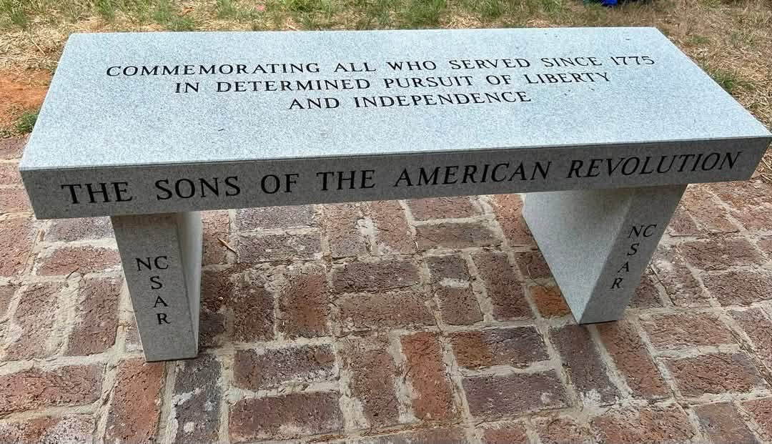
Memorial Bench

Slide 7
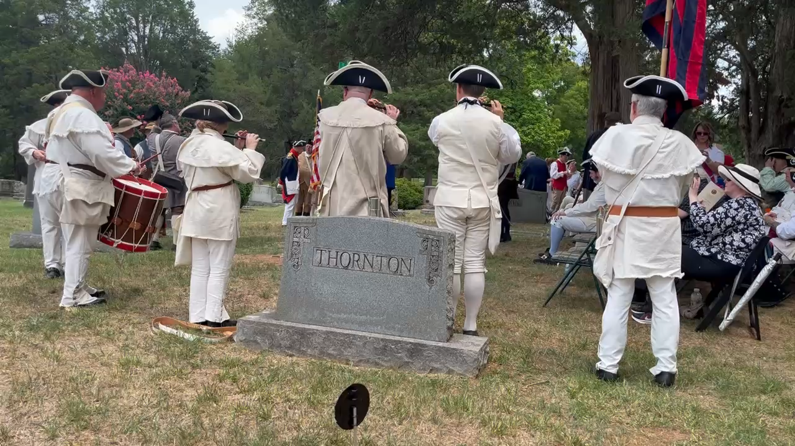
Buffalo Presbyterian Church Grave Marking & Bench Dedication
Fife & Drum Corp

Slide 8
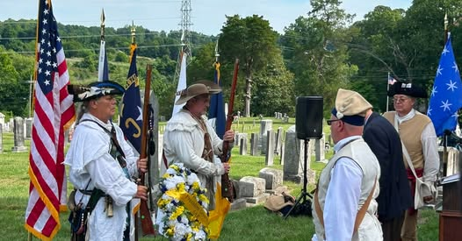
Buffalo Presbyterian Church Grave Marking & Bench Dedication
Honor Guard

Slide 9
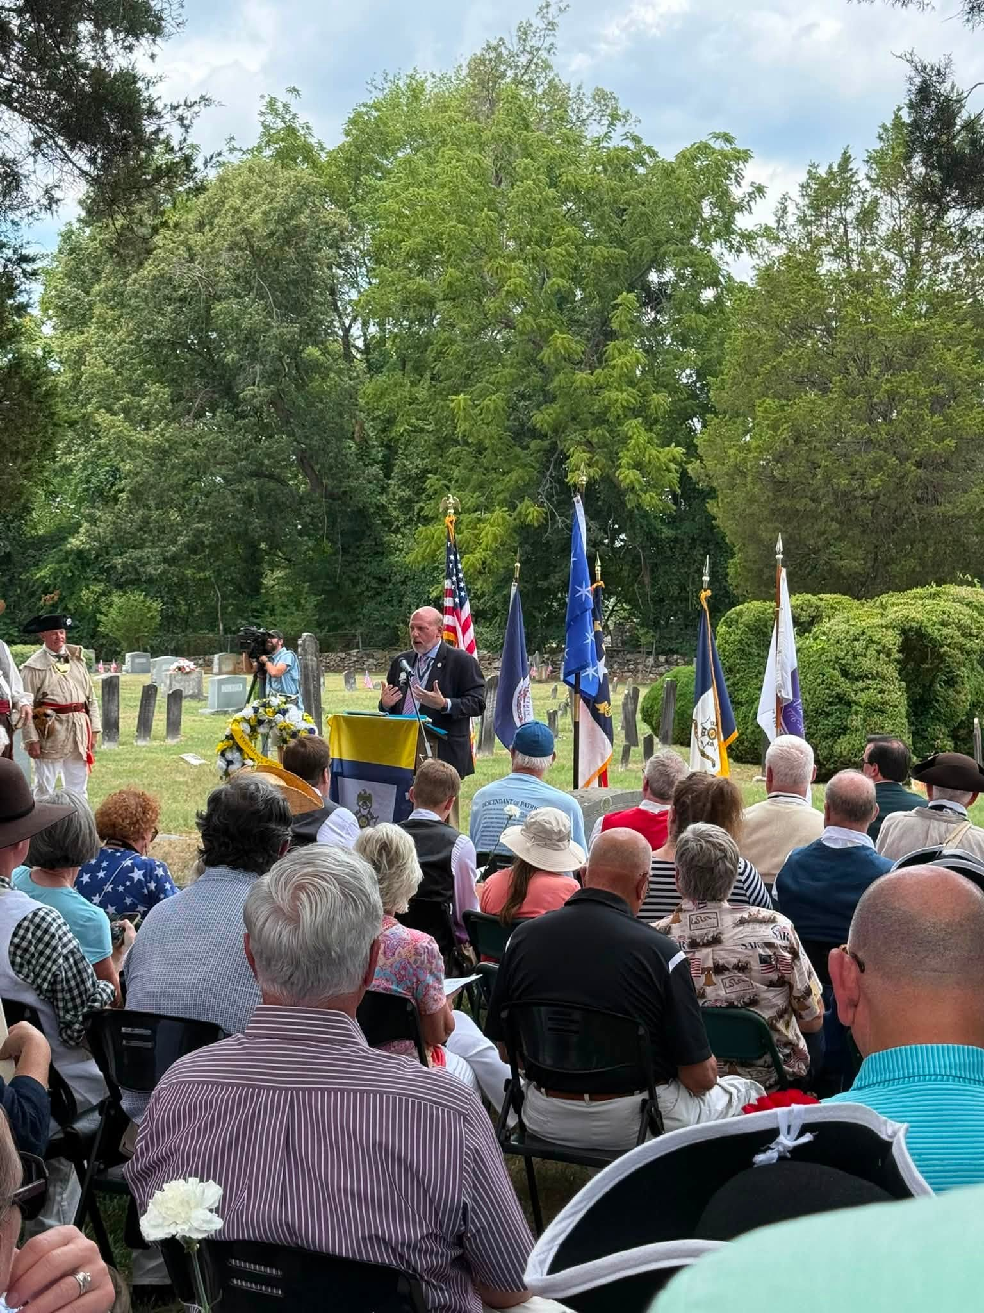
PG Michael Elson speaking

Slide 10
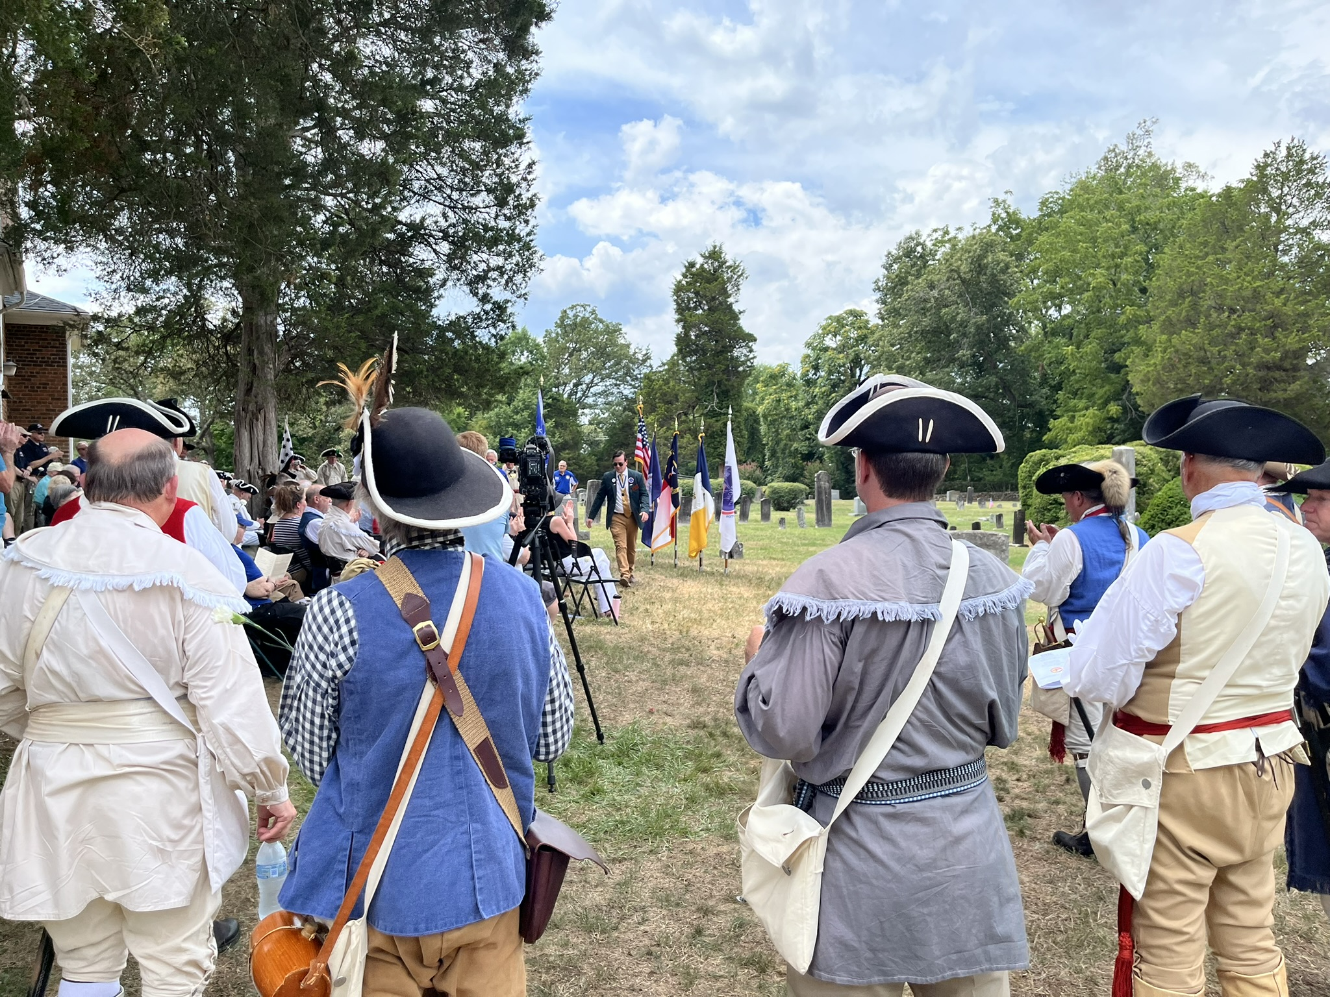
Buffalo Presbyterian Church Grave Marking & Bench Dedication

Slide 11
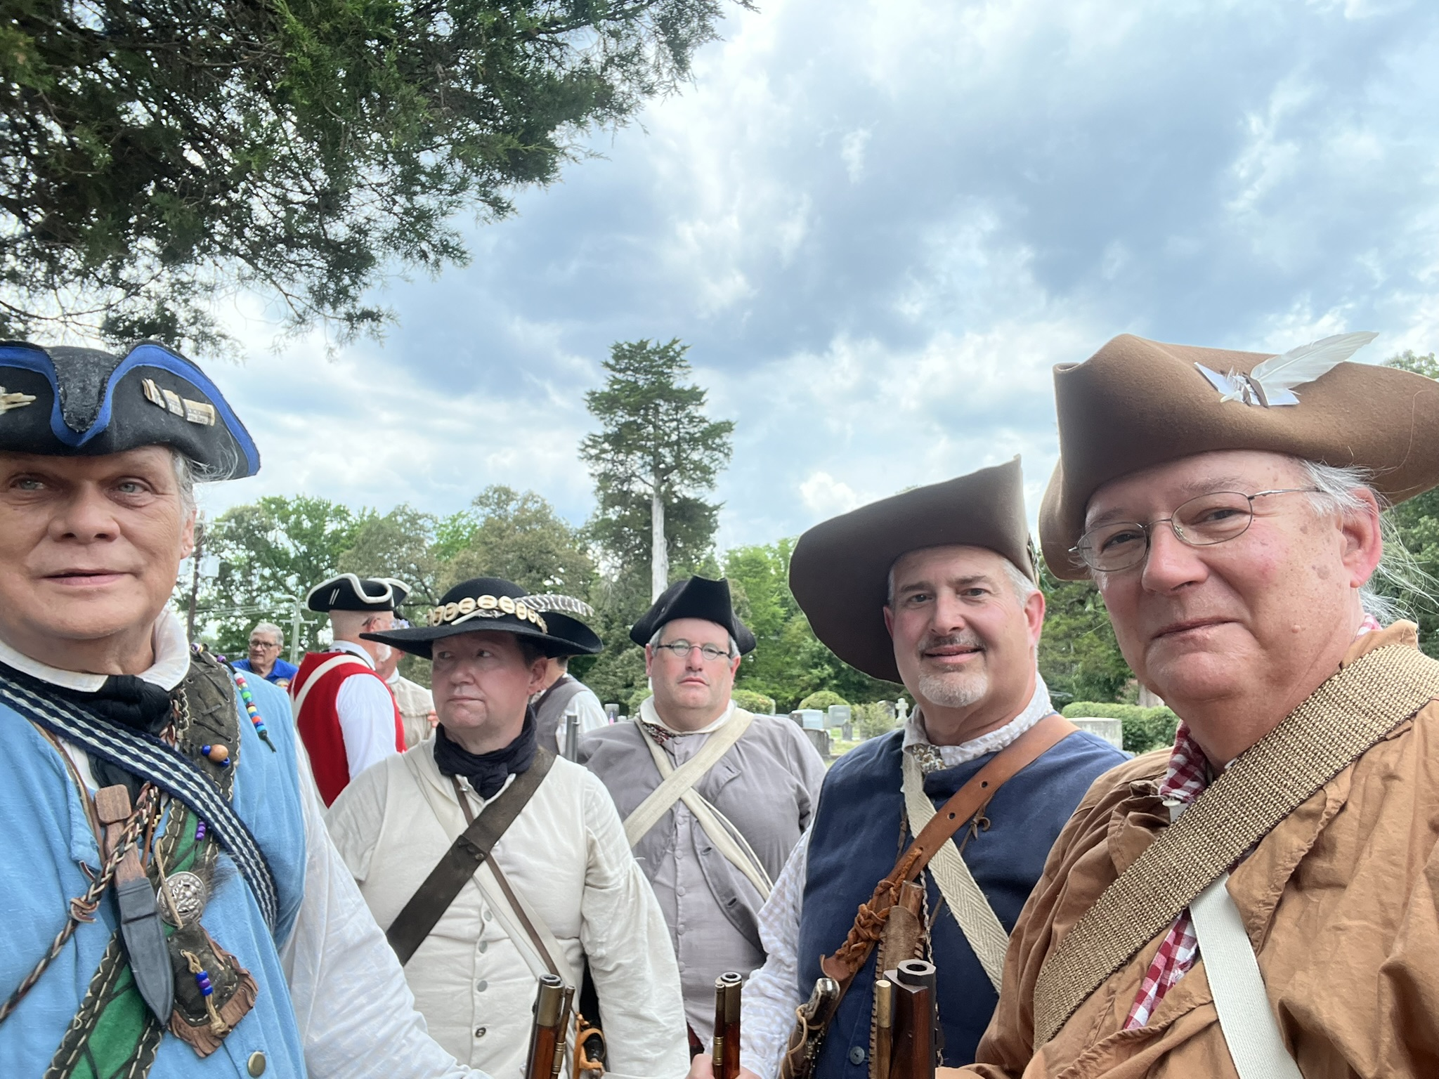
Buffalo Presbyterian Church Grave Marking & Bench Dedication
NC portion of the Honor Guard

Slide 12
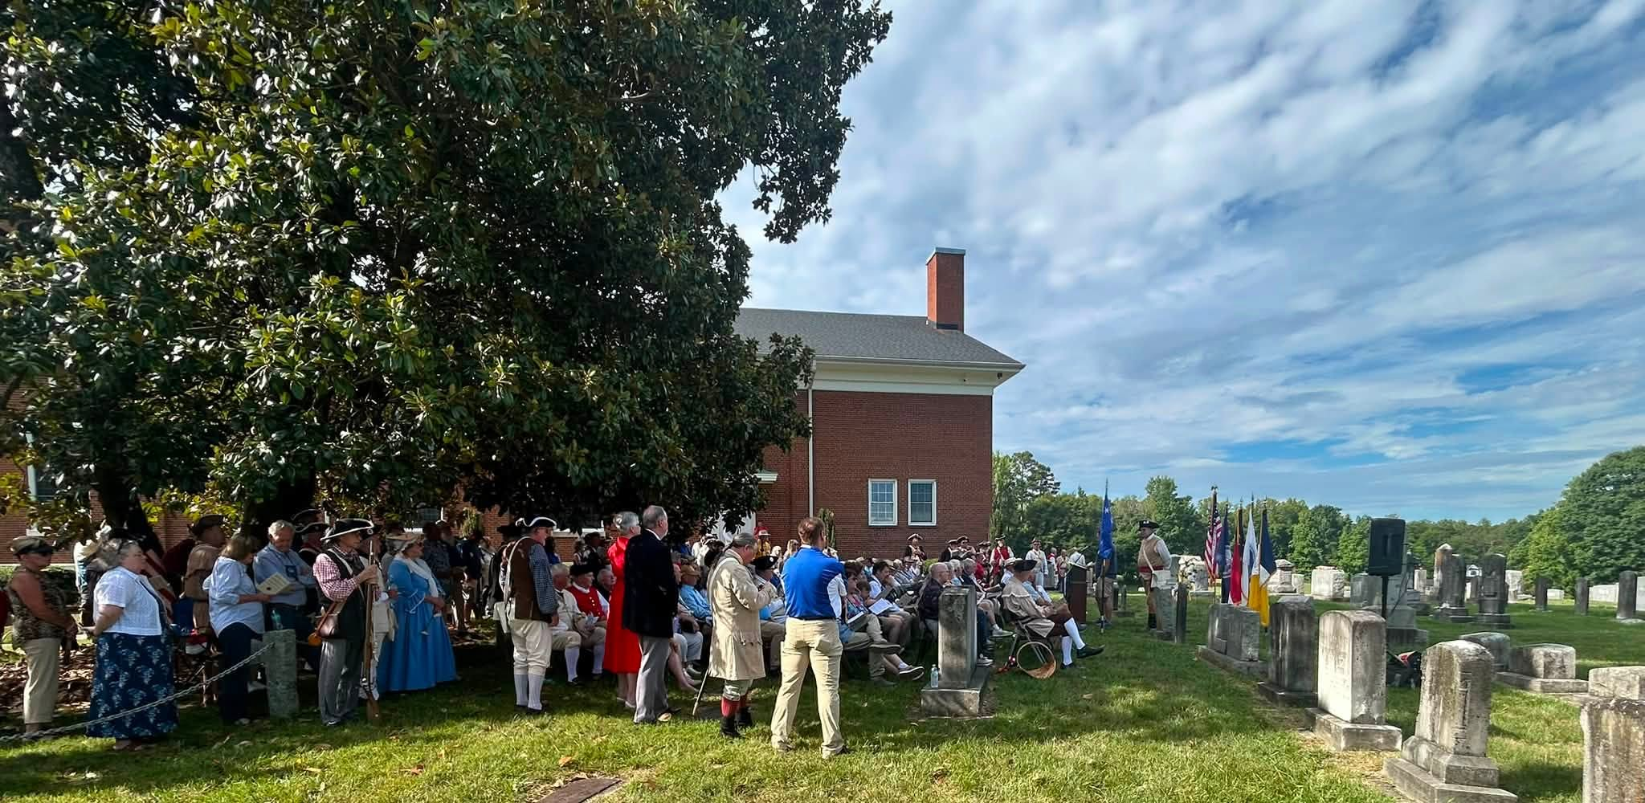
Buffalo Presbyterian Church Grave Marking & Bench Dedication

Slide 13
Host Reception
Saturday, 11 July 2026

Slide 14
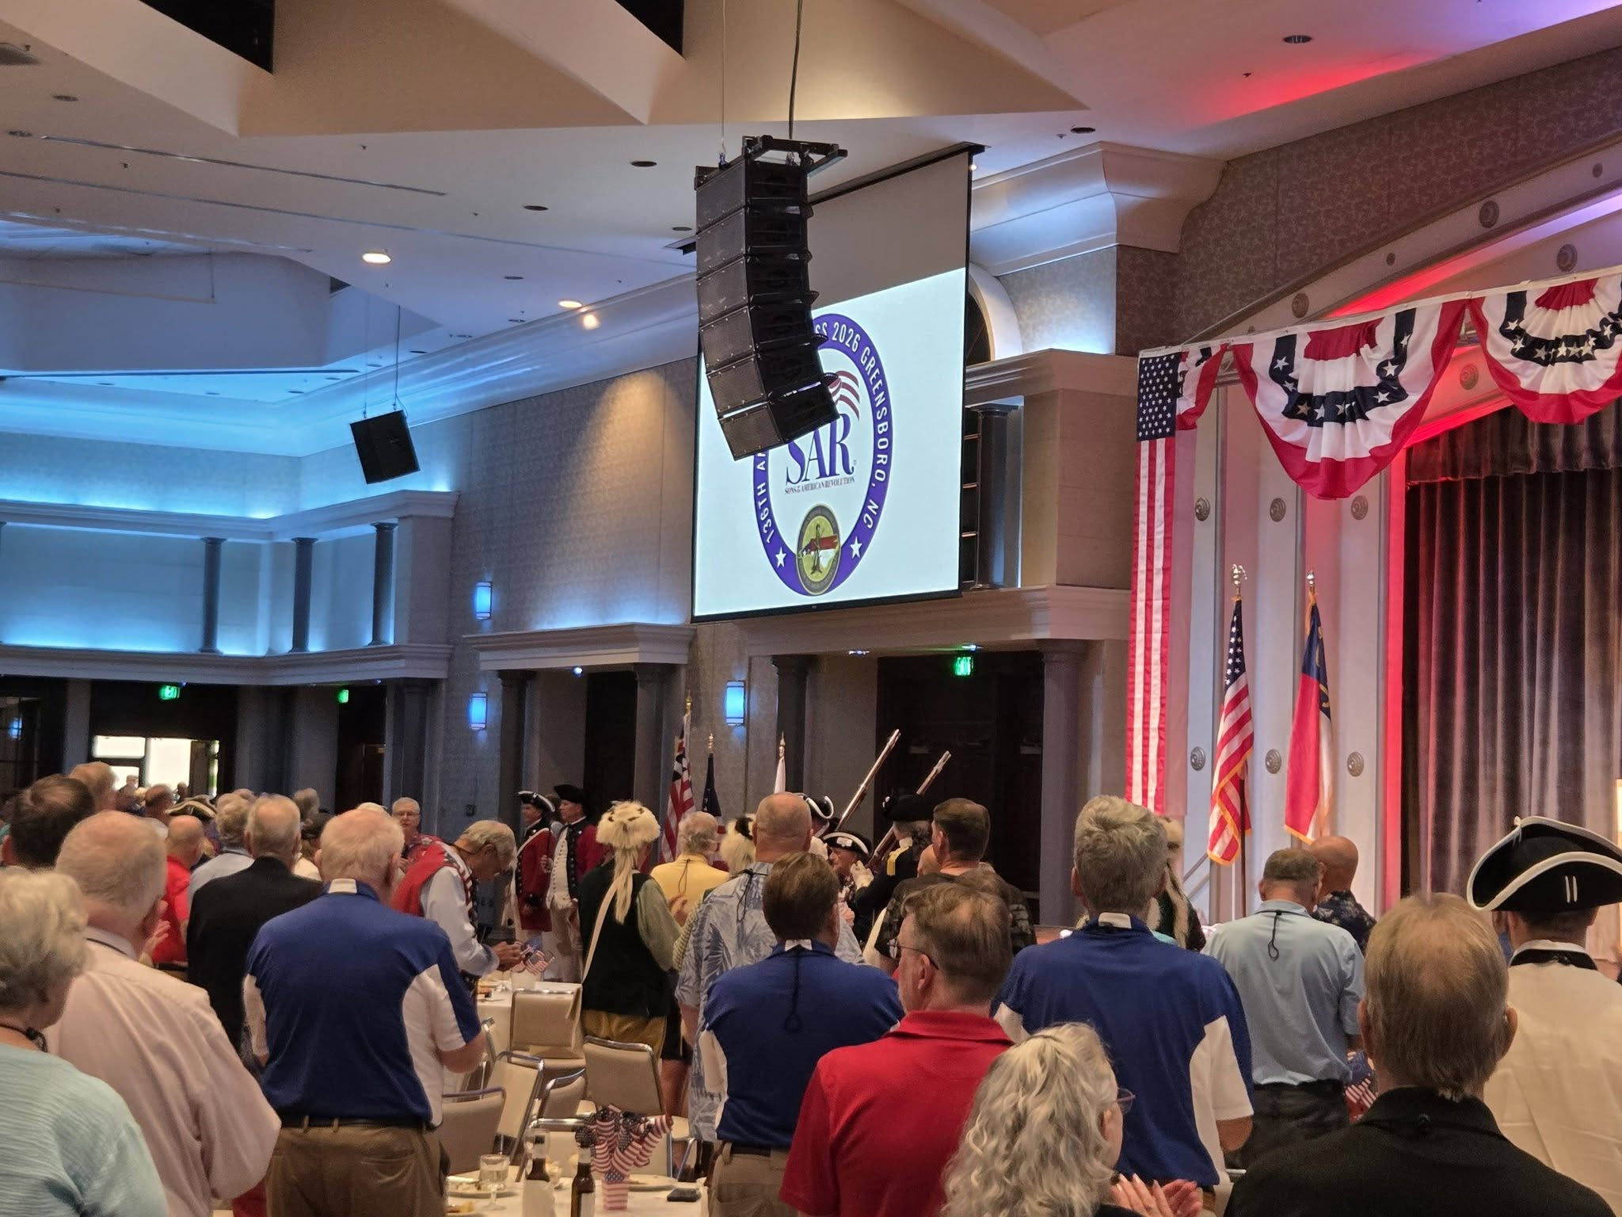
Host Reception
Opening Ceremony

Slide 15
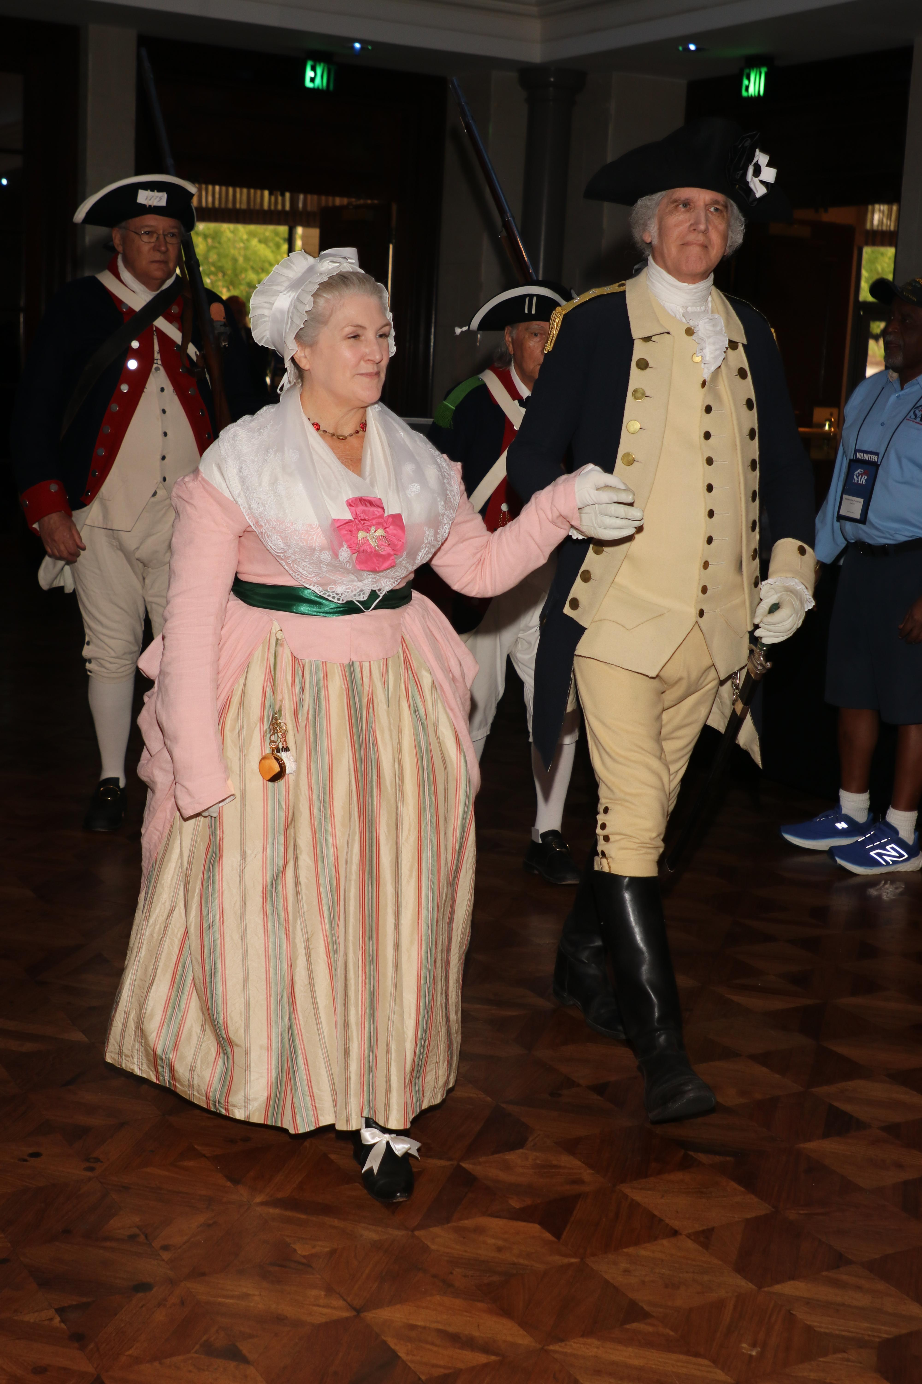
Host Reception
His Excellency & Mrs. Washington

Slide 16
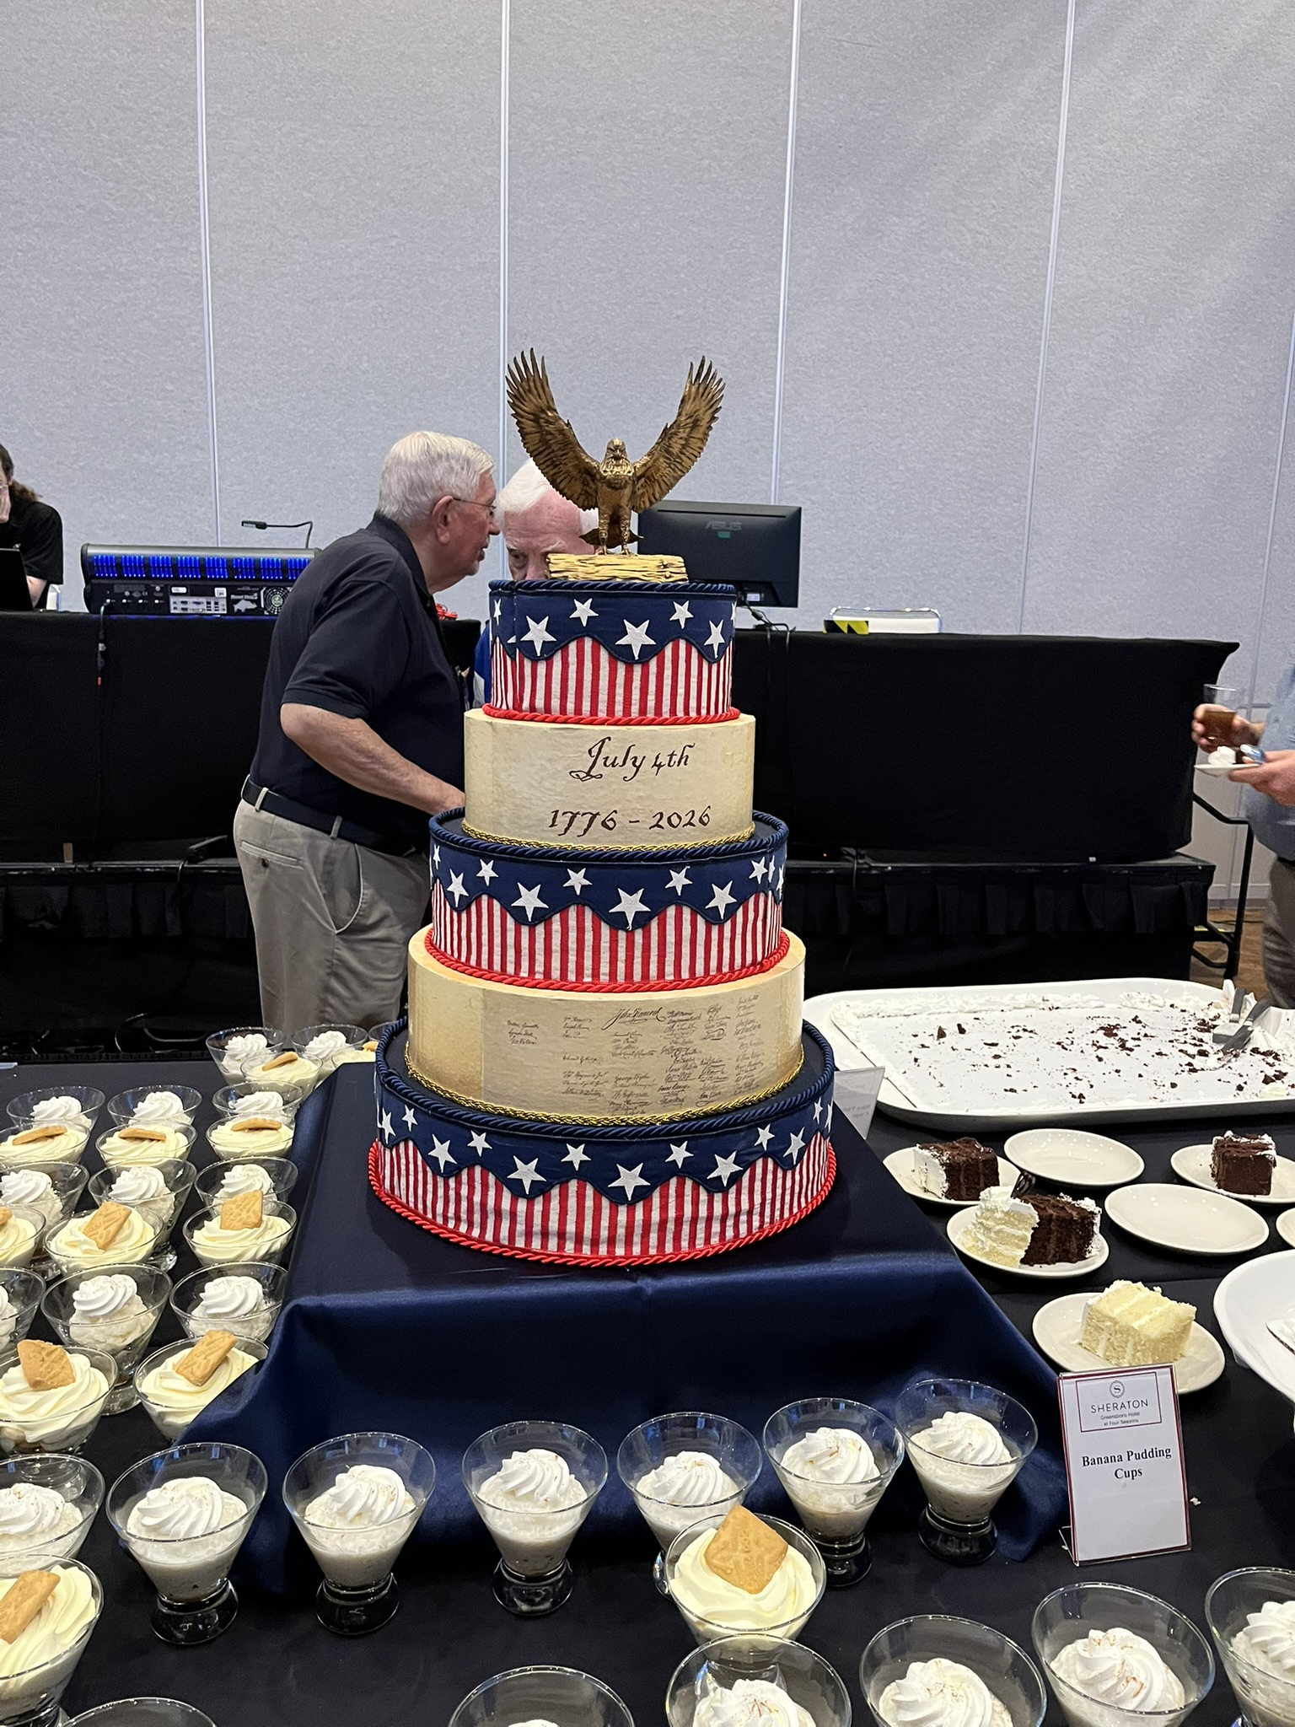
Host Reception
July 4th Cake

Slide 17
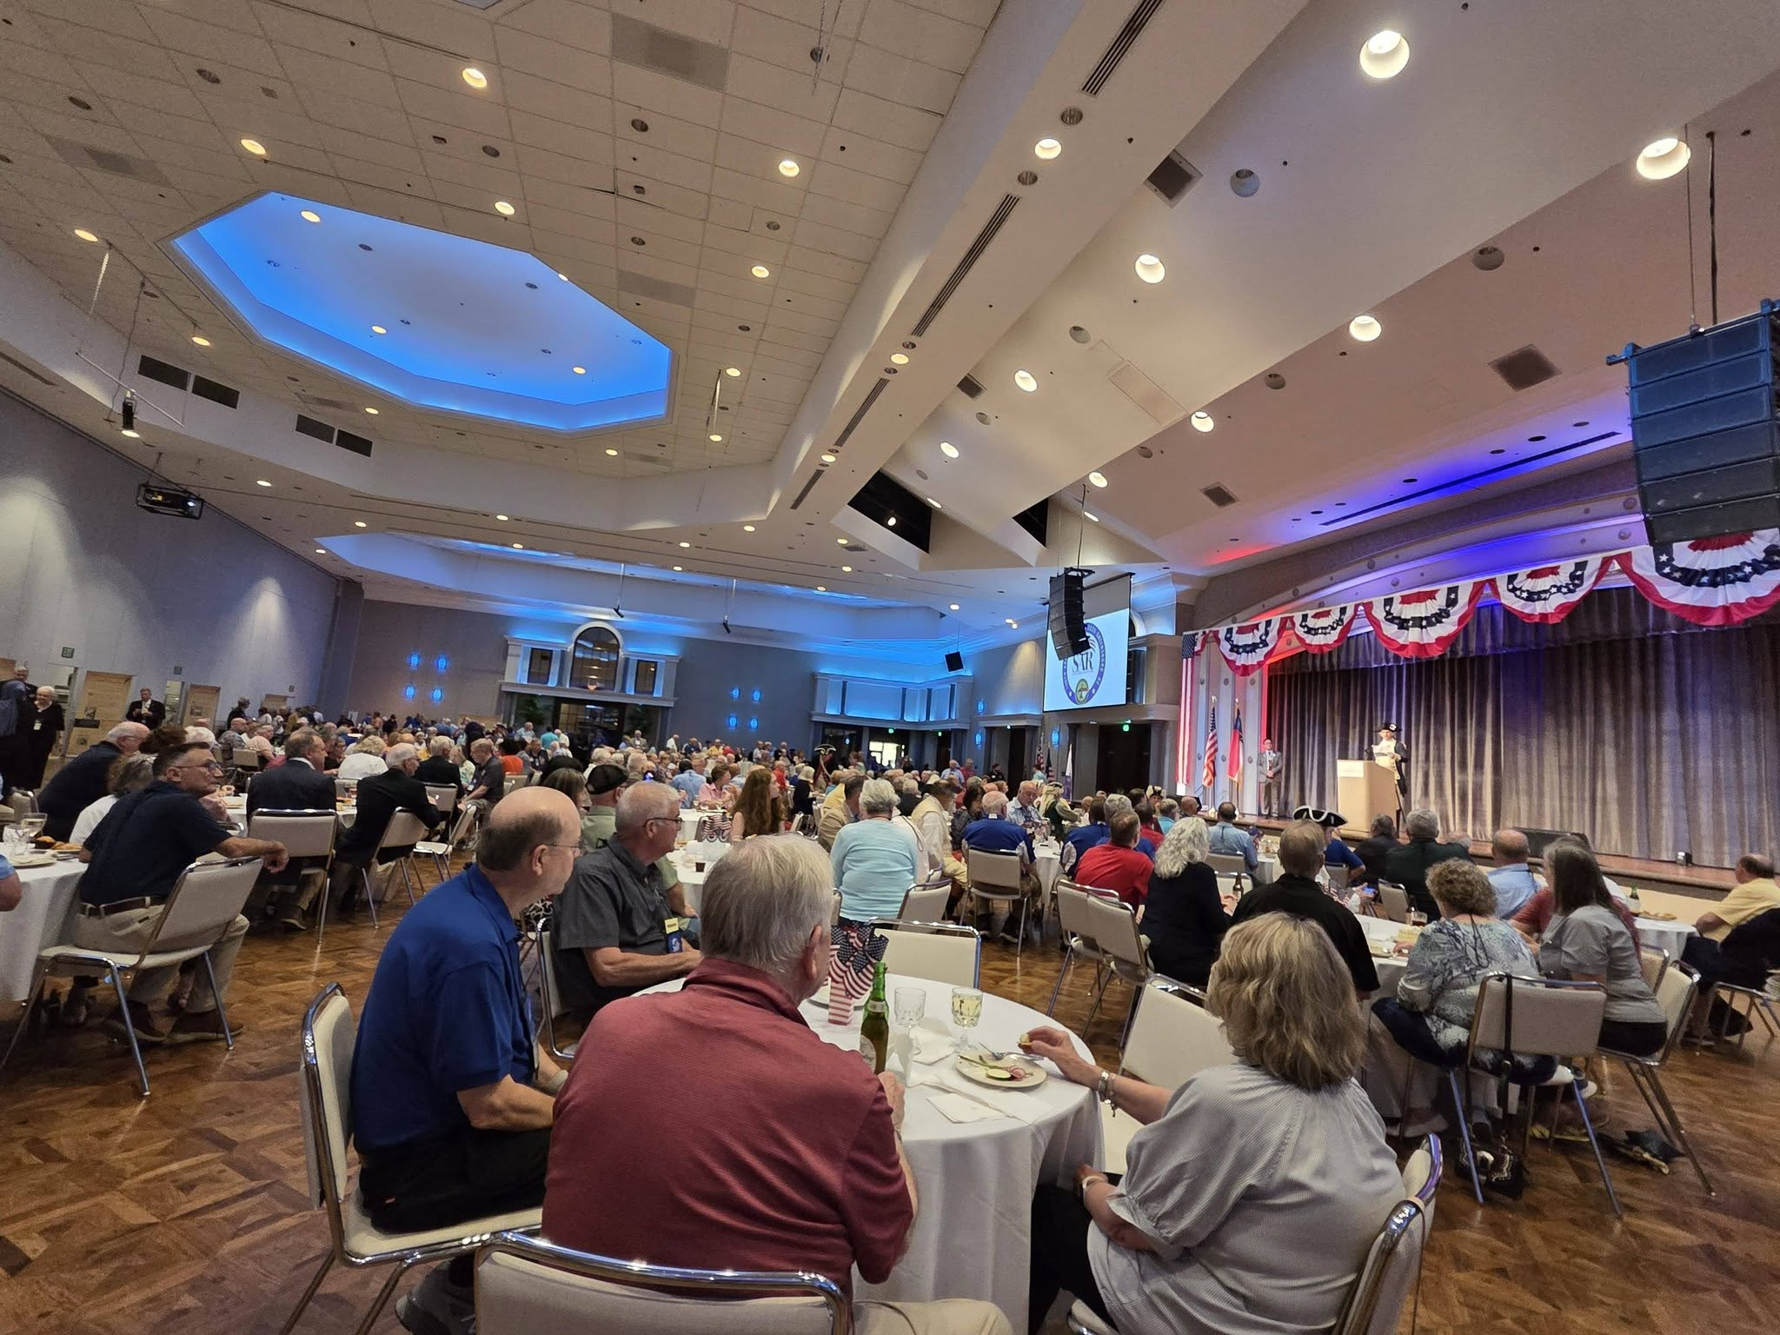
Host Reception
View of ballroom

Slide 18
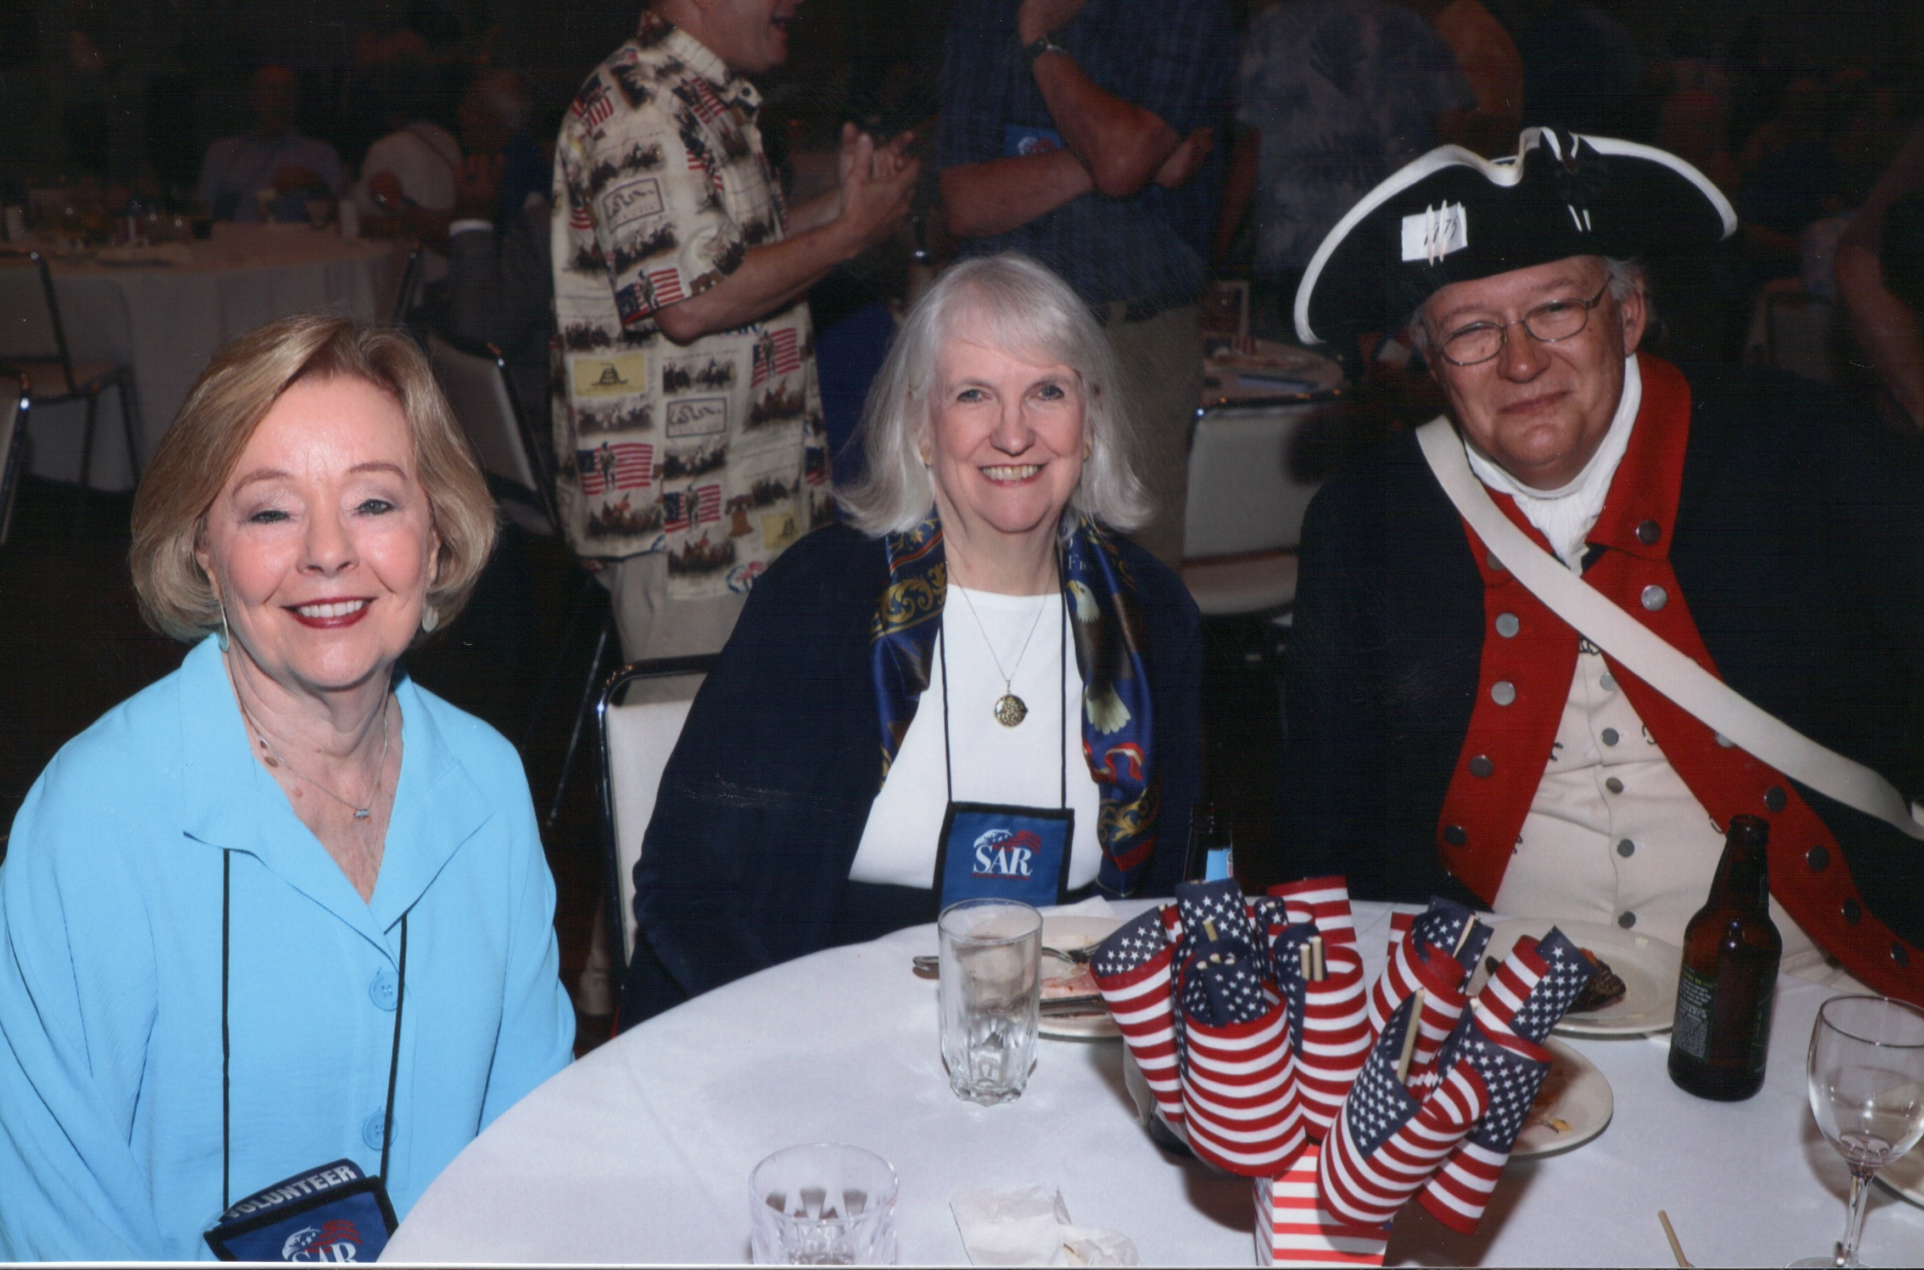
Host Reception
Beth Zeiss, Sherrie & Greg Catledge

Slide 19
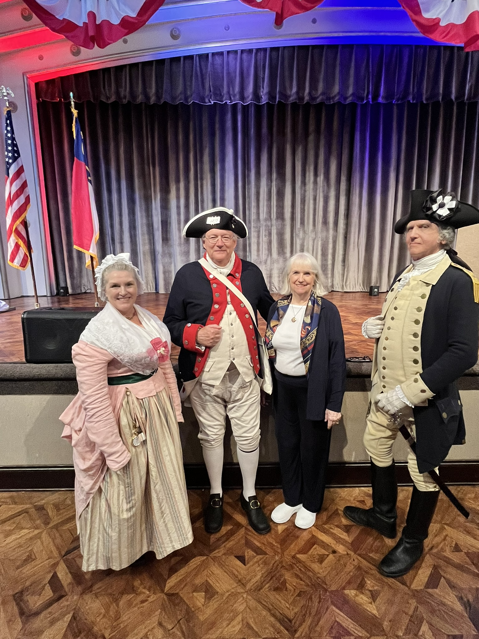
Host Reception
The Washingtons & the Catledges

Slide 20
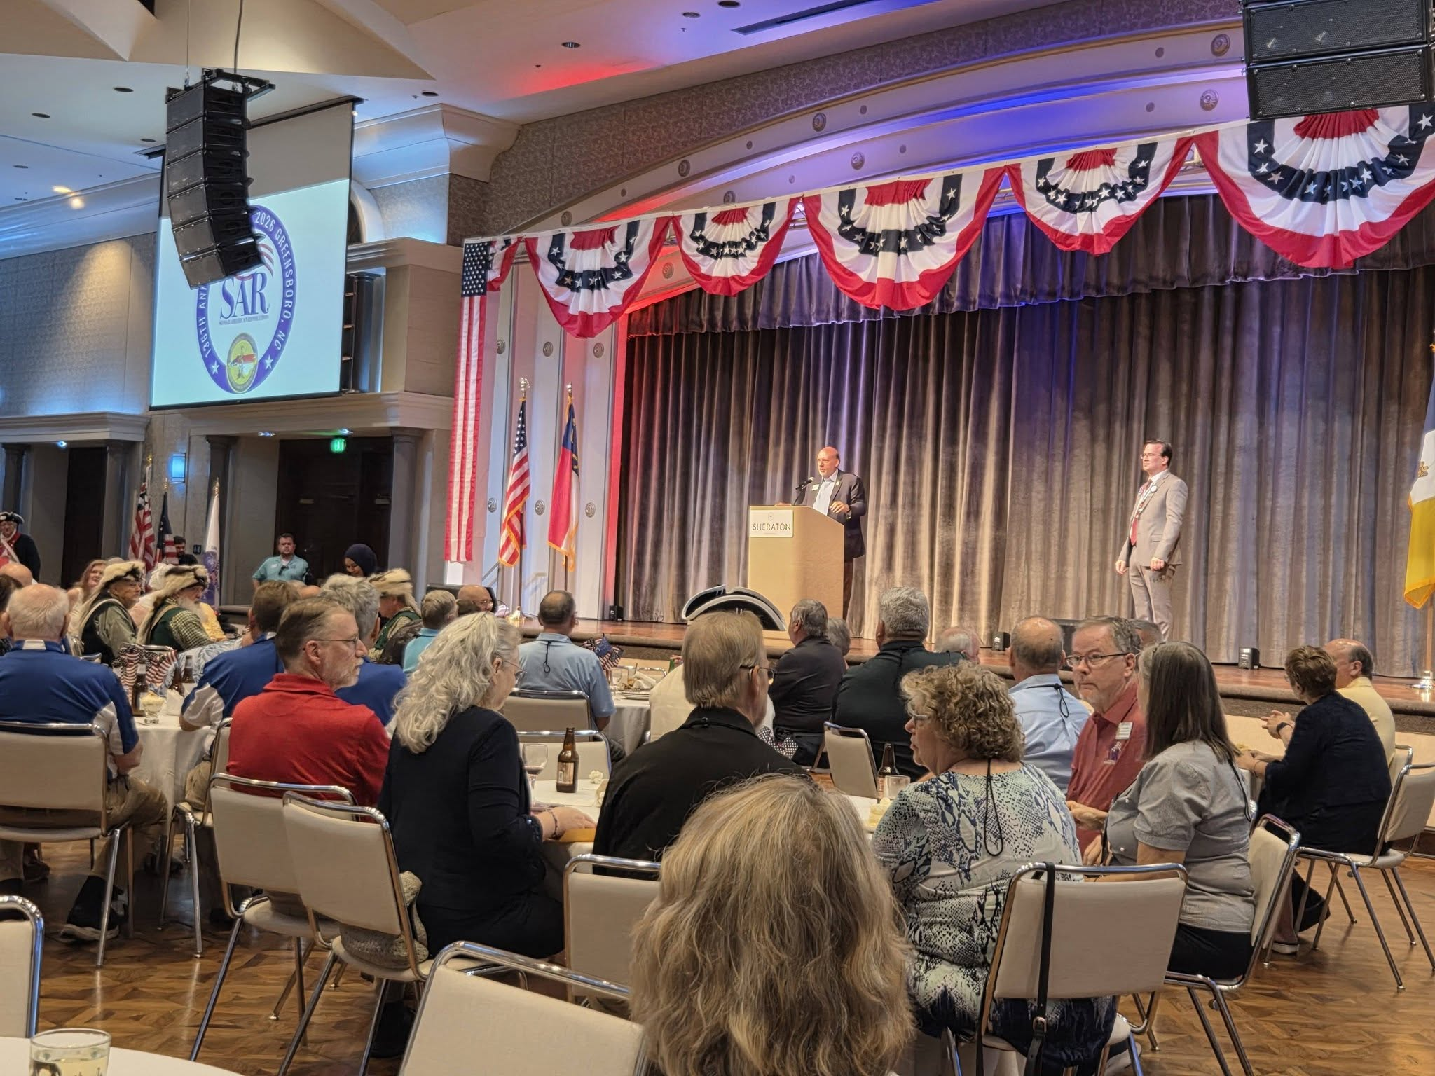
Host Reception
PG Elston bringing greetings.

Slide 21
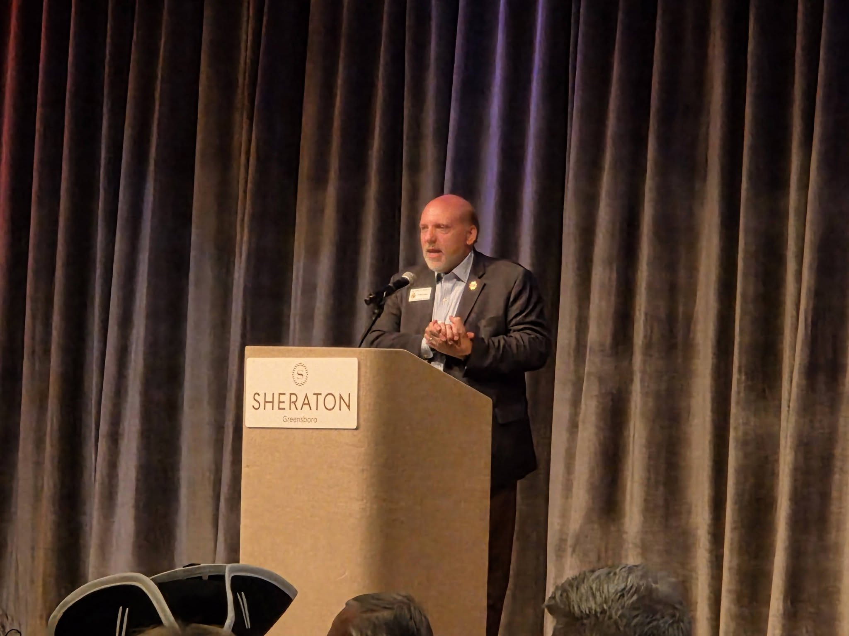
Host Reception
PG Elston bringing greetings.

Slide 22
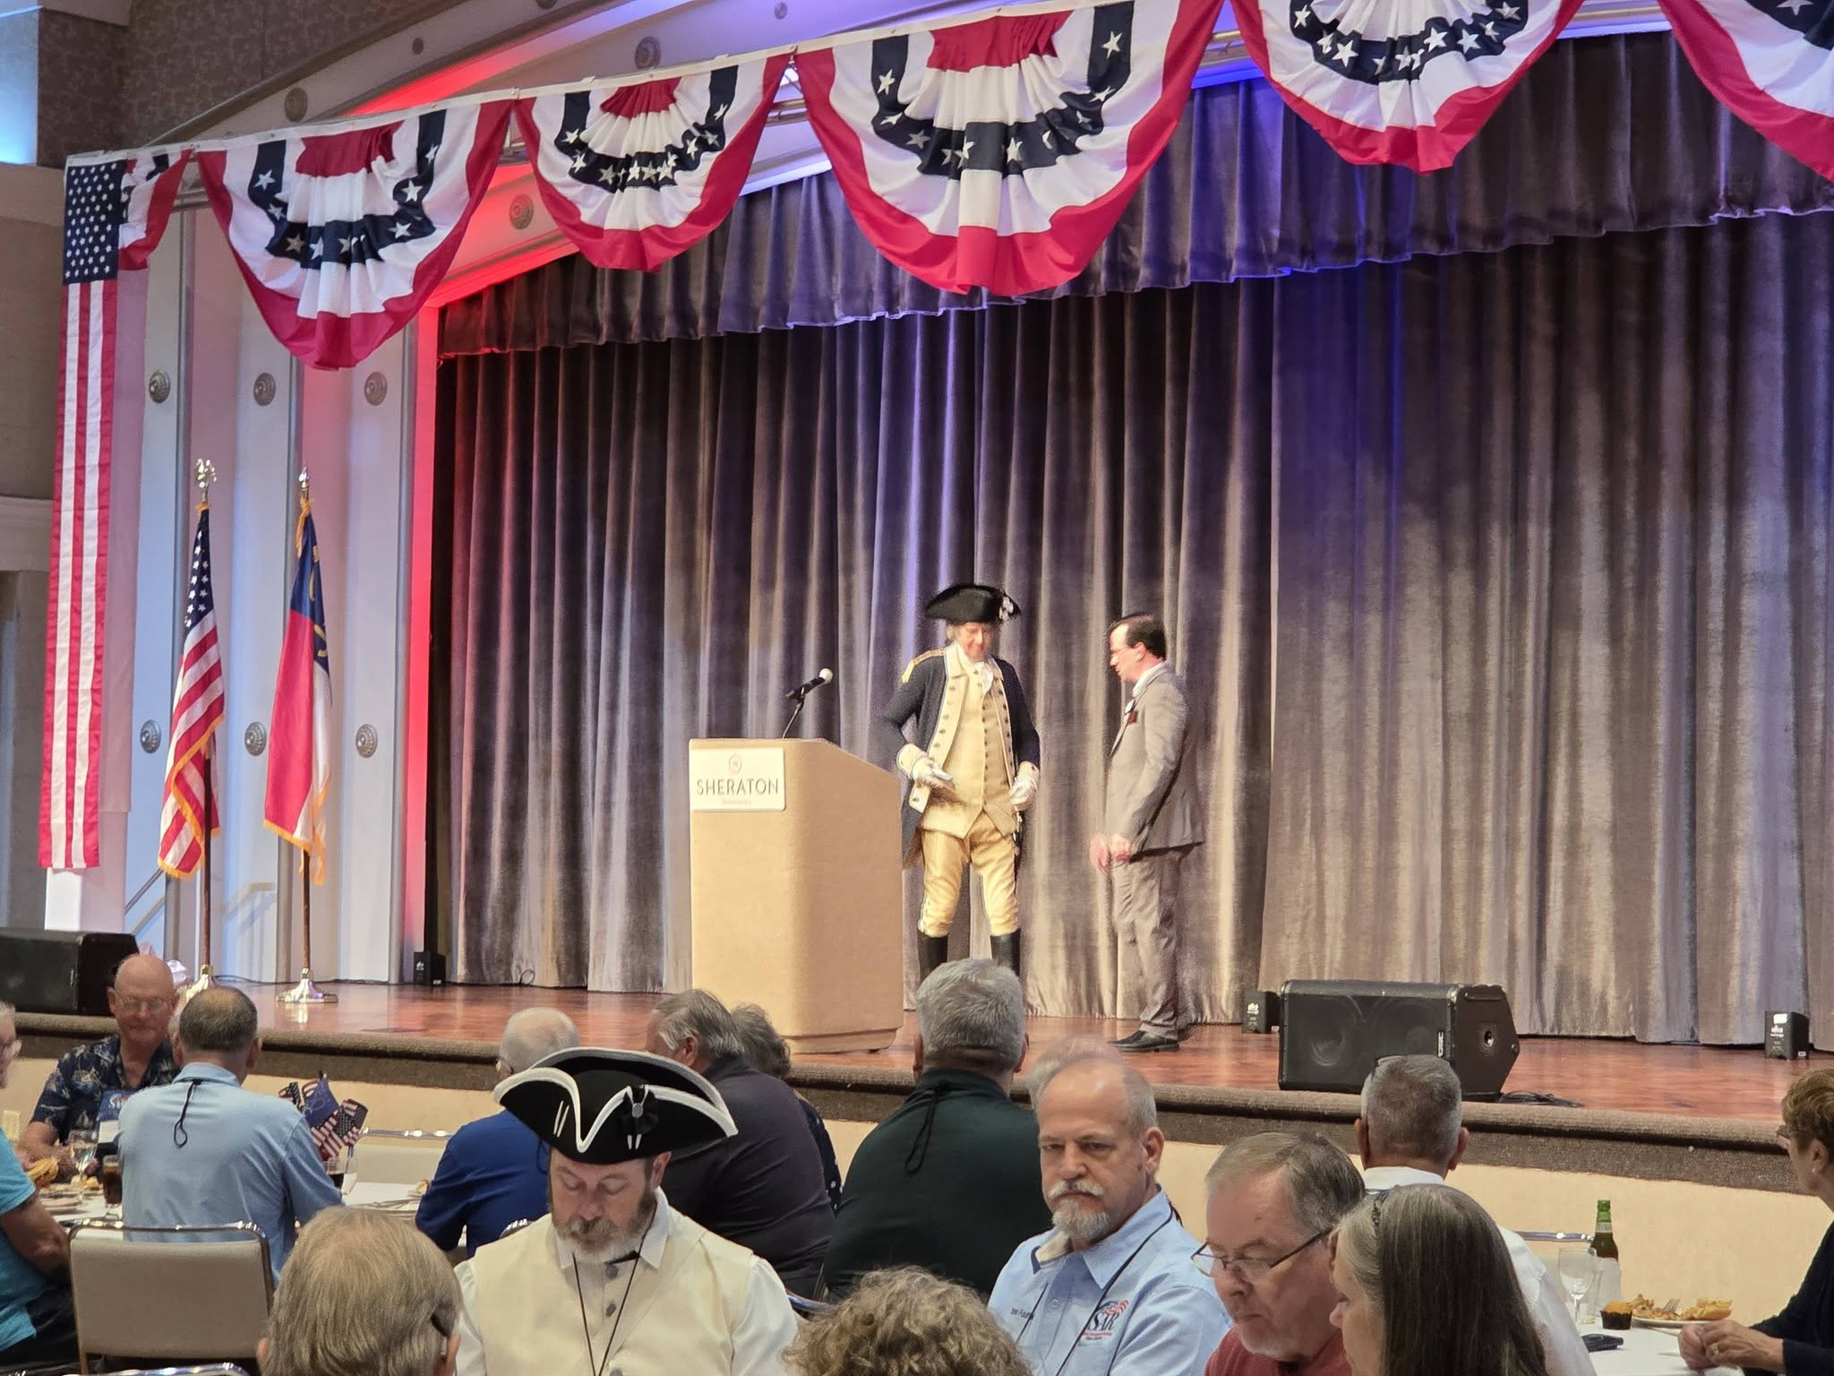
Host Reception
NC State President McKee introducing His Excellency

Slide 23
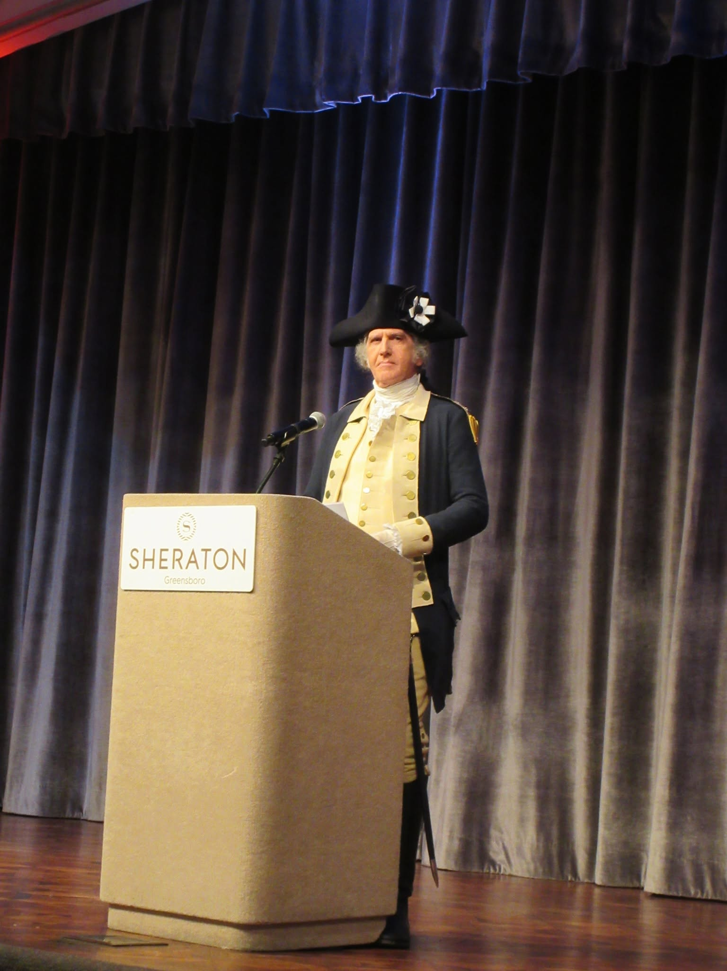
Host Reception
His Excellency President George Washington

Slide 24
Color Guard Breakfast
Sunday, 12 July 2026

Slide 25
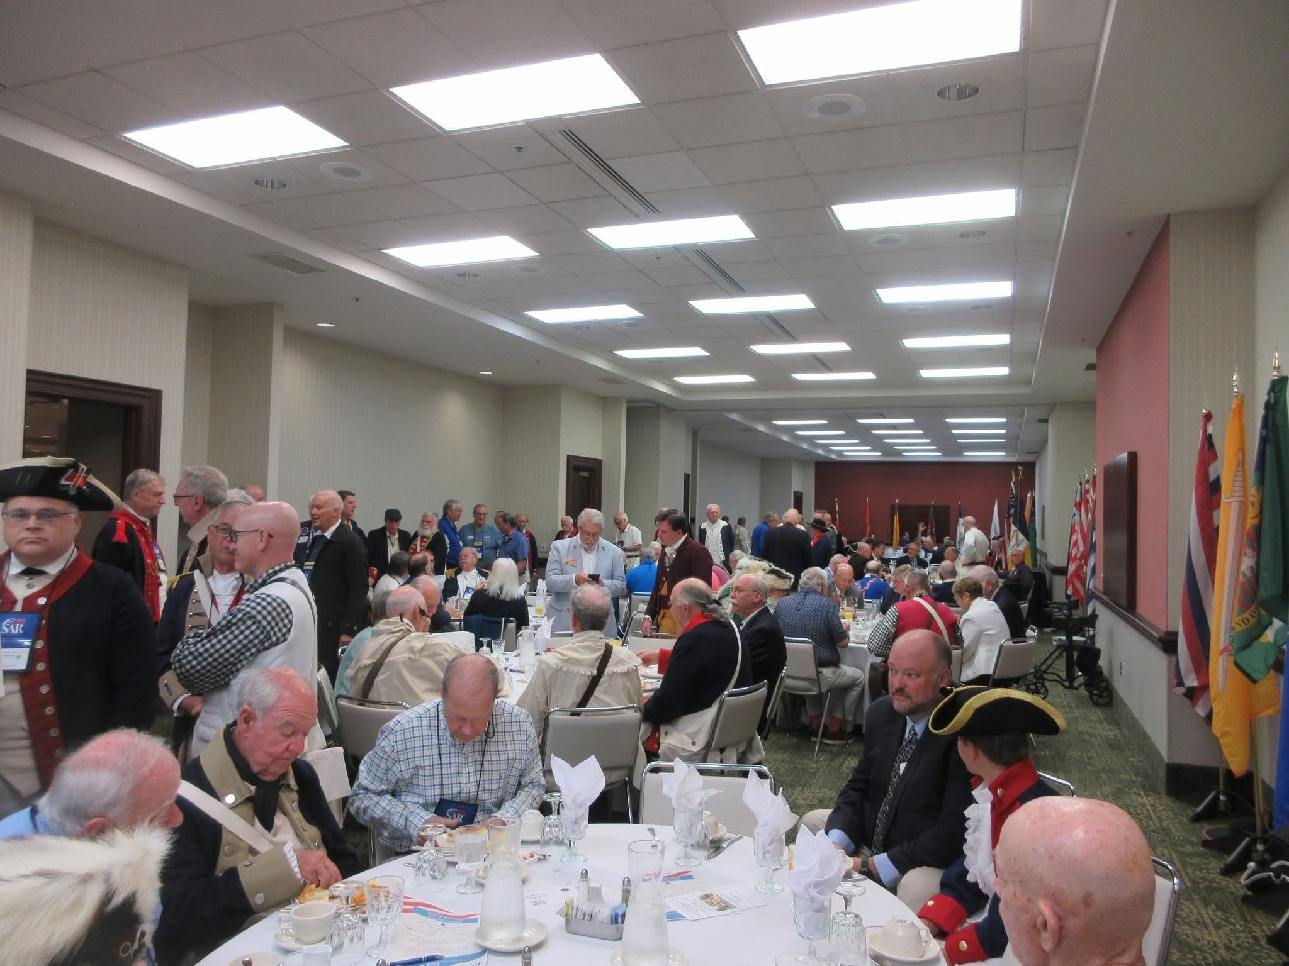
Color Guard Breakfast

Slide 26
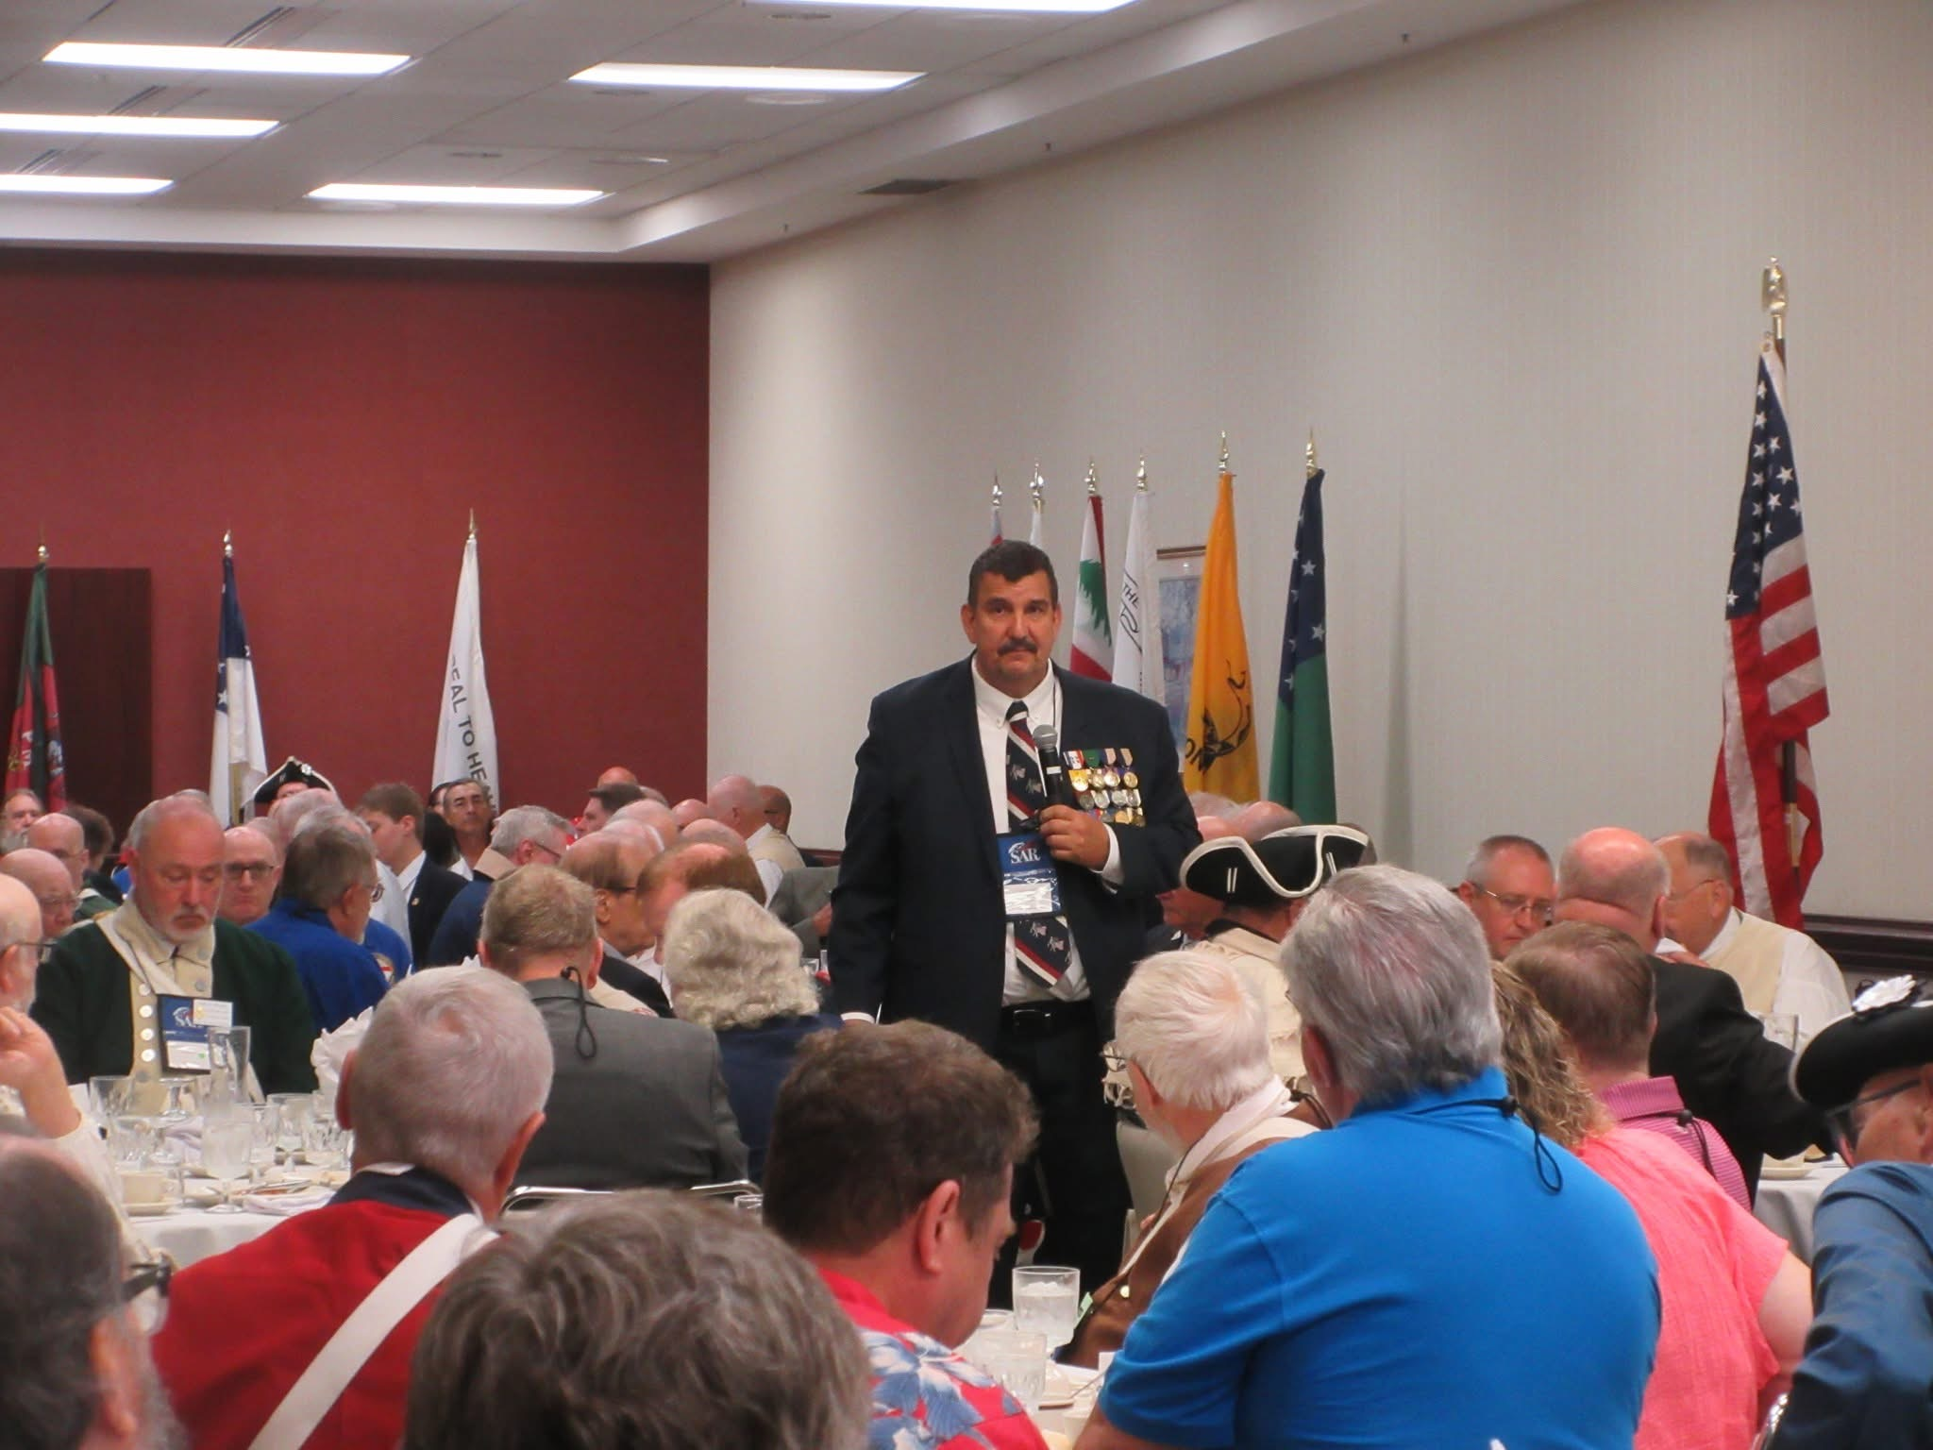
Color Guard Breakfast

Slide 27
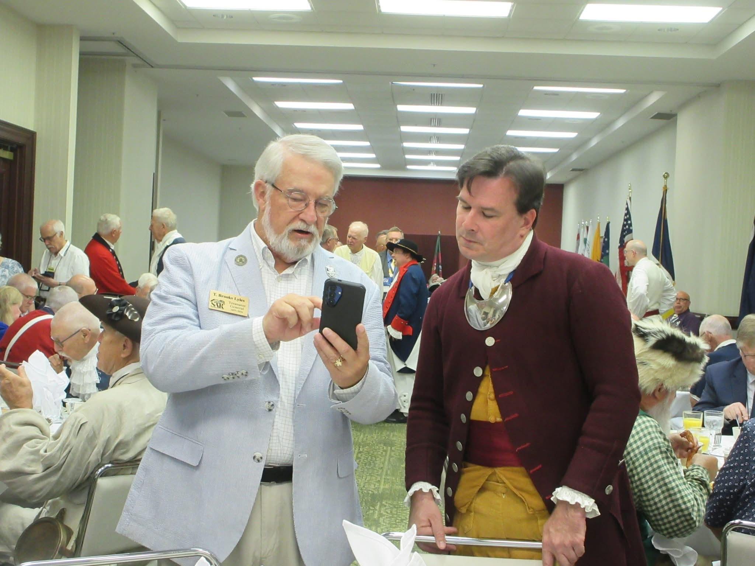
Color Guard Breakfast
The NC State President and Treasurer General Brooks Lyles discussing issues of the day

Slide 28
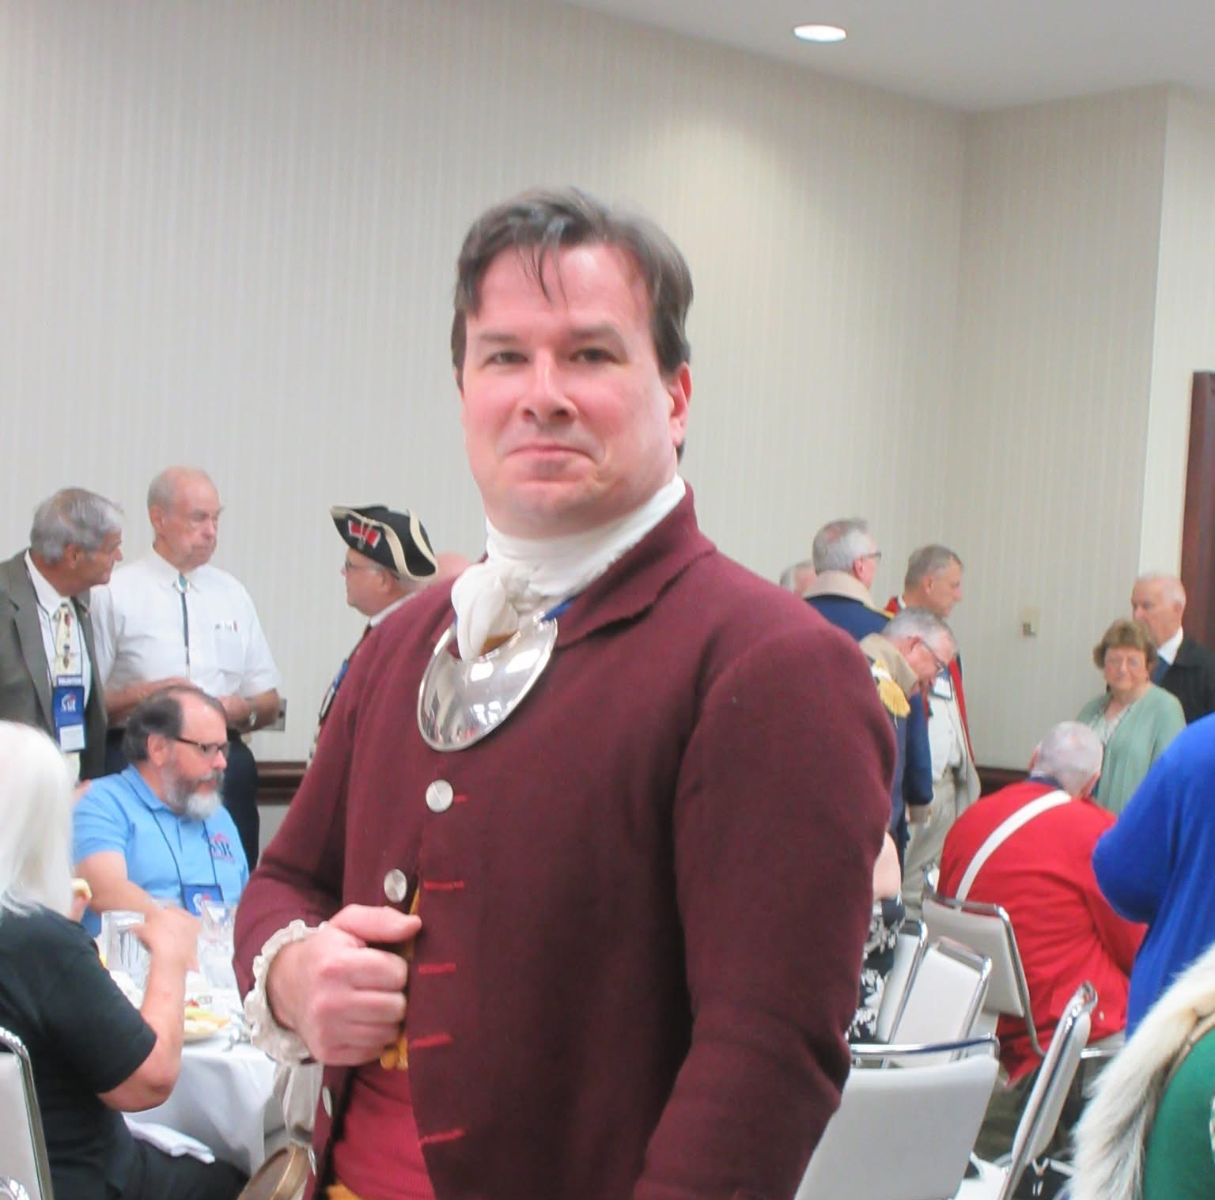
Color Guard Breakfast
North Carolina State President Stephen McKee

Slide 29
The President General’s Color Guard Inspection
The President General and General George Washington inspect the Color Guard
Sunday, 12 July 2026

Slide 30
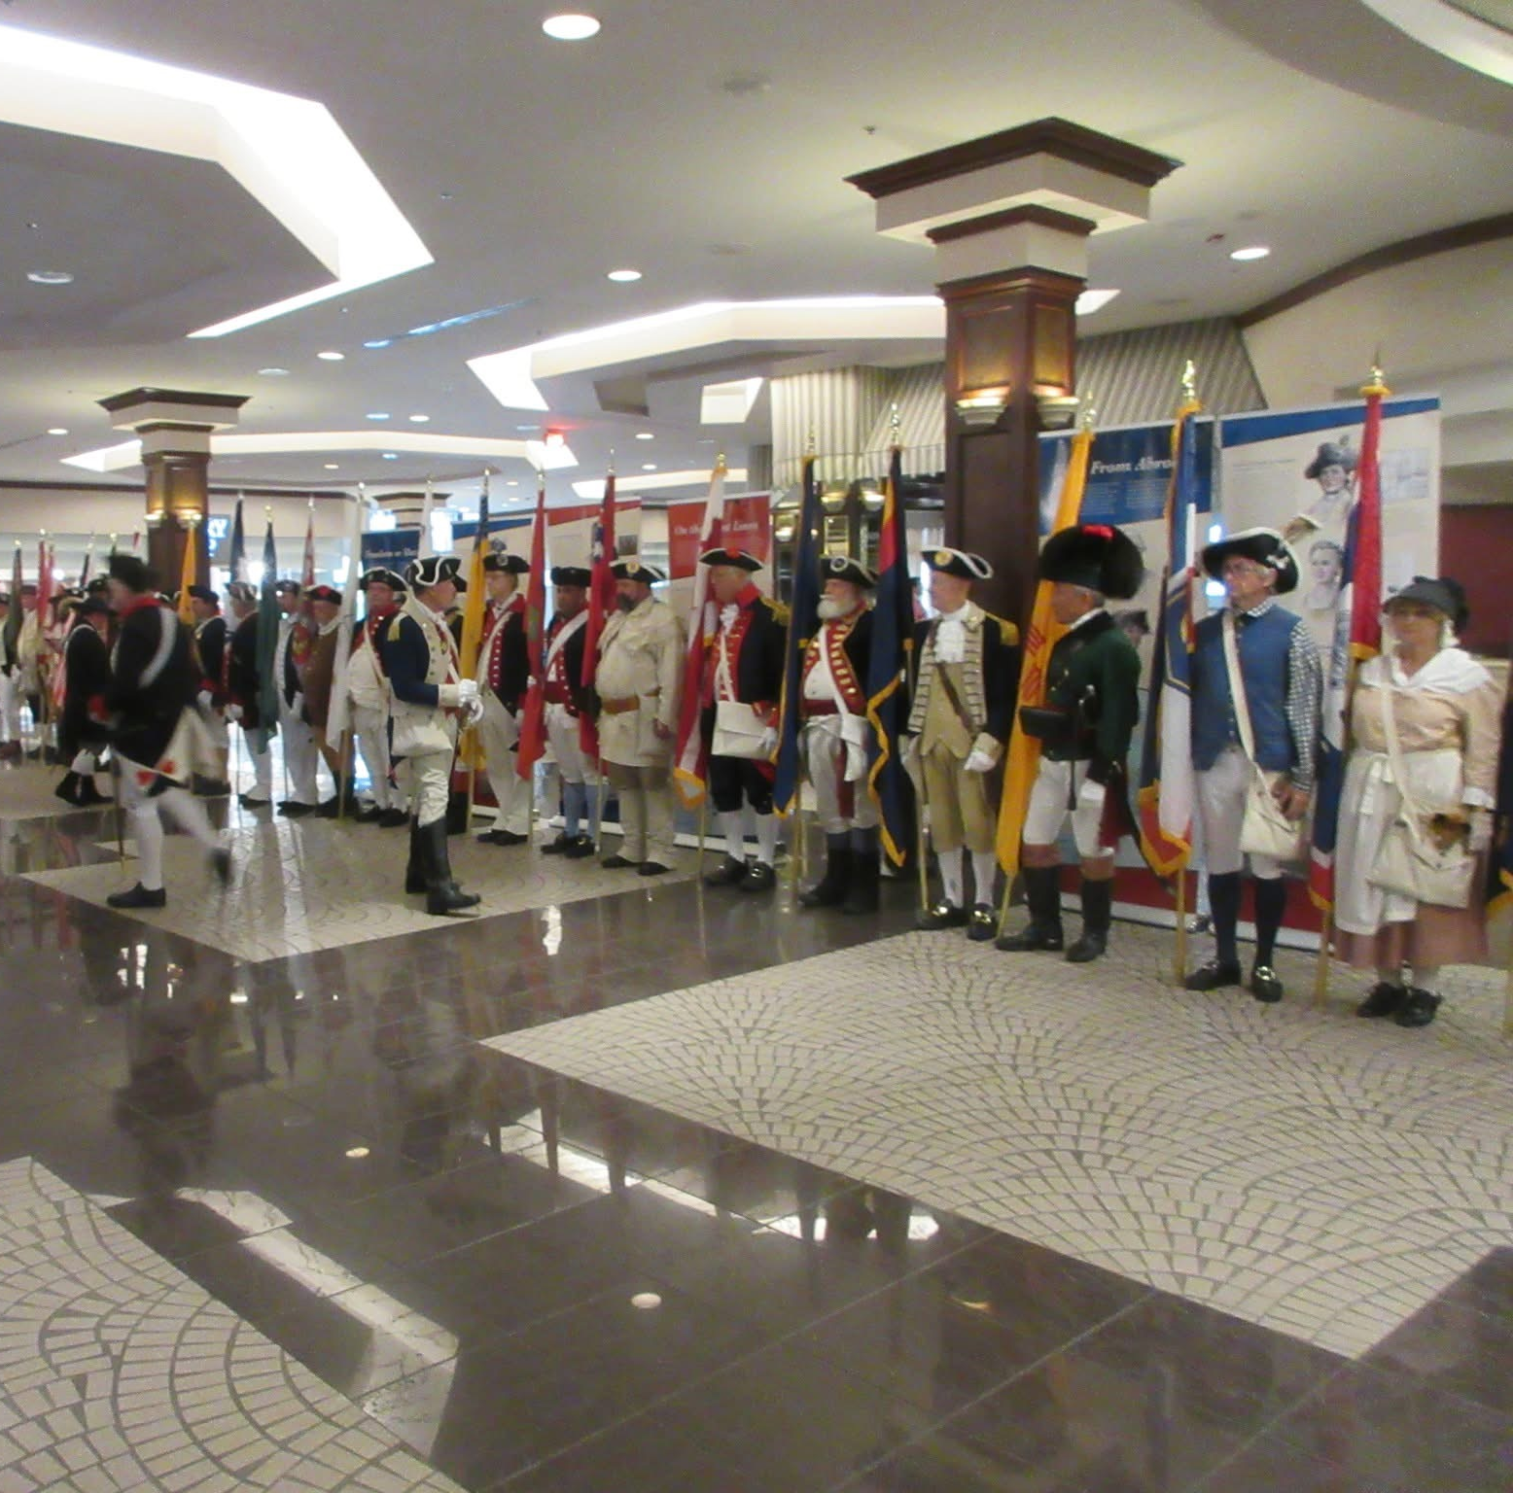
Preparation for the Color Guard Inspection

Slide 31
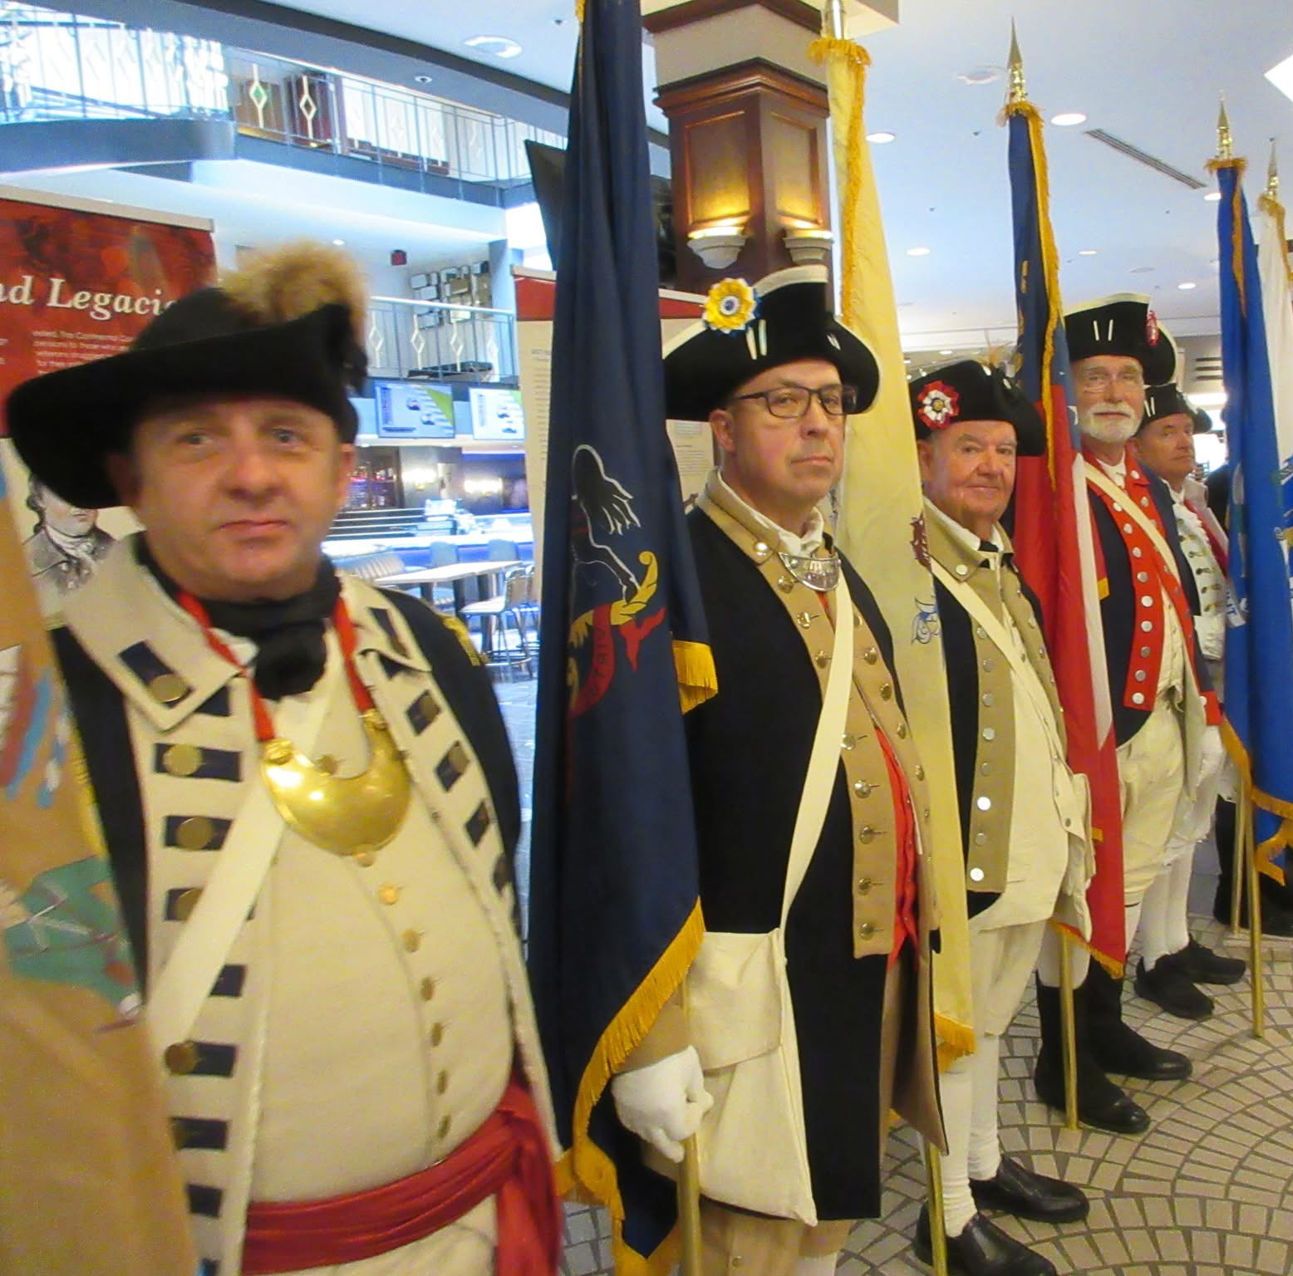
Color Guard Troops anticipate the PG’s Inspection

Slide 32
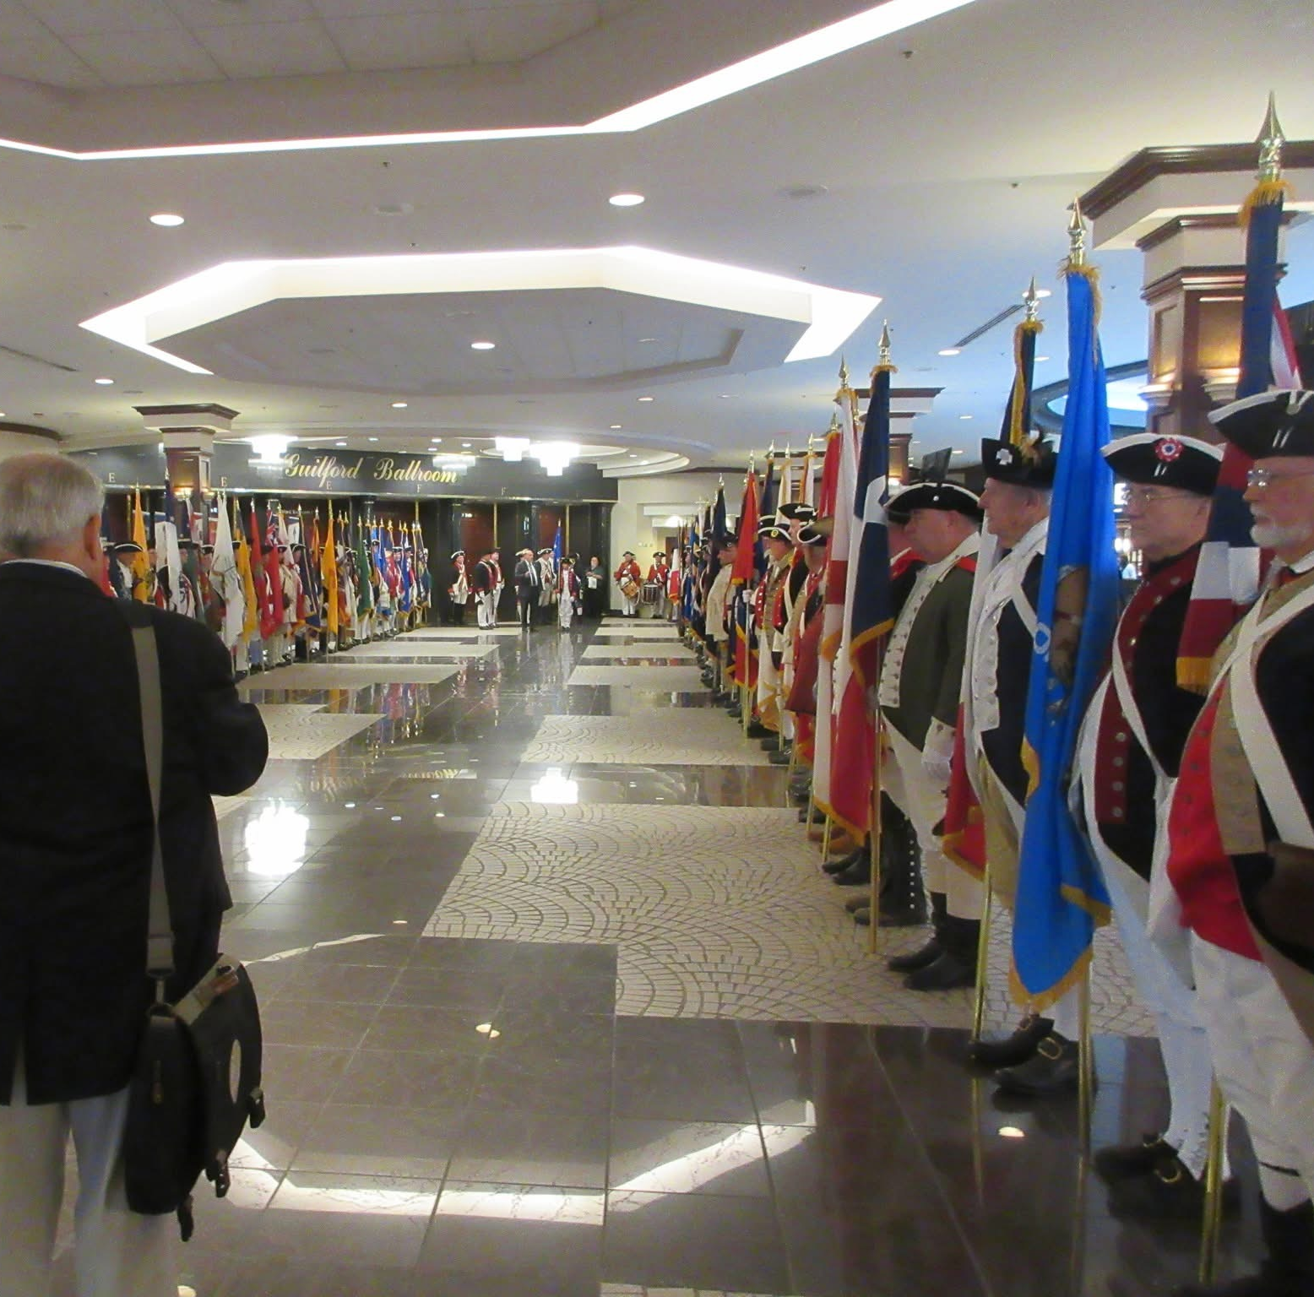
The President General’s Party prepares for inspection of the Color Guard

Slide 33
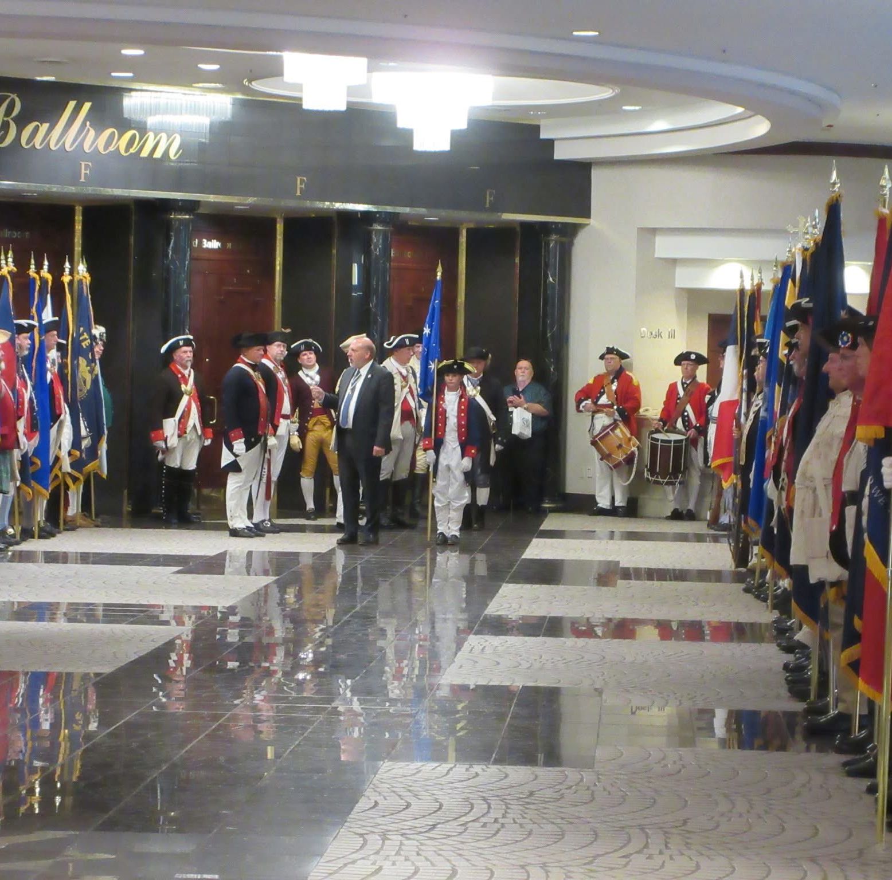
The President General’s issues final guidance to the Color Guard Commander as the Party prepares for inspection of the Color Guard

Slide 34
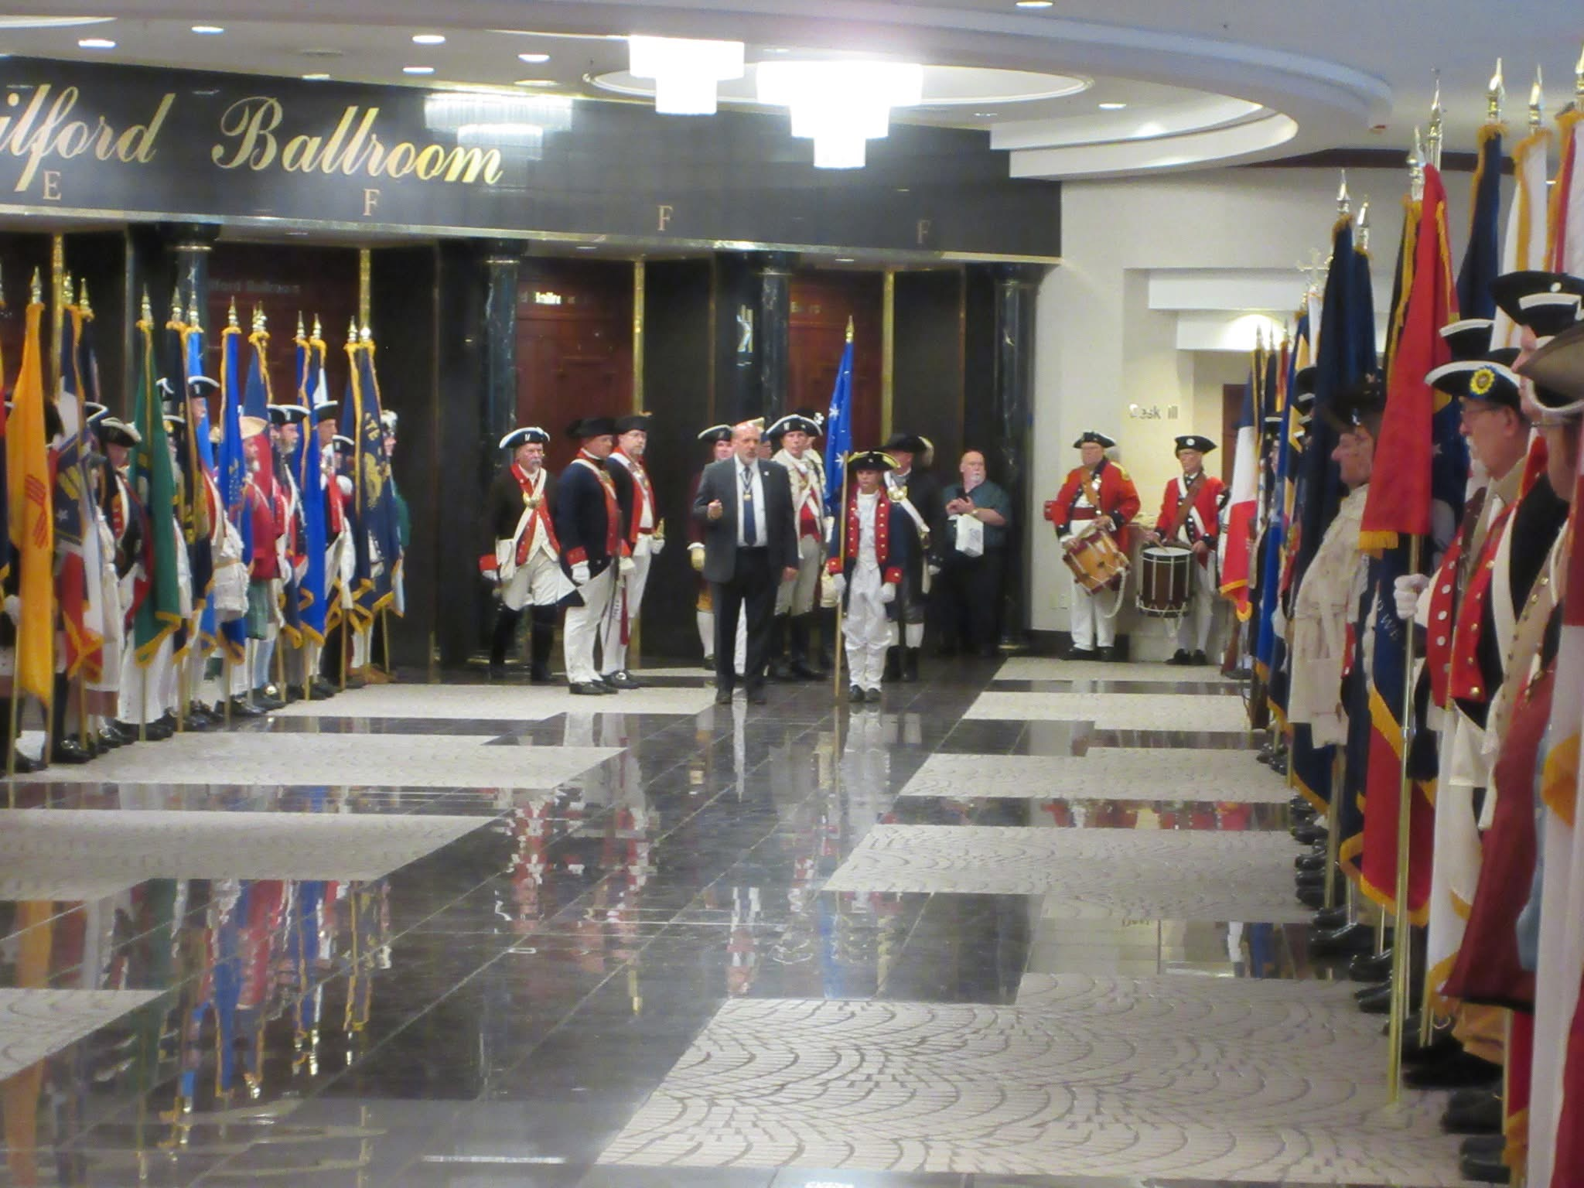
The Color Guard members stand tall for the President General’s inspection of the Color Guard

Slide 35
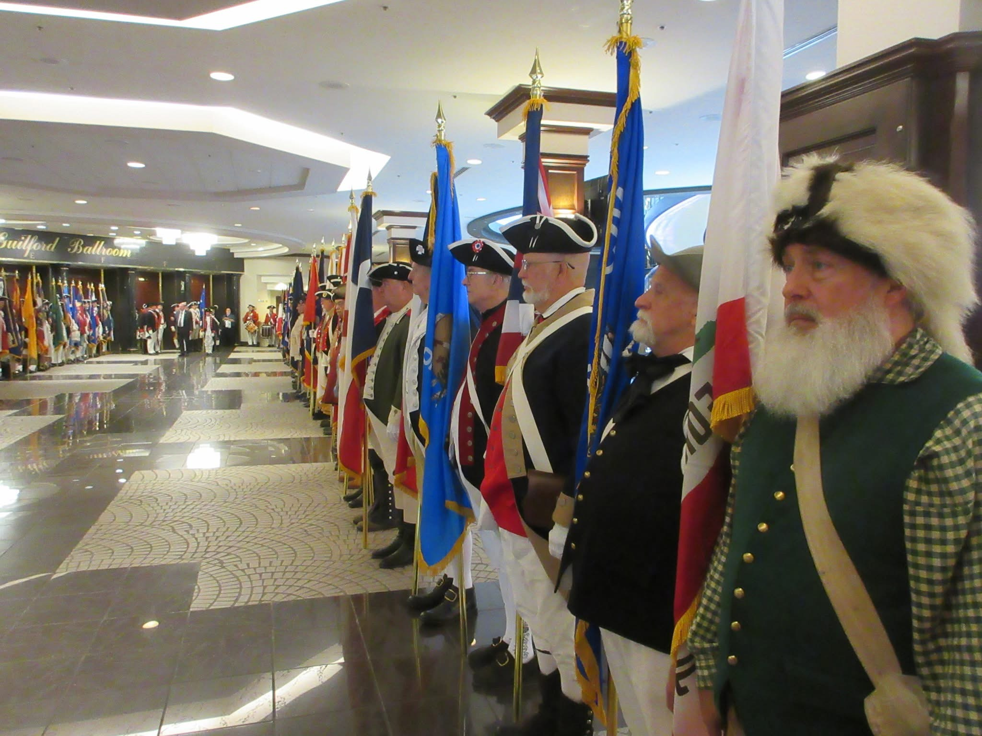
Color Guard members await The President General’s inspection

Slide 36
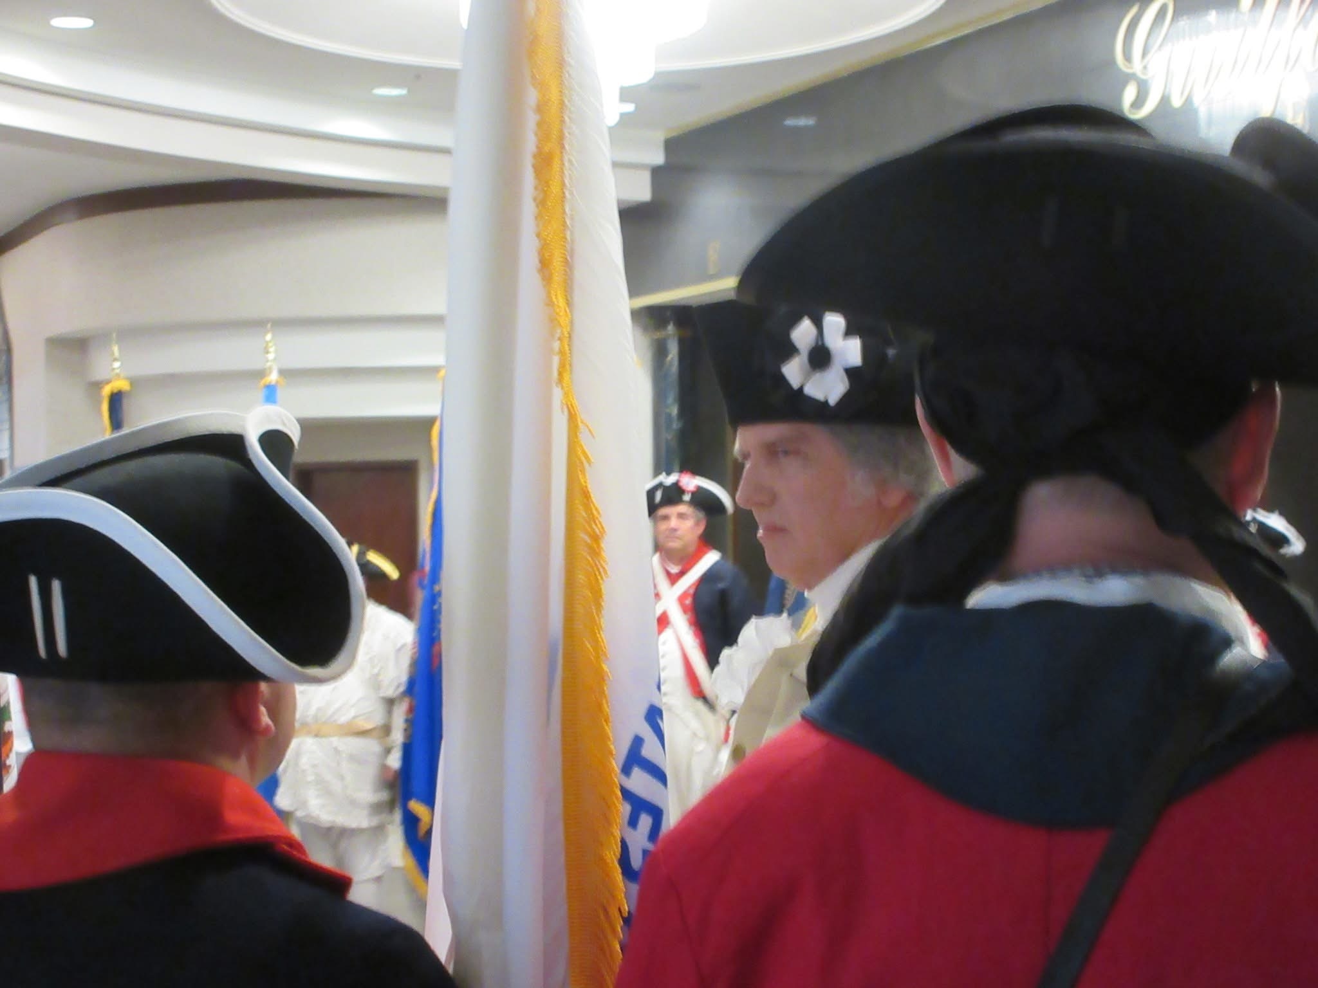
General Washington joins the President General’s Color Guard inspection

Slide 37
First Presbyterian Church
Memorial Service
Sunday, 12 July 2026

Slide 38
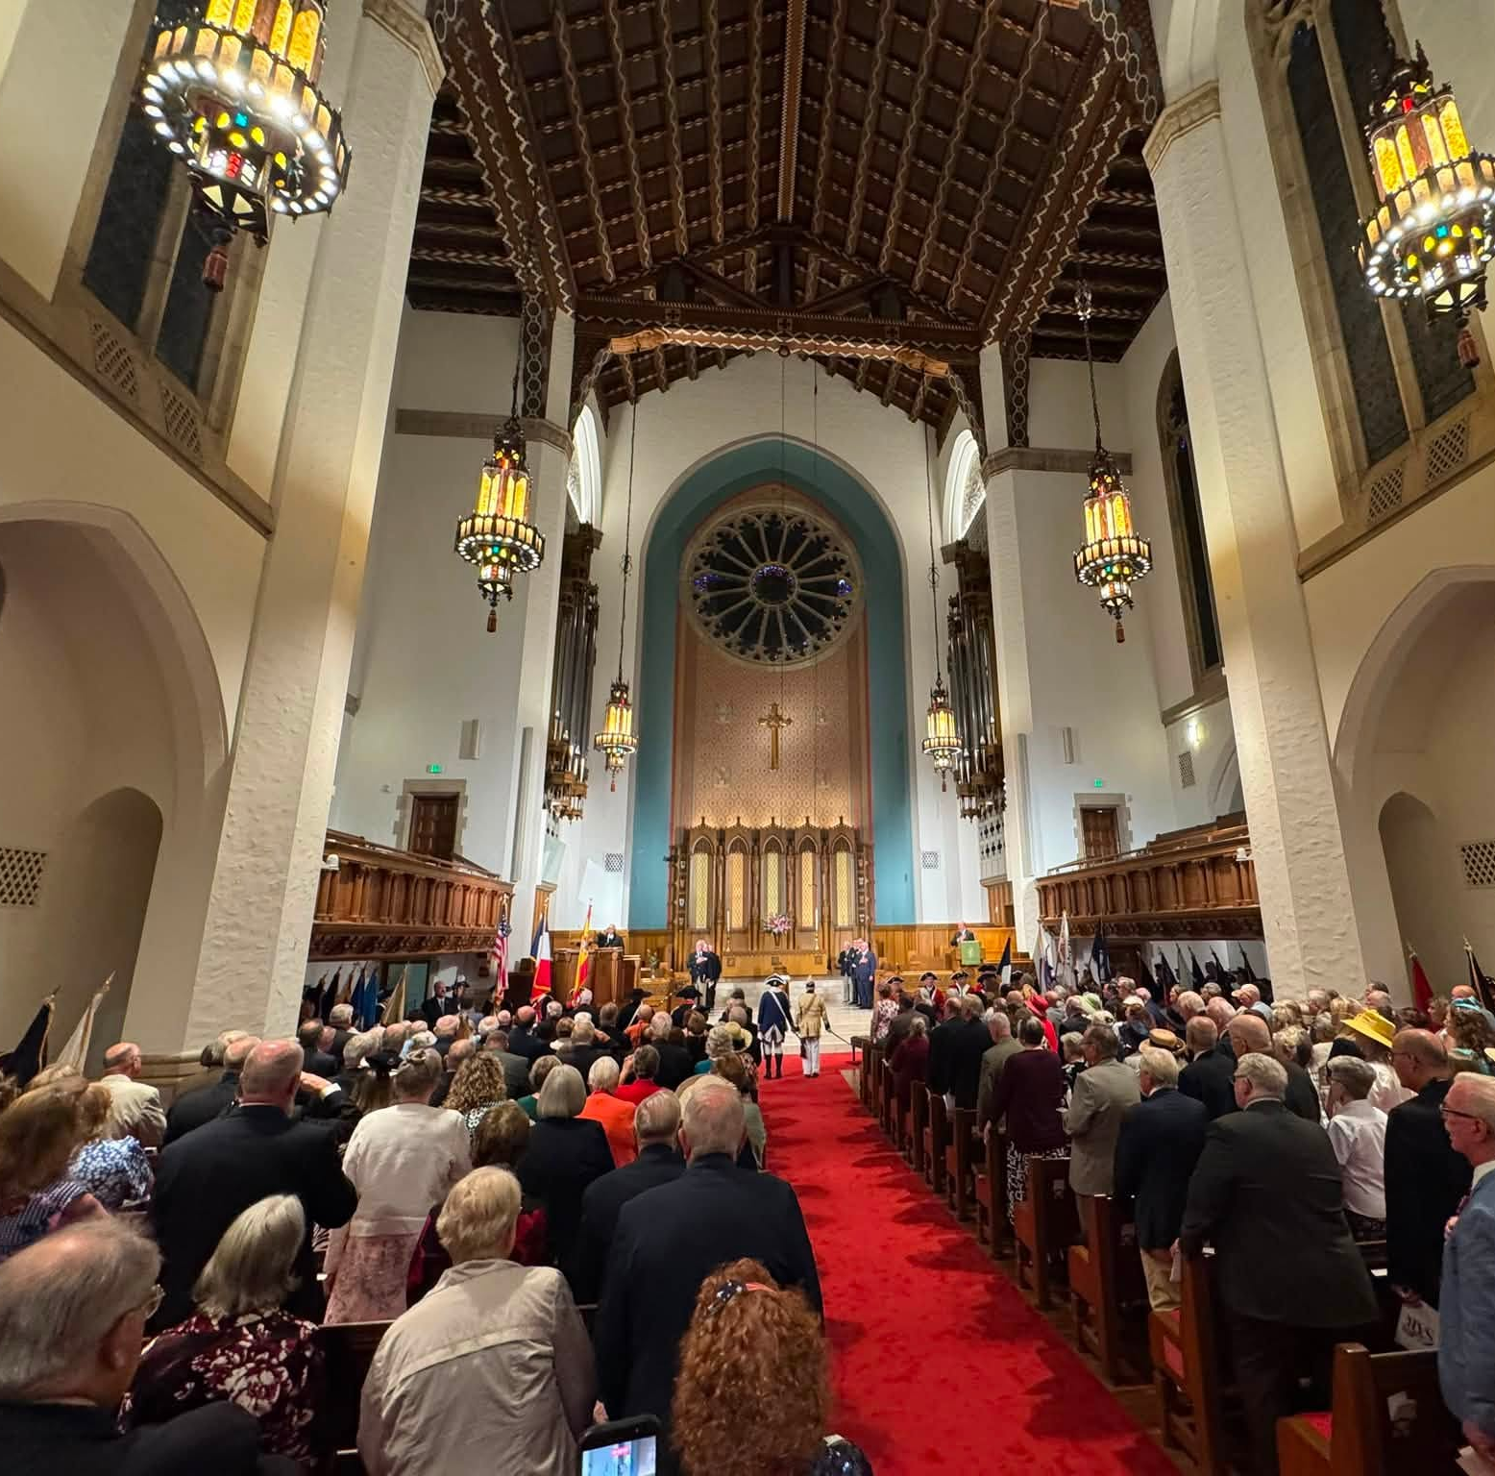
The First Presbyterian Church
Compatriots gathered for a SAR Memorial Service

Slide 39
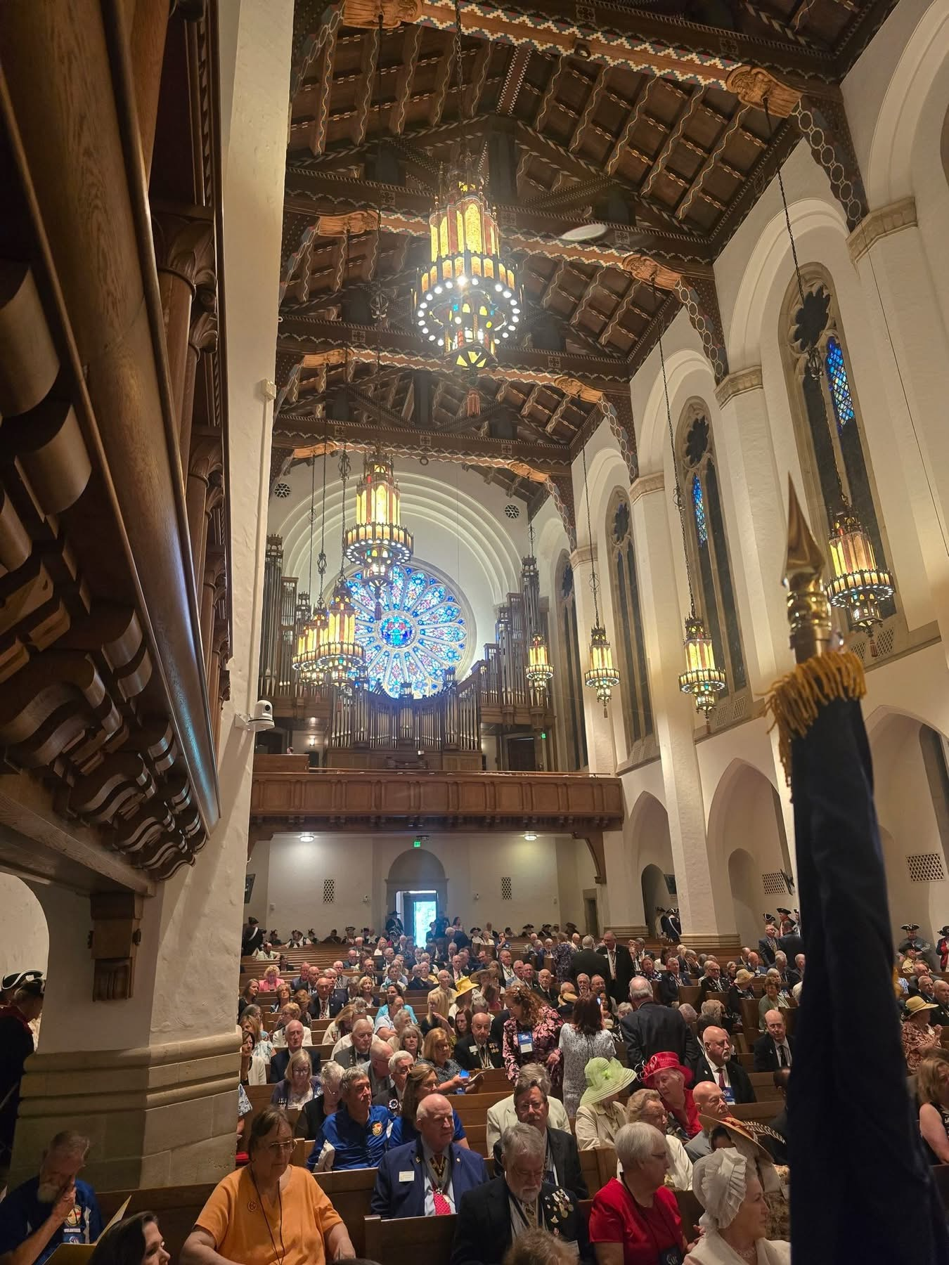
First Presbyterian Church

Slide 40
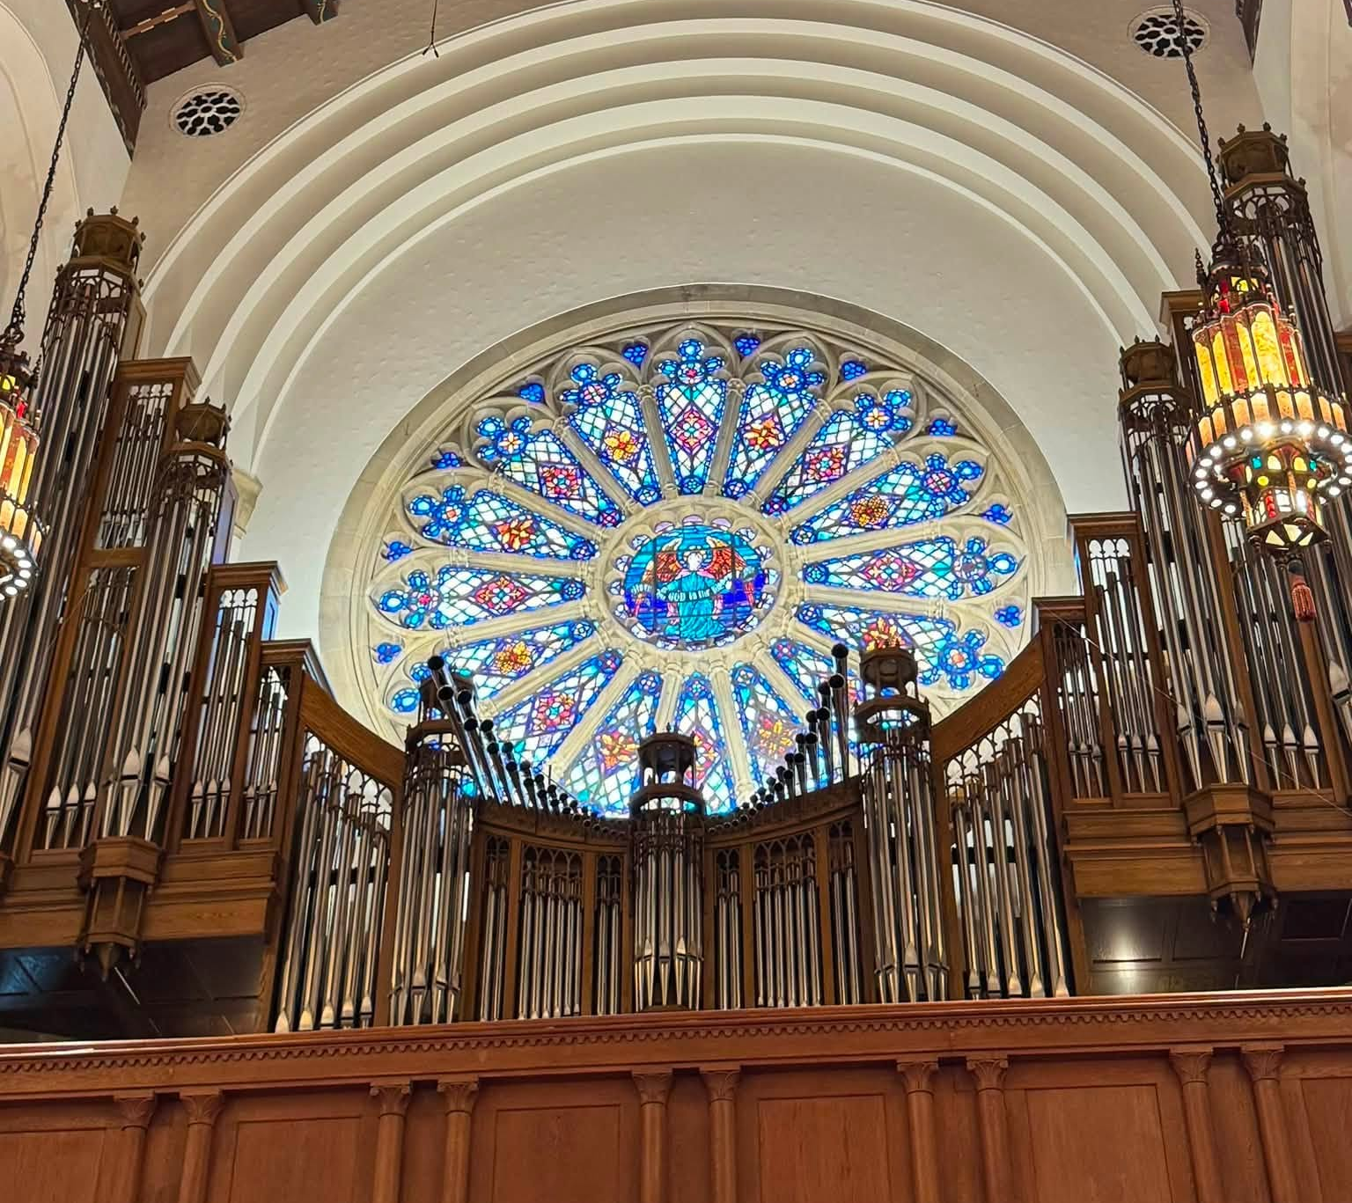
First Presbyterian Church
SAR Memorial Service

Slide 41
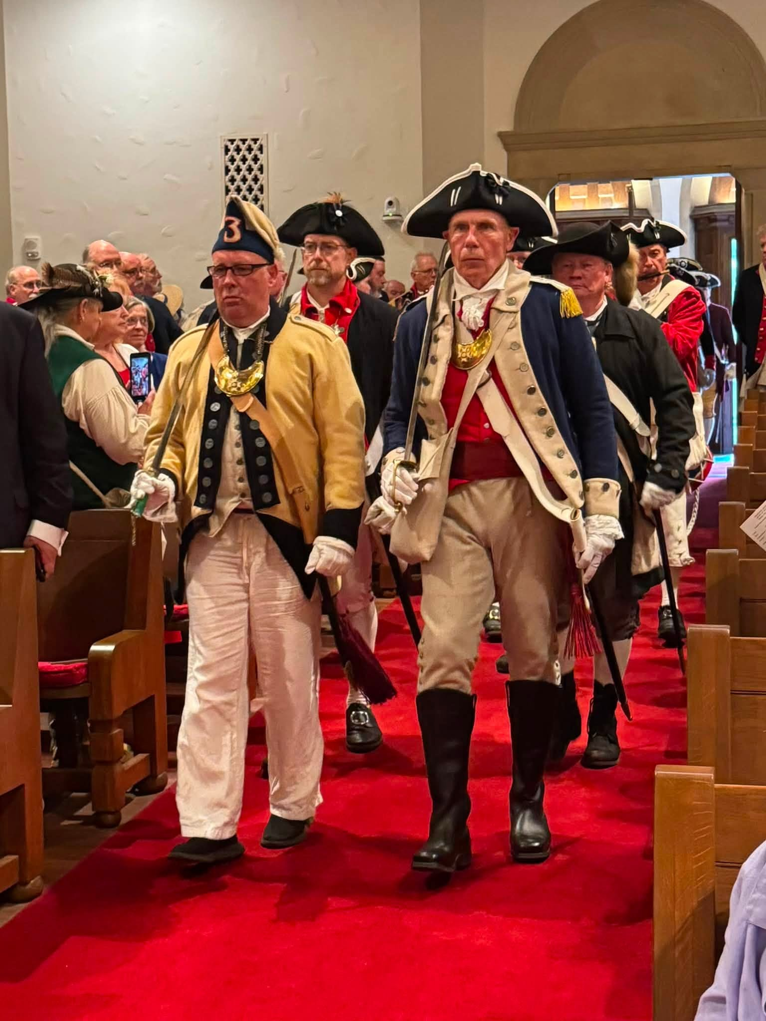
Color Guard Entrance
Sanctuary for ceremony

Slide 42
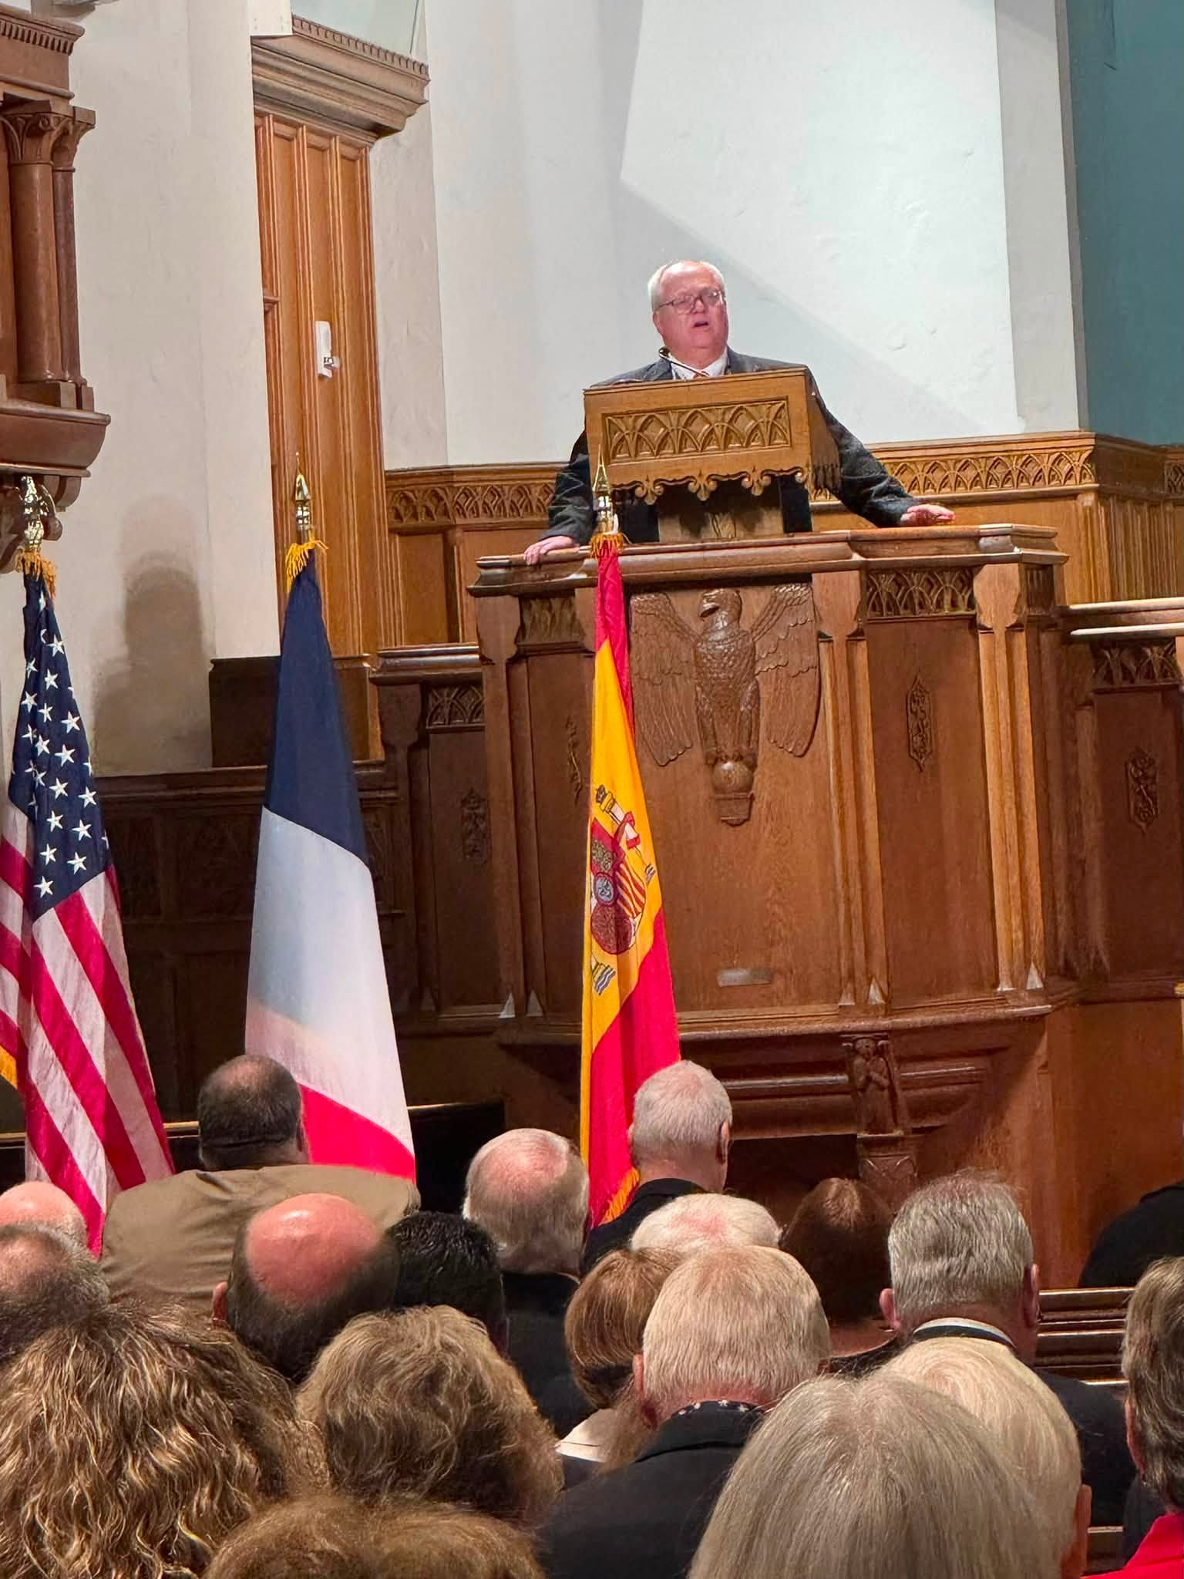
Speaker at the First Presbyterian Church
Chaplain General Pastor Christopher Grimes (NC Society) speaks to the gathering

Slide 43
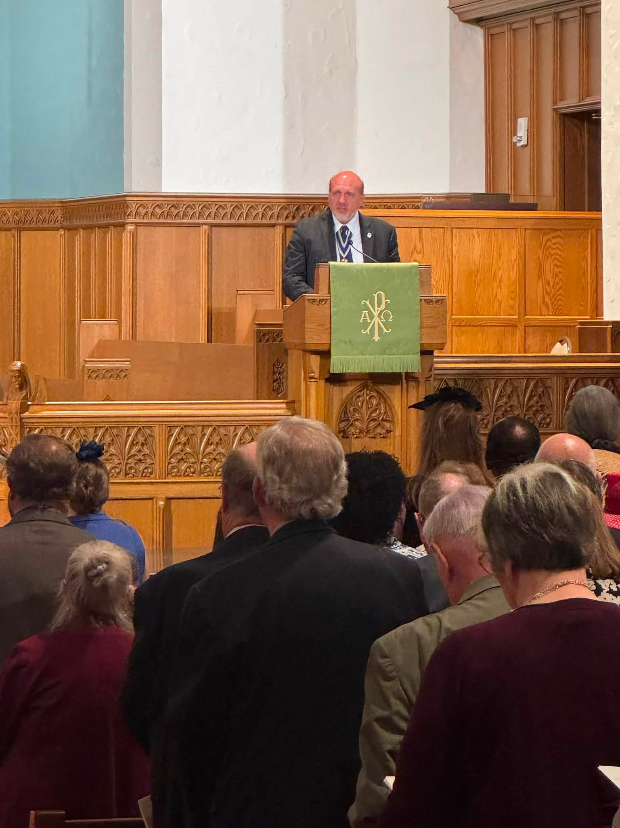
President General’s Presentation
President General Elston addresses the gathering

Slide 44
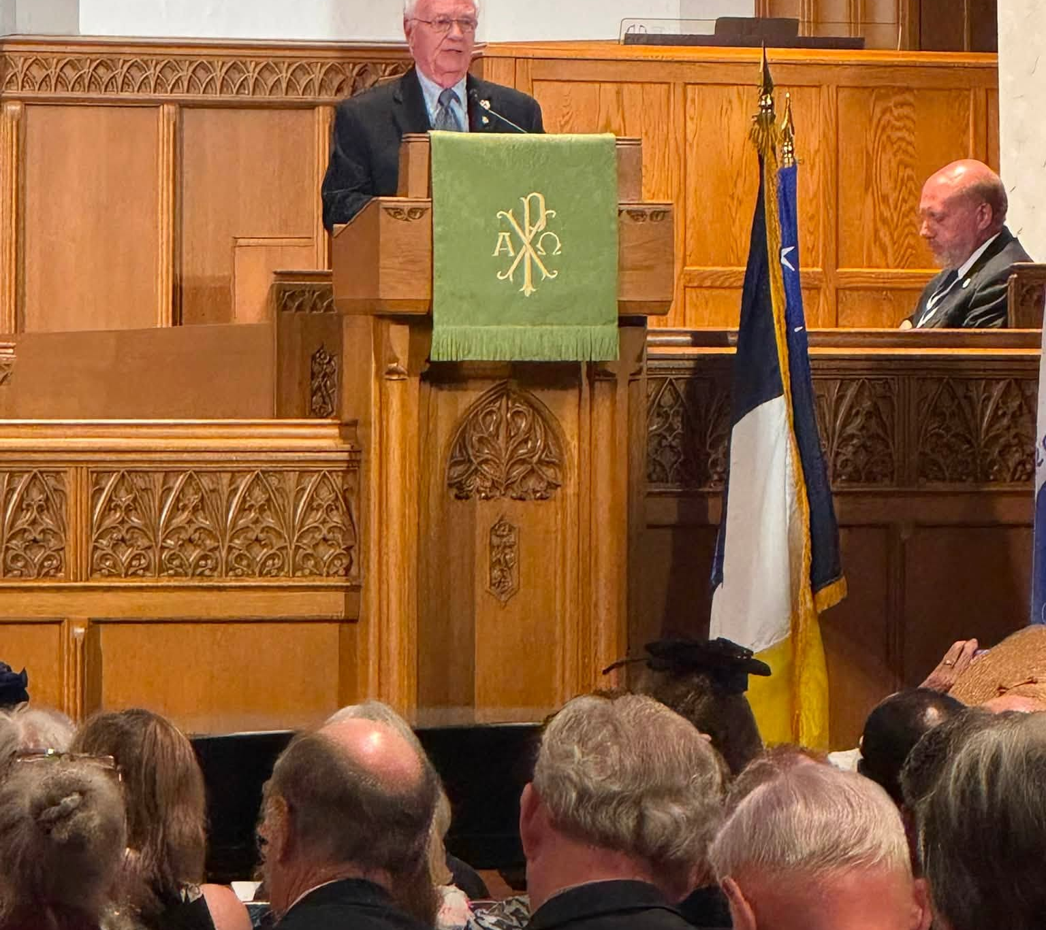
First Presbyterian Church

Slide 45
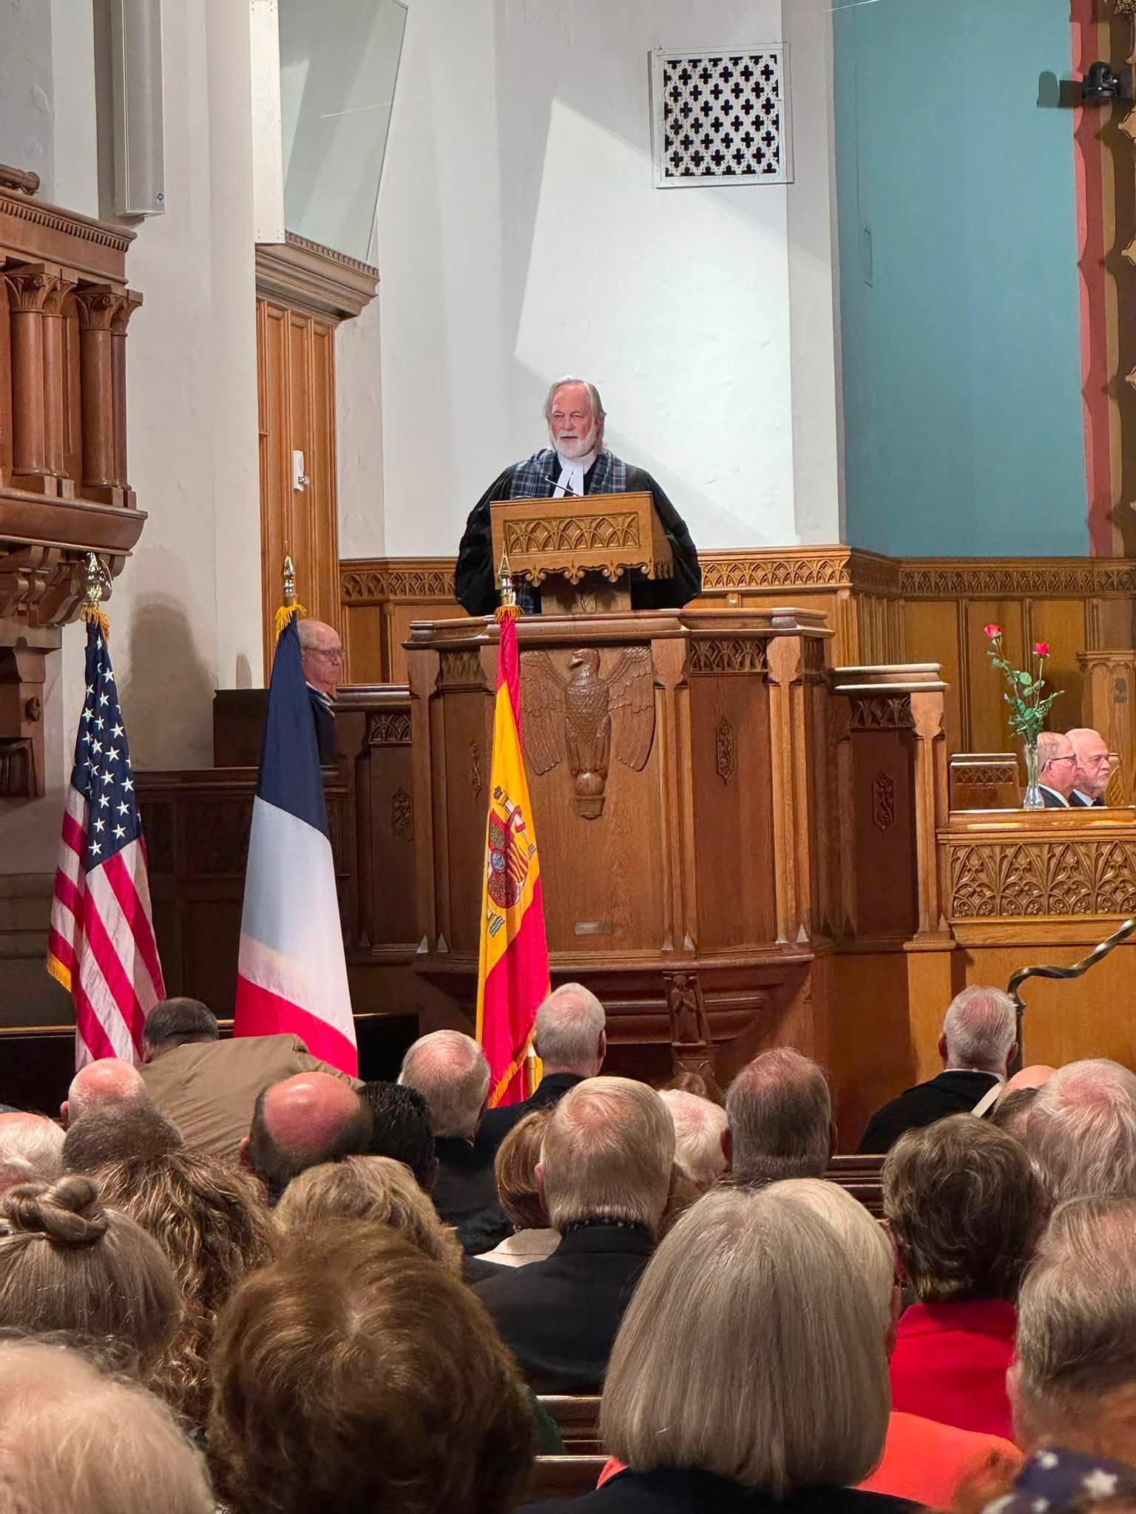
First Presbyterian Church
SAR Memorial Service, Rev Dr. Randy D. Moody

Slide 46
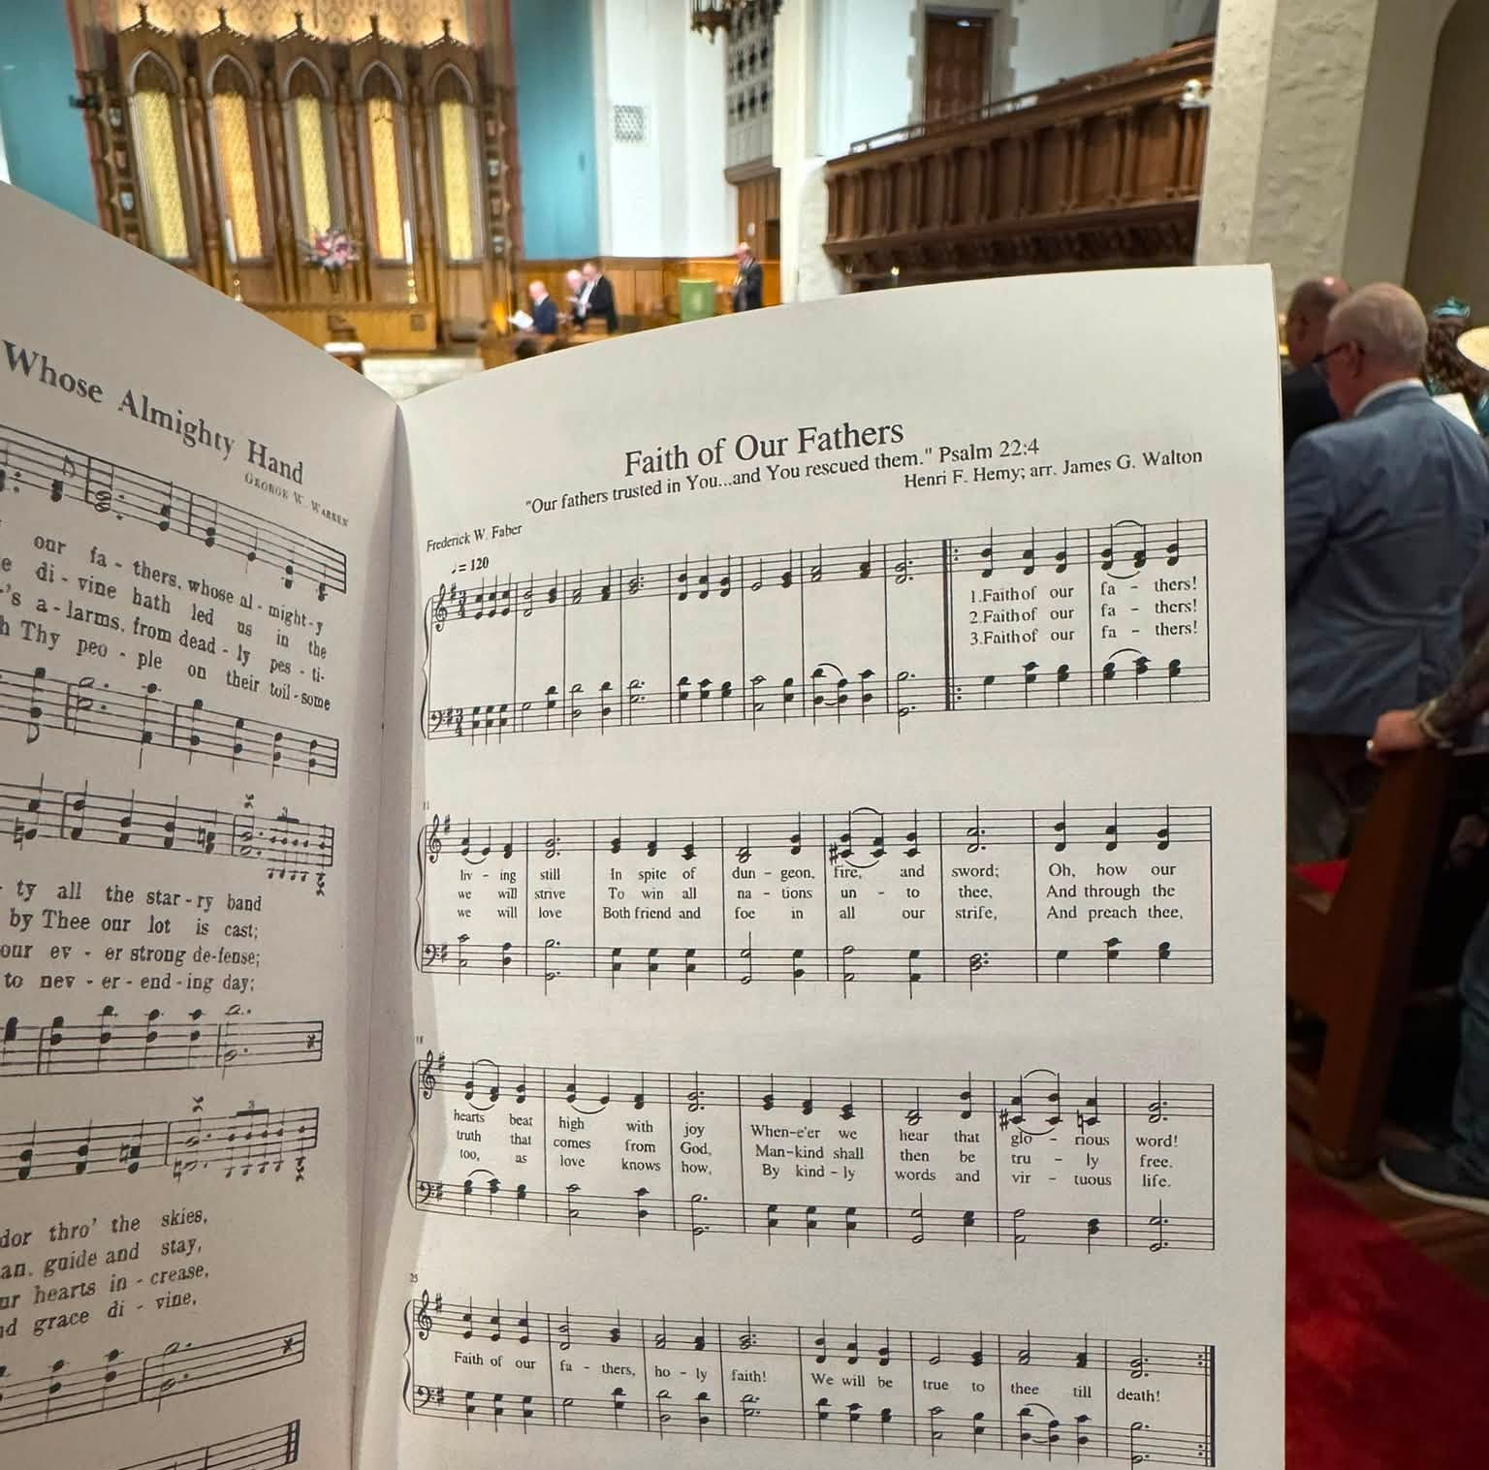
Copy of Hymnal

Slide 47
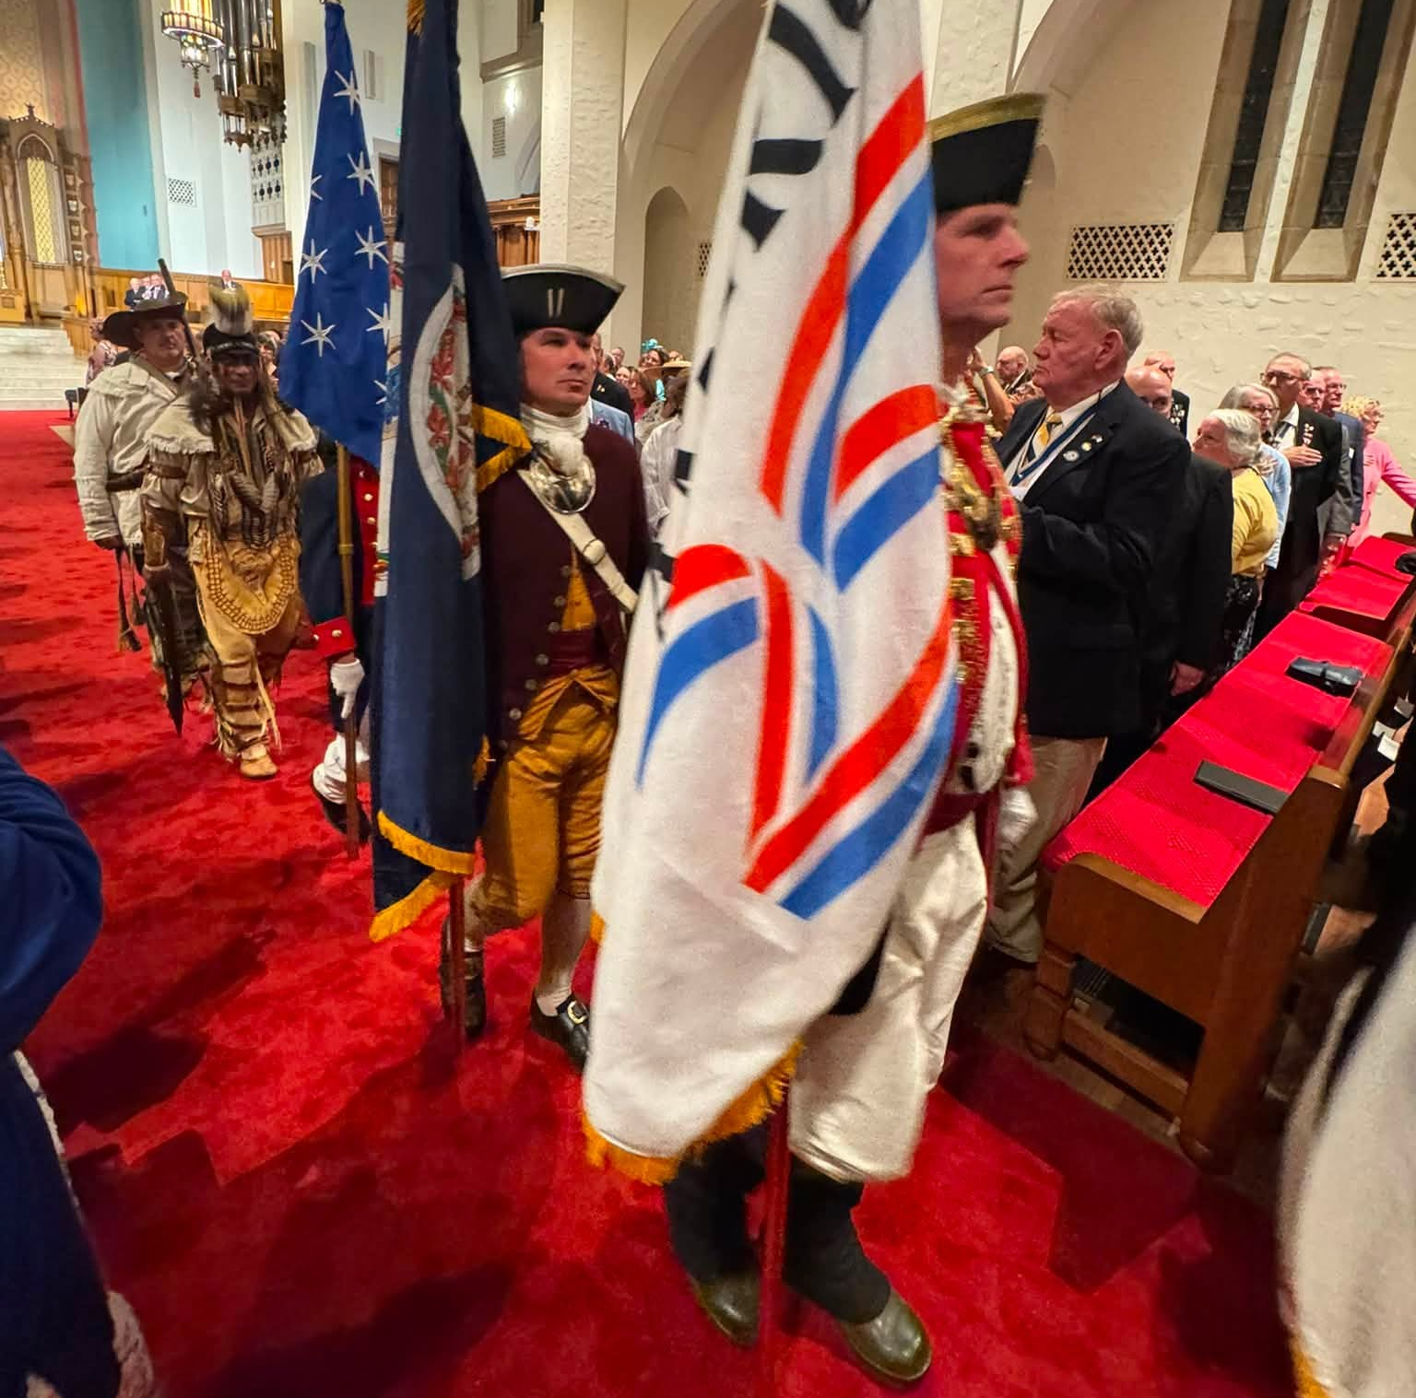
Color Guard
Departing the SAR Memorial Service

Slide 48
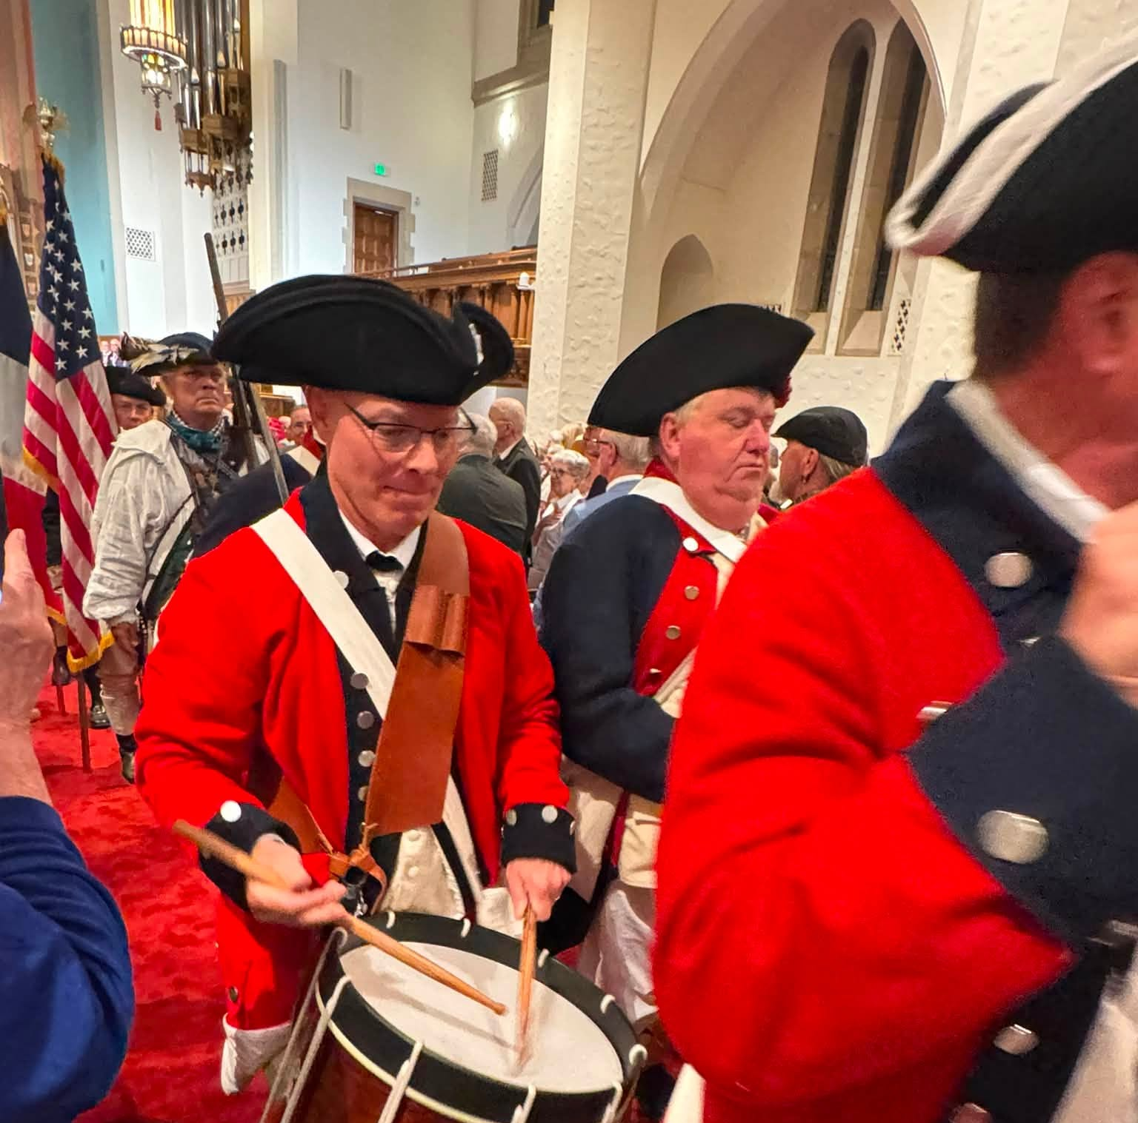
Color Guard
Departing the church service

Slide 49
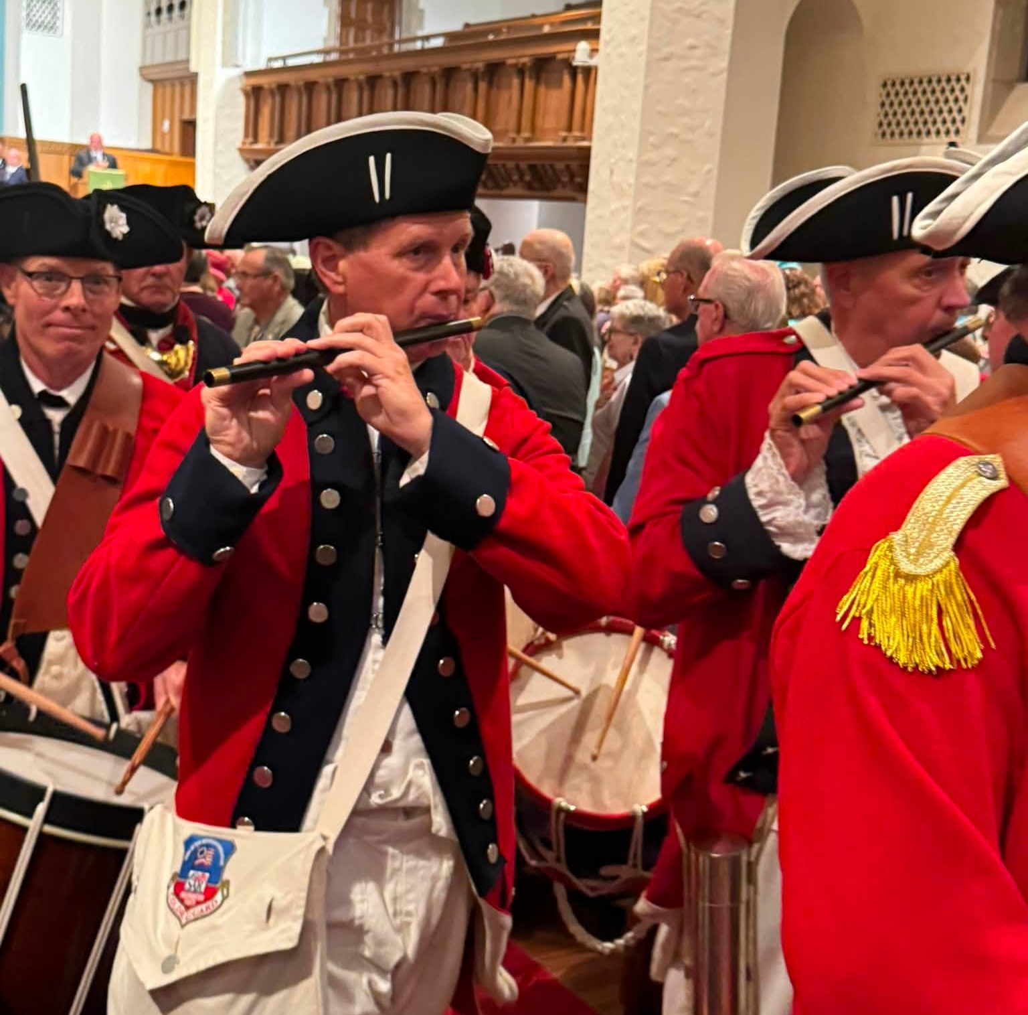
Color Guard
Departing the church service

Slide 50
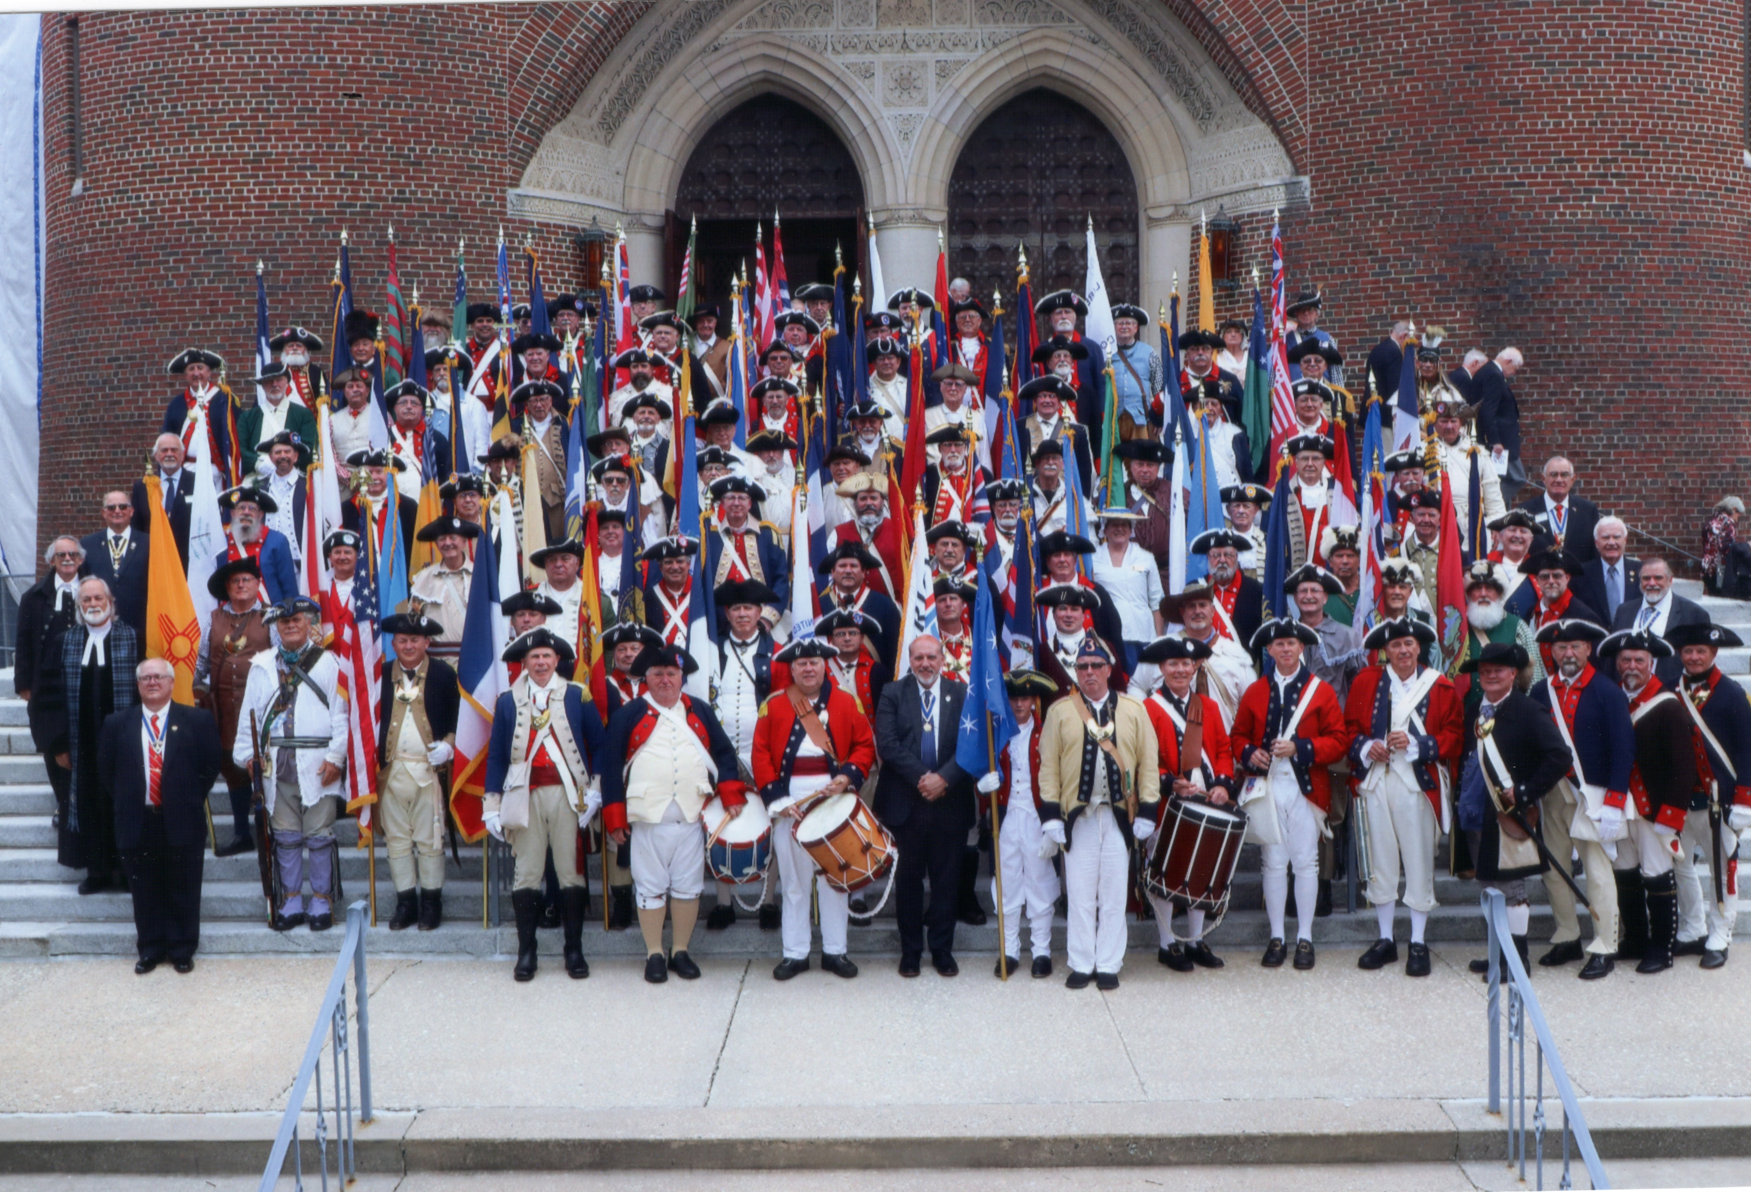
Color Guard & SAR Members
Gathered on the church steps after the service

Slide 51
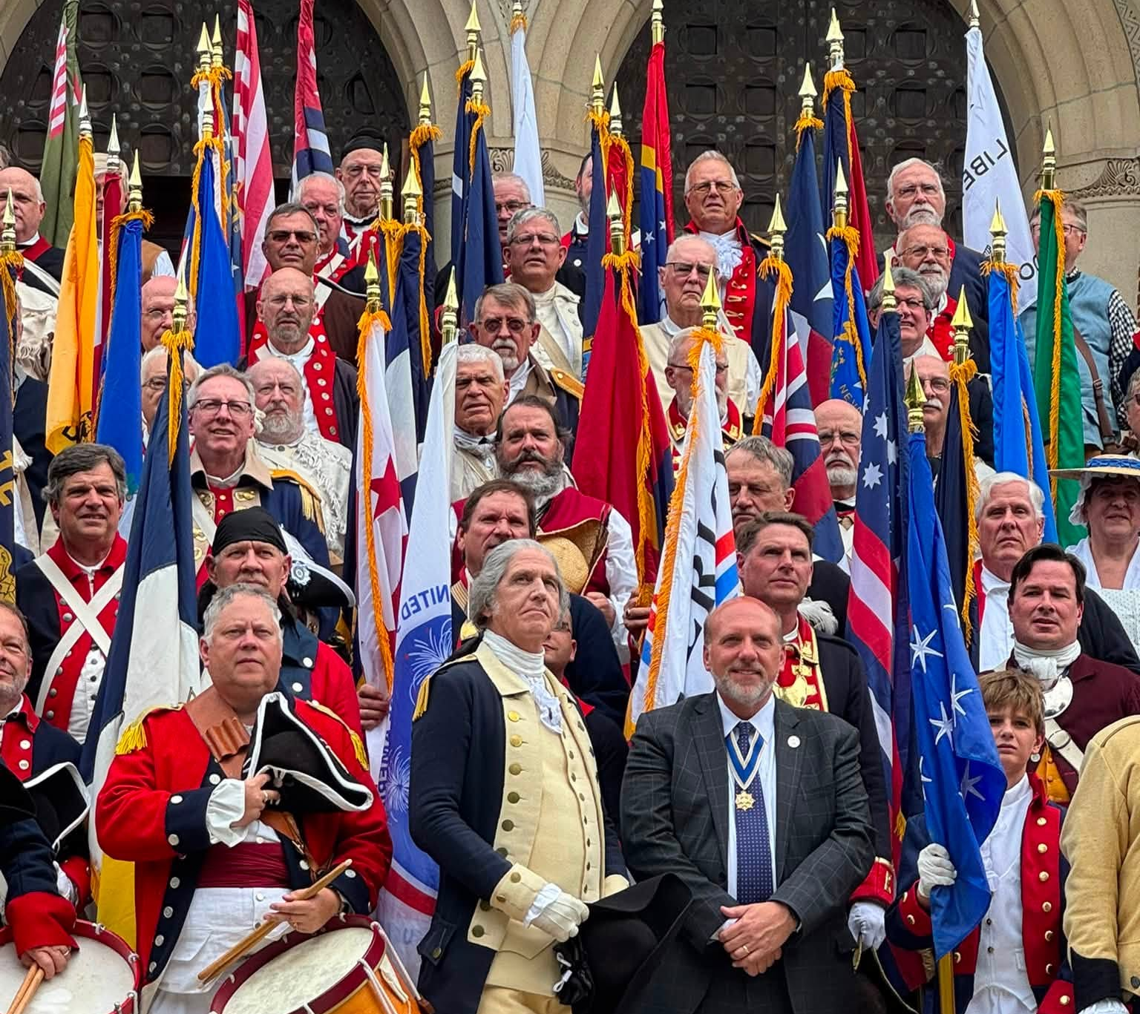
Color Guard, SAR Members, General Washington & President General Elston
Gathered on the front steps of the church

Slide 52
First Lady’s Tea – First Presbyterian Church
Sunday, 12 July 2026

Slide 53
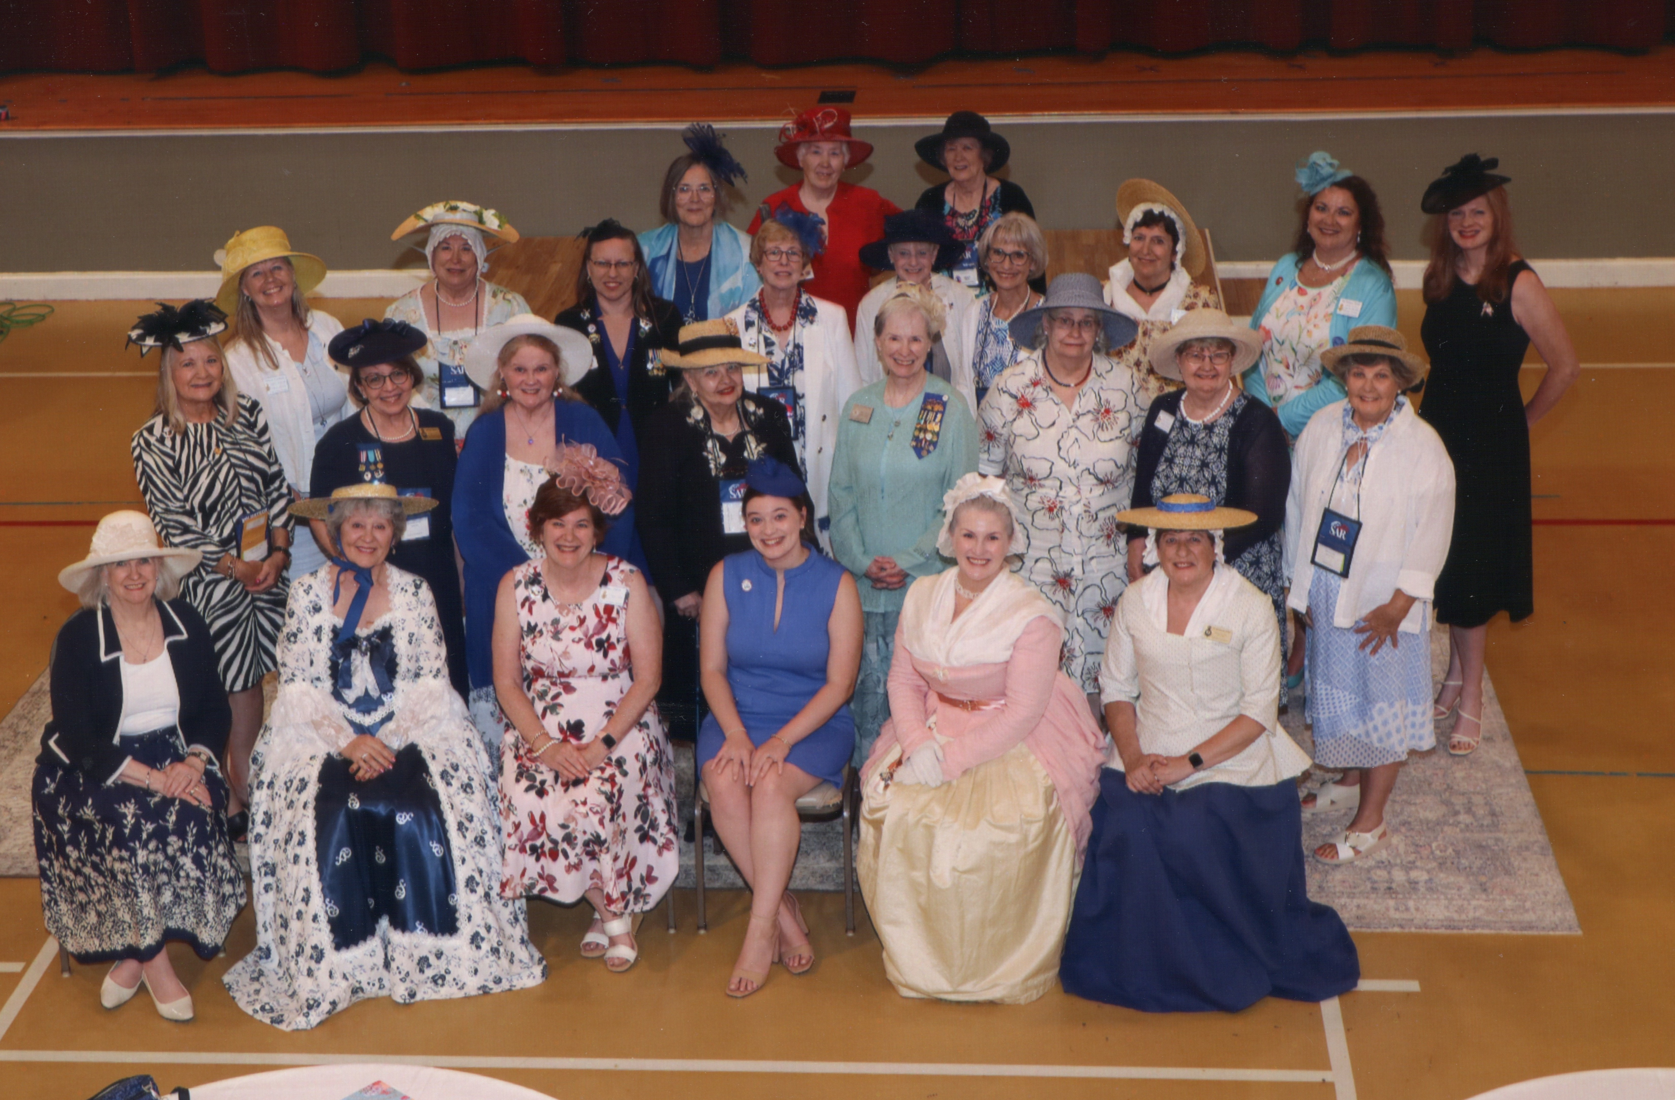
First Lady’s Tea – First Presbyterian Church
Sherrie Catledge – Row 1, far left; Mrs. Washington – Row 1, 2nd from right; Lynne Smith – Row 3, far right.

Slide 54
OPENING SESSION OF CONGRESS
Monday, 13 July 2026

Slide 55
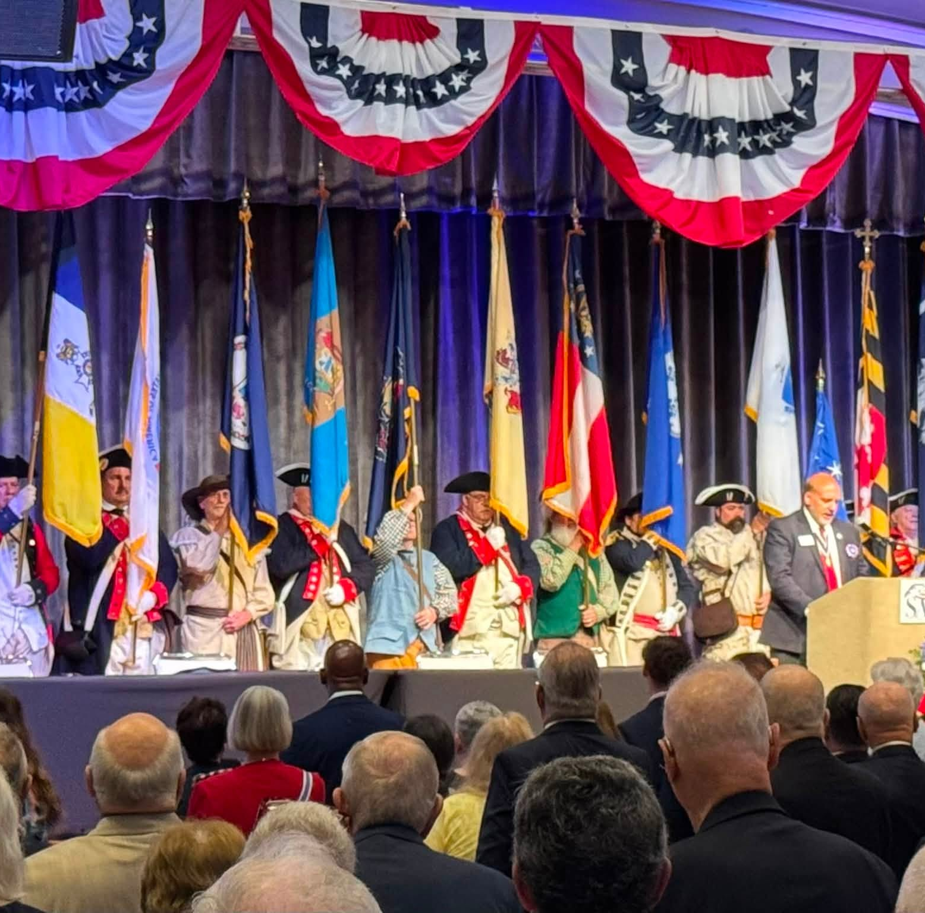
OPENING SESSION OF CONGRESS
Monday, 13 July 2026

Slide 56
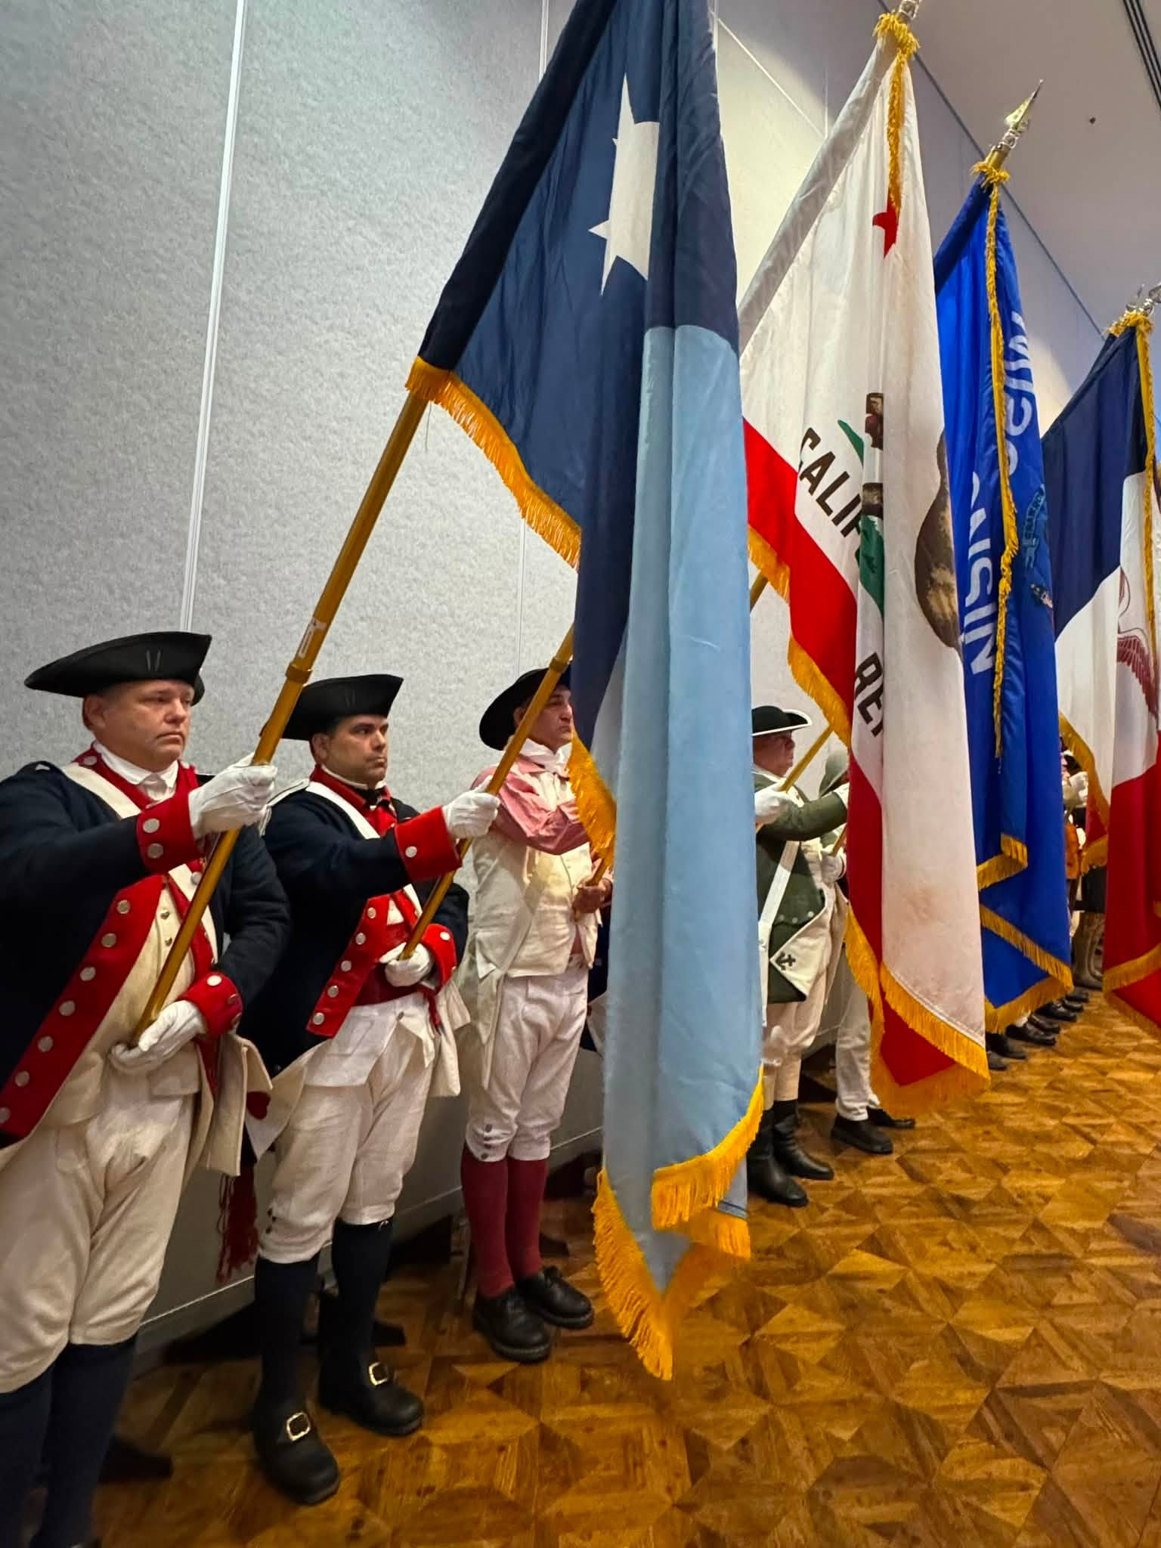
PRESENTATION OF COLORS AT OPENING CEREMOPNY
COLOR GUARD

Slide 57
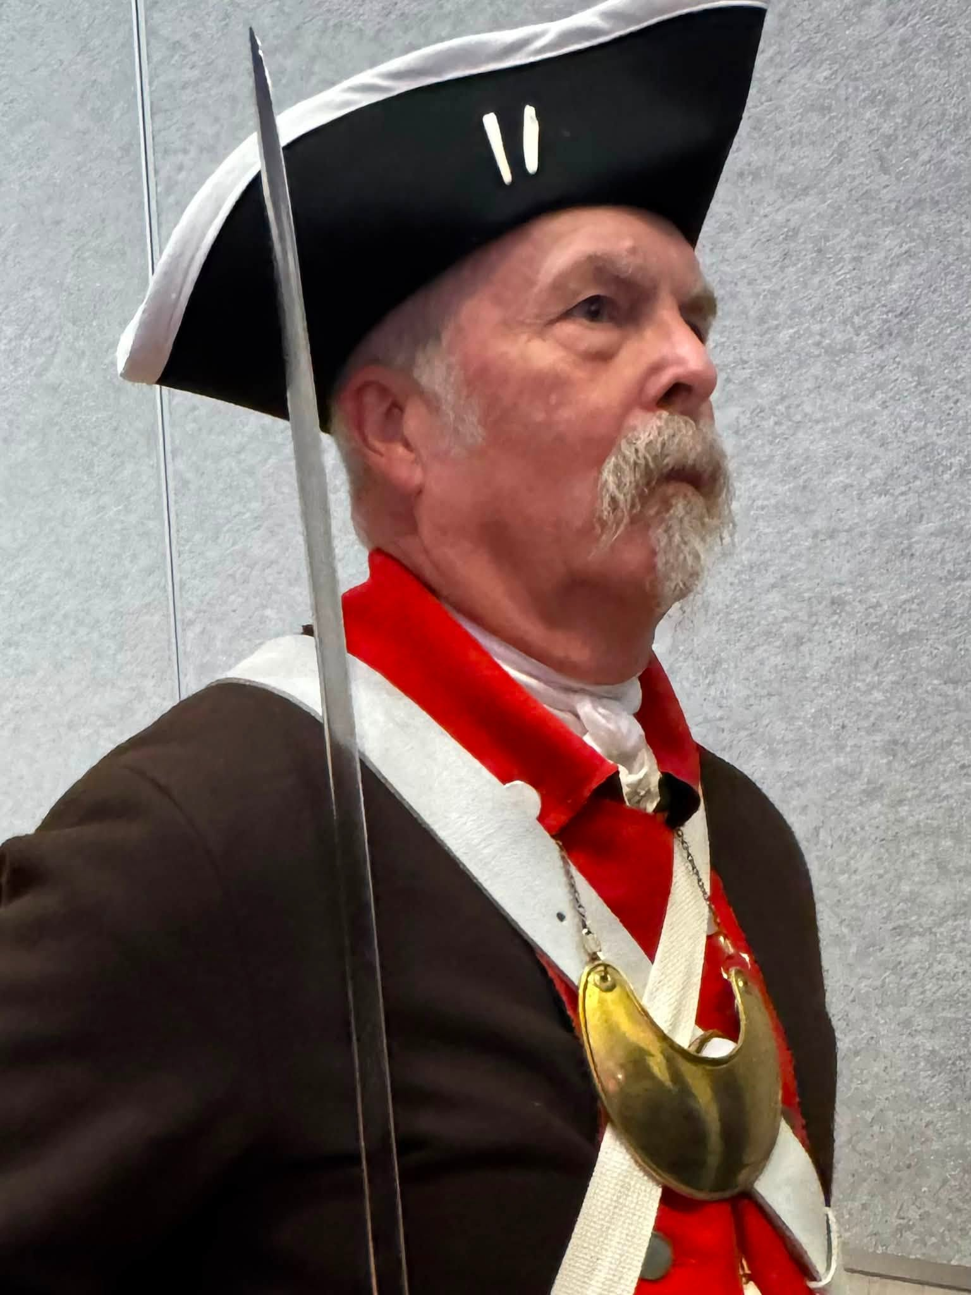
COLOR GUARD
Robert Vance
New Mexico State President

Slide 58
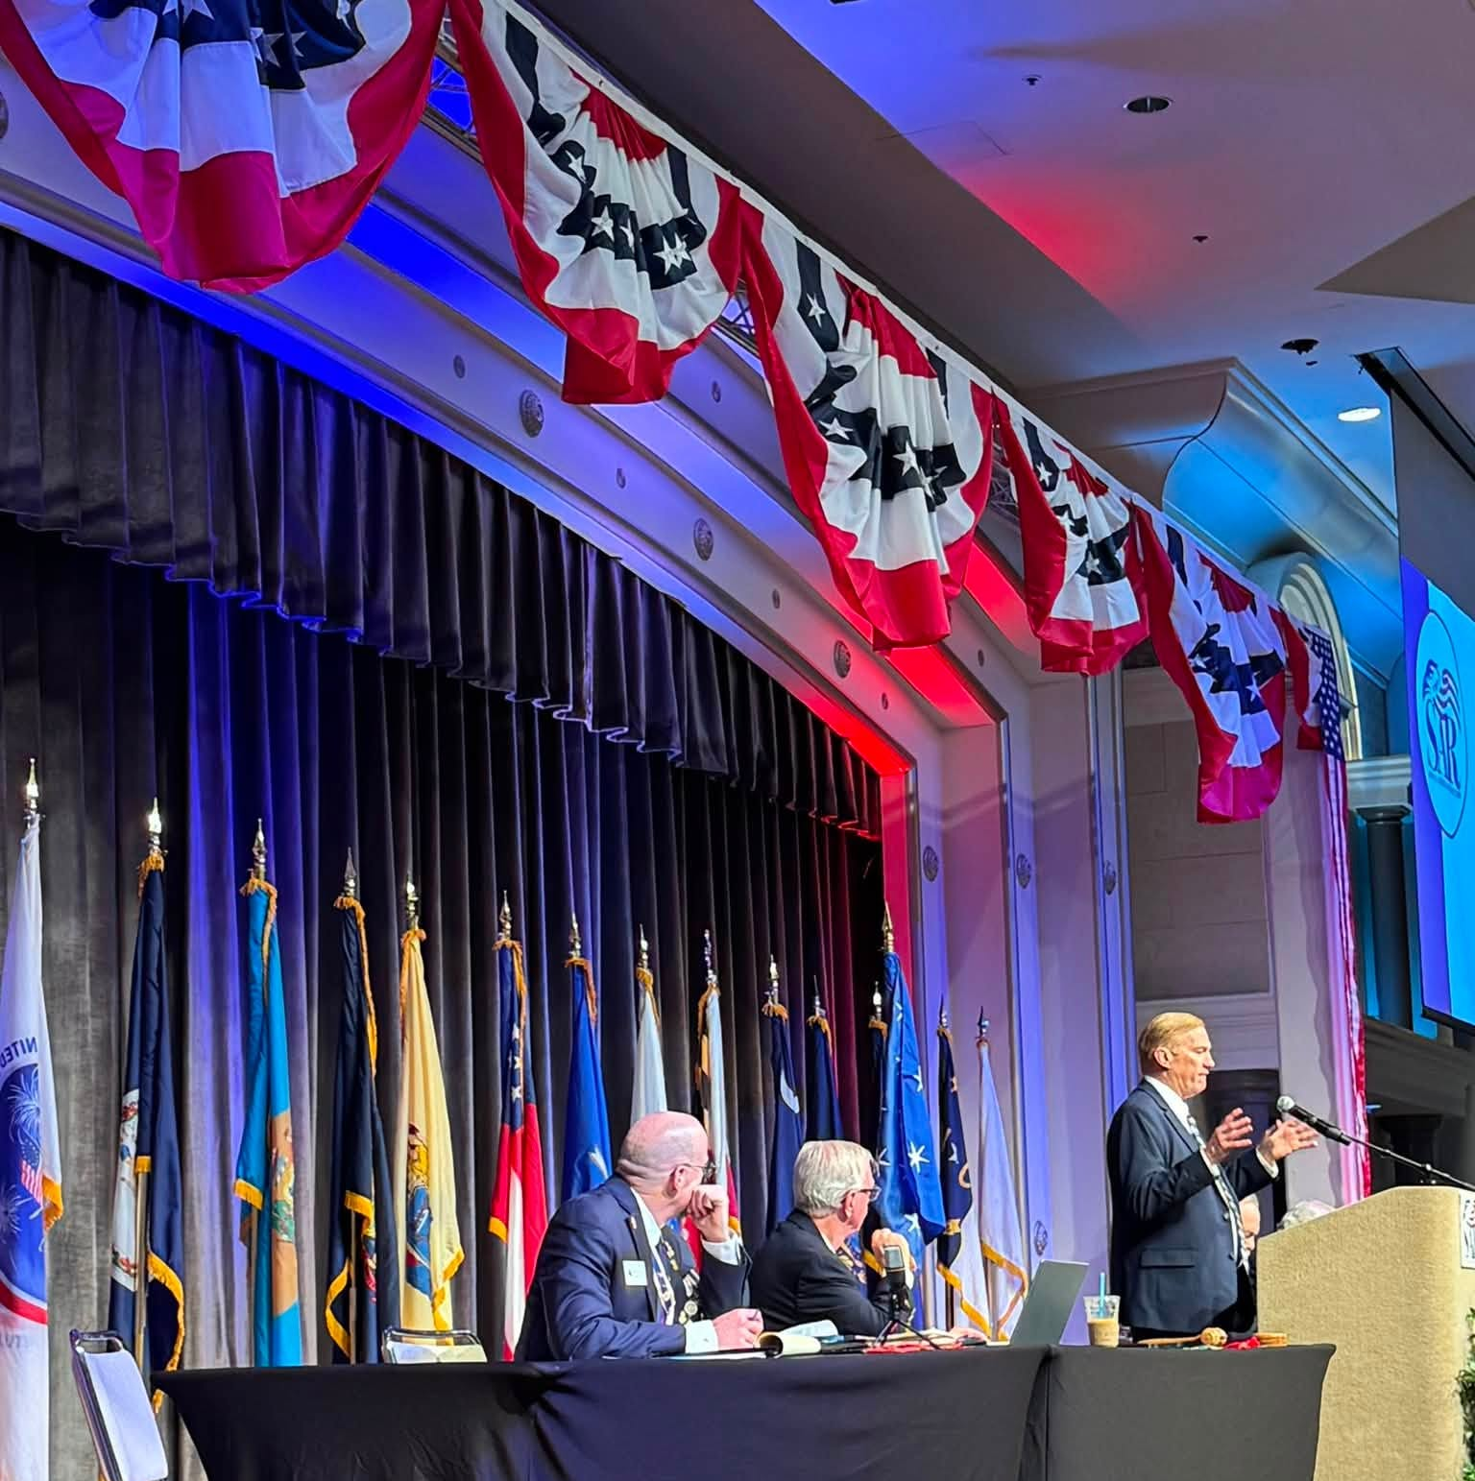
CONGRESS
SESSION
Addressing the Congress

Slide 59

SAR MISSION STATEMENT

Slide 60

THE PRESIDENT GENERAL
Addressing the Congress

Slide 61

Chad and The GENERAL

Slide 62

Congress in Session
Allen Greenly SAR Secretary General

Slide 63

Chad Lloyd & Jim Wood
Attending the opening ceremony

Slide 64

SESSION OF CONGRESS
PRESENTATION OF GIFTS

Slide 65
YOUTH AWARDS LUNCHEON
Monday, 13 JULY 2026

Slide 66

NAIONAL EAGLE SCOUT AWARD
Past President Greg Catledge with Ann Margaret Sproul, winner of the SAR National Eagle Scout Award and a $10,000 Scholarship. Sponsored by the Mecklenburg Chapter. Annie accompanied by her mother Noelle.

Slide 67

National Eagle Scout Award
National Award Winner, Ann Margaret Sproul and Mecklenburg Chapter Compatriot Greg Catledge

Slide 68
Recognition & Awards Ceremony
13 JULY 2026
MECKLENBURG CHAPTER

Slide 69

EVENT PROGRAM

Slide 70

PRESIDENT GENERAL ELSTON
Presents Activity Award

Slide 71

PRESIDENT GENERAL’S
ACTIVITY AWARD CERTIFICATE

Slide 72

PRESIDENT GENERAL’S ACTIVITIES AWARD
Activities Award Ribbon

Slide 73

PRESIDENT GENERAL’S CUP
The Chapter, based upon size presenting evidence of the most complete program of activities 2025 - 2026

Slide 74

LIBERTY BELL AMERICANISM AWARD
PG Elston presenting awards to
Mecklenburg President Chad Lloyd,
State President McKee on behalf
of the Catawba Chapter, and a
representative of the Freedom Chapter, TXSSAR.

Slide 75
SOUTH ATLANTIC DISTRICT BREAKFAST
Tuesday, 14 July 2026

Slide 76

SOUTH ATLANTIC DISTRICT BREAKFAST

Slide 77

SOUTH ATLANTIC DISTRICT BREAKFAST
Chapter members Stephen McKee, Jim Wood, and Greg Catledge joined by Genealogist General Gary Green, Chaplain General Chris Grimes, State Secretary Bob Sigmon, Past-State President Steve VanPelt, and Michael Aycock.

Slide 78
PRESIDENT GENERAL’S BANQUET
Tuesday, 14 July 2026

Slide 79

President General’s Banquet
Color Guard

Slide 80

President General’s Banquet
Fife and Drum Corp

Slide 81

President General’s Banquet
PG Elston leads the Pledge of Allegiance

Slide 82

President General Banquet
Guest speaker Karl Rove

Slide 83

President General’s Banquet
Overview of Banquet Room

Slide 84

President General’s Banquet
Swearing in ceremony of new SAR Member Karl Rove by PG Ellison

Slide 85

President General’s Banquet
Chad Lloyd Meck Chapter President meets Ginnie Sebastian Storage, President General NSDAR and Jamie Burchfield Senio, National President NSCAR

Slide 86

President General’s Banquet
Chad Lloyd talking with chapter member Tony and Beth Zeiss

Slide 87

President General’s Banquet
Color Guard including Catawba Indian member

Slide 88

President General’s Banquet
Chad Lloyd and Jim Wood in main hall

Slide 89

President General’s Banquet
NC State President & Mecklenburg Member, Stephen McKee speaks to the members

Slide 90

President General’s Banquet
Greg Catledge, Mecklenburg member and his wife, Sherrie also a DAR member.

Slide 91

President General’s Banquet
Stephen McKee, NC State President, Mecklenburg member and Lynne Smith, DAR member

Slide 92

President General’s Banquet
Stephen McKee and Lynne Smith
Tony and Beth Zeiss

Slide 93

President General’s Banquet
Mecklenburg Chapter member and new Secretary General of the SAR Brooks Lyles and his wife Diane.

Slide 94
INSTALLATION BANQUET
Wednesday, 15 JULY 2026

Slide 95

The north Carolina society’s contingent to the 2026 ANNUAL CONGRESS

Slide 96

Ring Ceremony Honor Guard
The Honor Guard included Mecklenburg Chapter’s own Stephen McKee and Greg Catledge

Slide 97

Honor Guard providing security detail for Ring Ceremony

Slide 98

State President Stephen McKee & Lynne Smith at the Installation Banquet

Slide 99

Sherrie & Greg Catledge at the Installation Banquet

Slide 100

RECIPIENTS OF THE BRONZE CONGRESS APPRECIATION MEDAL 2026

Slide 101

MECKLENBURG CHAPTER’S BRONZE CONGRESS APPRECIATION MEDAL RECIPIENTS
GREG CATLEDGE
TONY ZEISS
STEPHEN MCKEE

Slide 102

National Congress venue

Slide 103
Grave Marking Ceremonies
Buffalo Presbyterian Church
Alamance Presbyterian Church
Hillsborough Old Town Cemetery
Guilford Courthouse
Pilgrim Reformed Chruch

Slide 104
Buffalo Presbyterian Church Patriots
David Caldwell – P-127365
Mrs. Rachel Craighead/Caldwell – P-127364
Daniel Gillespie – P-166256
George Nicks – P-256416
John Rankin - P-275575
SAR Bench Dedication

Slide 105
Alamance Presbyterian Church Patriots
Arthur Forbis/Forbes, Sr. – P-160155
Nathanael/Nathaniel Kerr – P-228969
John Paisley – P-266479
Sampson Stewart – P-297848
John Thom – P-305620

Slide 106
Hillsborough Old Town Cemetery Patriots
Mrs. Anne Clark/Hooper – P-347422
James Hogg – P-183058
George Herndon – P-180124
William Elmore – P-348310
William Hooper – P-184512

Slide 107
Guilford Courthouse Patriots
John Daves – P-144111
Henry Dixon/Dixson – P-148540
Robert Dunlap – P-151356
Jesse Franklin – P-161614
Jethro Exum Summer – P-300270

Slide 108
Pilgrim Reformed Church Patriots
Capt. John Lopp – P-218439
Philip Leonard – P-235591
Joseph Essig/Essex/Esseck – P-346242
Christopher Eddinger/Ottinger – P-263924
Michael Cink/Link/Sink – P-290527

Slide 109

The 136th Annual SAR Congress, Greensboro, NC - 14 July 2026
Chad Llyod, Mecklenburg
Stephen Mckee, Mecklenburg & State
PG Michael Elston

